Slide 1
Brown v. Board of Education
The NAACP legal campaign against segregation in schools

Slide 2
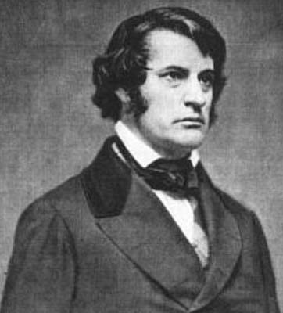
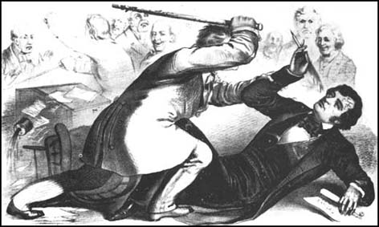
“The fact that a child is black, or that is white, cannot of itself be a qualification or disqualification [for access to education] . . . . The committee cannot assume . . . without individual examination that all of an entire race are so deficient in proper moral and intellectual qualifications as to justify their universal degradation to a class by themselves. . . . Separate school is not an equivalent . . . . [While] the matters taught in the two schools may be precisely the same, a school exclusively devoted to one class must differ essentially in spirit and character from that common school known to the law, where all classes meet together in equality. “
-- Charles Sumner – brief in Roberts v. City of Boston, 1849

Slide 3
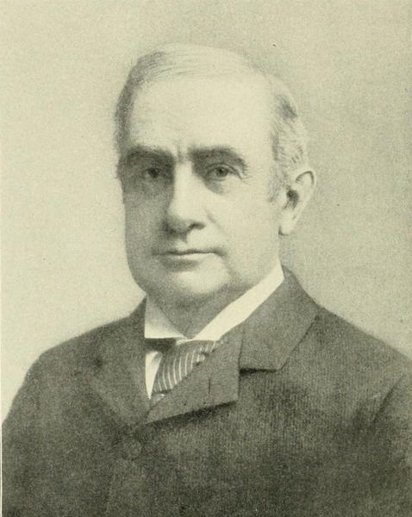
“ . . . The underlying fallacy of the . . . argument [is] the assumption that the enforced separation of the two races stamps the colored race with the badge of inferiority. If this be so, it is not by reason of anything found in the act, but solely because the colored race chooses to put that construction on it.”
-- Justice Henry Brown, majority opinion in Plessy v. Ferguson (1896)

Slide 4
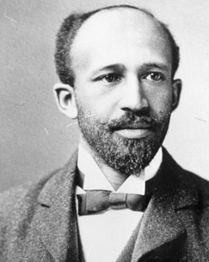
“A black man born in Boston has a right to oppose any separation of schools by color . . . . But this black man in Boston, has no right, after he has made this academic pronouncement to send his own helpless immature child into school where white children kick, cuff or abuse him, or where teachers openly and persistently neglect or hurt or dwarf its soul.”
-- W. E. B. DuBois, “Separation and Self-respect” 1934

Slide 5
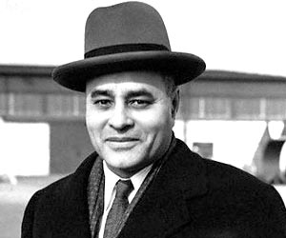
The use of courts rests on an “inherent fallacy . . . In the failure to appreciate the fact that the instruments of the state are merely reflections of the political and economic ideology of the dominant group. . . . The Constitution is a very flexible instrument and that, in the nature of things, it cannot be anything more than the controlling elements in the American society wish it to be.”
-- Ralph Bunche, 1935
Notes:
Ralph Bunche (English pronunciation: /bʌntʃ/; August 7, 1903 (disputed) or 1904^{[1][2][3][4]} – December 9, 1971) was an American political scientist and diplomat who received the 1950 Nobel Peace Prize for his late 1940s mediation in Palestine. He was the first person of color to be so honored in the history of the Prize.^{[5]} He was involved in the formation and administration of the United Nations and in 1963, received the Medal of Freedom from President John F. Kennedy.

Slide 6
“To separate them from others of similar age and qualifications solely because of their race generates a feeling of inferiority as to their status in the community that may affect their hearts and minds in a way unlikely ever to be undone.”
-- Justice Earl Warren, majority opinion, Brown v. Board, 1954

Slide 7
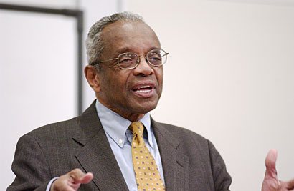
"From the standpoint of education, we would have been better served had the court in Brown rejected the petitioners' arguments to overrule Plessy v. Ferguson . . . . "Our hopes that it would [remove barriers to equal education]have been replaced by a reluctant observation that it unintentionally replaced overt barriers with less obvious but equally obstructive new ones."
-- Derrick Bell, speech at Stanford Univ., 2004

Slide 8
Stage One: 1909-34
The NAACP legal battle against school segregation

Slide 9
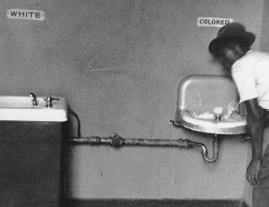
Context: the Jim Crow South
“Unequal justice interacted with disfranchisement, segregation, economic exploitation, inferior schooling, and violence to remind blacks of all ages and classes where power rested in the society.” – Leon Litwack

Slide 10
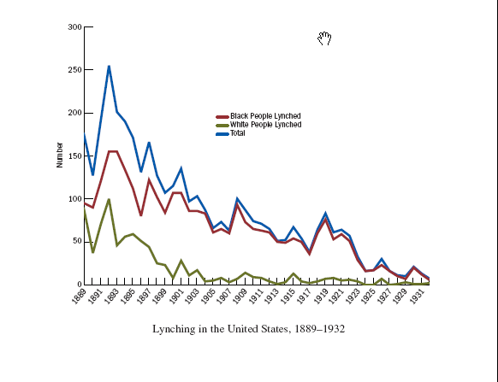

Slide 11
Springfield, Illinois Riot, 1908
4,000 state militia quell riots
Six shot
Two lynched
2,000 burned out of homes
Notes:
At the beginning of the 20th century, the allure of Lincoln's association and jobs in bustling coal mines and factories made Springfield a magnet for African-Americans fleeing deepening racial oppression across the Southern states. By 1900, Springfield had the highest percentage of black residents of any city in Illinois.
But the influx also stirred racial resentments among whites. On Aug. 14, 1908, after a white woman in Springfield claimed to have been raped by a black man, large crowds gathered outside the county jail, intent on lynching the man accused of the rape and another black prisoner charged with killing a local white man, according to historical accounts. The woman later admitted her allegation of rape was fabricated.
Without the crowd realizing what was happening, the sheriff -- Mr. Werner's grandfather, also named Charles Werner -- spirited the defendants to safety. After the mob learned the African-American prisoners were gone, thousands of whites swirled through the city for two days, looting and shooting within sight of the old state capitol building where Lincoln proclaimed 50 years earlier that "a house divided against itself cannot stand."
By the time 4,000 state militiamen re-established order, most of the black residential areas of the city were razed. More than 40 houses were burned. The African-American business district was gutted. A black barber was lynched when he tried to fight off attackers. Five white men had been killed in stampedes, unintentional shootings or militia gunfire.
The last person to die was an elderly black man named William Donnegan. He had once been a shoe maker and was reputed to have had a passing acquaintance with Abraham Lincoln. By 1908, he was one of the city's most prominent and prosperous African-Americans, with real-estate holdings, a large home and a white wife. On the second day of the attacks, a mob dragged him from his home, cut his throat and hung him from a tree.

Slide 12
The NAACP

Slide 13
“That there be equal educational opportunities for all and in all the States, and that public school expenditure be the same for the Negro and the white child.”

Slide 14
NAACP Goals and Tactics
Lobbying
Ex: Anti-lynching law
Generate Anti-discrimination Publicity
Crisis Magazine
Form Local Chapters to address local issues
Use litigation to attack discrimination through the courts
Favored winnable battles with far-reaching consequences

Slide 15
NAACP Legal Bureau
Early Successes
Guinn v. United States (1915)
Overturned Oklahoma Grandfather Clause
Nixon v. Herndon (1927)
Ended the “white primary” practice
Increased focus on litigation after 1927
Focus on federal courts due to “lack of sectional prejudices”
Notes:
The unanimous Court, speaking through Justice Oliver Wendell Holmes, rejected the argument that the political question doctrine barred the Court from deciding the case. The argument, said the Court, was "little more than a play upon words." While the injury which the plaintiff alleged "involved political action," his suit "allege[d] and s[ought] to recover for private damage."
The Court then turned to the merits of the suit. It stated that it was unnecessary to discuss whether the statute violated the Fifteenth Amendment, "because it seems to us hard to imagine a more direct and obvious infringement of the Fourteenth." The Court continued:
“ The [Fourteenth Amendment] ... was passed, as we know, with a special intent to protect the blacks from discrimination against them. ... The statute of Texas ... assumes to forbid negroes to take part in a primary election the importance of which we have indicated, discriminating against them by the distinction of color alone. States may do a good deal of classifying that it is difficult to believe rational, but there are limits, and it is too clear for extended argument that color cannot be made the basis of a statutory classification affecting the right set up in this case.

Slide 16
Stage Two: 1934-38
The NAACP legal battle against school segregation

Slide 17
Charles Hamilton Houston
“Almost single-handedly . . . organized and led the legal battalion in the critical early battles seeking equality for black Americans.”
Notes:
Quote from Leon Higginbotham
Harvard trained and first black elected to Havard Law Review
Trained by Felix Frankfurter and legal realism – the idea that law served certain social interests and reflected the preferences and biases of those who made and interpreted it (not a formal abstract logial process). Given this, judicial activism was appropirate
He came to believe that black lawyers should be social engineers – use law to solve the problems of the black community
His reasoning opened the door for sociological evidence
Left private practice to become dean of Howard Univ. Law School

Slide 18
Charles Hamilton Houston
Harvard trained and first black elected to Harvard Law Review
Trained by Felix Frankfurter and legal realism – the idea that law served certain social interests
came to believe that black lawyers should be social engineers – use law to solve the problems of the black community
Left private practice to become dean of Howard Univ. Law School
Notes:
Quote from Leon Higginbotham
Harvard trained and first black elected to Havard Law Review
Trained by Felix Frankfurter and legal realism – the idea that law served certain social interests and reflected the preferences and biases of those who made and interpreted it (not a formal abstract logial process). Given this, judicial activism was appropirate
He came to believe that black lawyers should be social engineers – use law to solve the problems of the black community
His reasoning opened the door for sociological evidence
Left private practice to become dean of Howard Univ. Law School

Slide 19
Charles Hamilton Houston
Raised quality of Howard Law School
Trained a cadre of young black lawyers
E.g. Thurgood Marshall
Pioneered Civil Rights Law and Public Interest Law
Chosen as NAACP Special Counsel in 1934
Notes:
Quote from Leon Higginbotham
Harvard trained and first black elected to Havard Law Review
Left private practice to become dean of Howard Univ. Law School

Slide 20
Crisis, Oct. 1935

Slide 21
Thurgood Marshall
Hired by NAACP in 1936
Replaced Houston and Special Counsel in 1939
Houston continued as mentor until death in 1950

Slide 22
Houston and Marshall
Both viewed the legal campaign as more than just court victories
The court battles were also a tool to
Publicize the NAACP
Recruit New Members
Stimulate grassroots activism

Slide 23
Houston and Marshall -- Strategy
Realized that 1930s were inauspicious for aggressive tactics
Began an incremental approach, seeking targets of opportunity

Slide 24
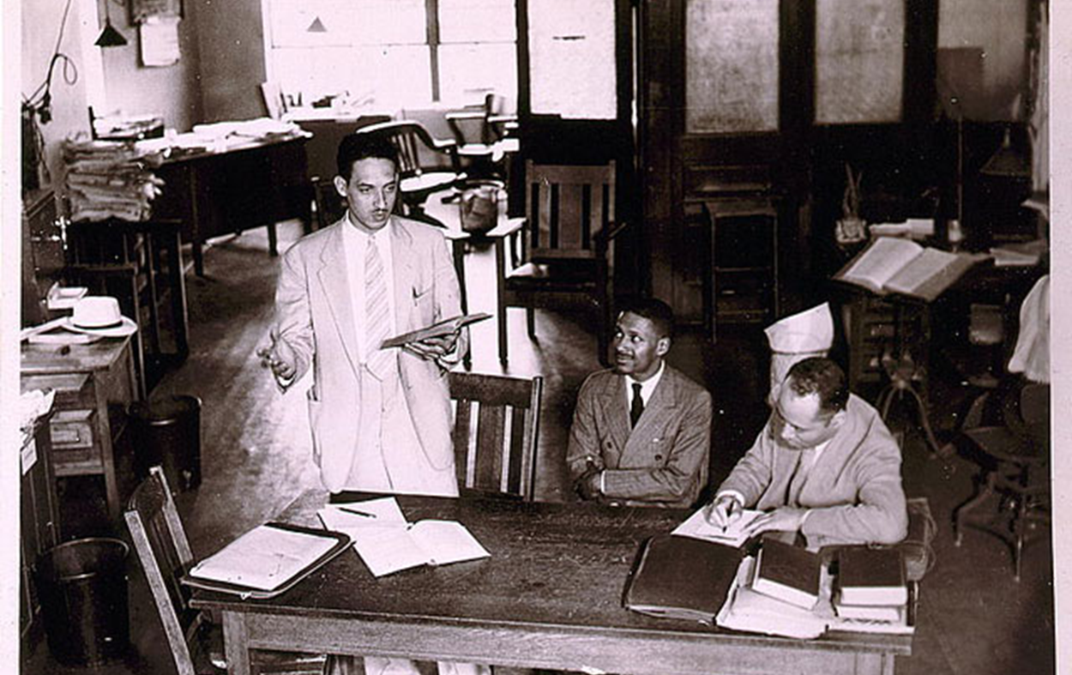
Houston’s Three-Pronged Strategy
Desegregate graduate and professional schools
Equalization of teachers’ salaries
Equalization of elementary and secondary schools

Slide 25
W. E. B. DuBois – Critic of the NAACP Legal Approach
“ . . . The Negro need neither segregated nor mixed schools. What he needs is education. What he must remember is that there is no magic, in either mixed schools or in segregated schools. A mixed school with poor and unsympathetic teachers, with hostile public opinion, and no teaching of truth concerning black folk, is bad. A segregated school with with ignorant placeholders, inadequate equipment, poor salaries, and wretched housing, is equally bad. Other things being equal, the mixed school is the broader, more natural basis for the education of all youth. It gives wider contacts; in inspires greater confidence; and suppresses the inferiority complex. But other things are seldom equal, and in that case, Sympathy, Knowledge, and the Truth, outweigh all a mixed school can offer.”
-- “Does the Negro Need Separate Schools?” 1935

Slide 26
Gradualism – Graduate and Professional School Cases
Pearson v. Murray (1936)
Won in Maryland – not appealed to Supreme Court
Since laws differed from state to state, a scholarship did not satisfy “separate but equal”
Notes:
Circuit court case
Donald Gaines Murray sought admission to the University of Maryland School of Law on January 24, 1935, but his application was rejected on account of his race. The rejection letter stated, "The University of Maryland does not admit Negro students and your application is accordingly rejected."^{[2]} The letter noted the university's duty under the Plessy v. Ferguson doctrine of separate but equal to assist him in studying elsewhere, even at a law school located out-of-state. Murray appealed this rejection to the Board of Regents of the university, but was refused admittance.
The nation's oldest black collegiate fraternity, Alpha Phi Alpha, initiated Pearson v. Murray on June 25, 1935 as part of its widening social program, and retained Belford Lawson to litigate the case. By the time the case reached court, Murray was represented by Charles Hamilton Houston and Thurgood Marshall of the Baltimore National Association for the Advancement of Colored People (NAACP).^{[3]} Houston and Marshall used Pearson v. Murray as the NAACP's first case to test Nathan Ross Margold's strategy to attack the 'separate but equal' doctrine using the equal protection clause of the Fourteenth Amendment to the U.S. Constitution. Margold concluded "such laws administering such a system were denying equal protection of law under the Yick Wo v. Hopkins ruling of 1886 and therefore were unconstitutional.^{[4]}
At the circuit court hearing, Marshall stated that Maryland failed to provide a 'separate but equal' education for Murray as required by the Fourteenth Amendment (using the legal standard at that time).^{[2]} Since laws differ from state to state, a law school located in another state could not prepare a future attorney for a career in Maryland. Marshall argued in principle that "since the State of Maryland had not provided a comparable law school for blacks that Murray should be allowed to attend the white university"^{[5]} and stated
“ What's at stake here is more than the rights of my client. It's the moral commitment stated in our country's creed.^{[6]} ”

Slide 27
Missouri ex rel. Gaines v. Canada (1938)
Gaines rejected at U. Missouri Law School
Offered out-of-state scholarship or the state would create a separate law school at Lincoln University (HBC)
Supreme Court ruled that the out-of-state option violated the equal protection clause
After decision, Missouri allocated $200,000 ($3.06 million today) to build a law school at Lincoln (for which they expected 60 students).
First Supreme Court victory eroding Plessy. Facilities had to be really equal to satisfy requirement.
Notes:
Circuit court case
Donald Gaines Murray sought admission to the University of Maryland School of Law on January 24, 1935, but his application was rejected on account of his race. The rejection letter stated, "The University of Maryland does not admit Negro students and your application is accordingly rejected."^{[2]} The letter noted the university's duty under the Plessy v. Ferguson doctrine of separate but equal to assist him in studying elsewhere, even at a law school located out-of-state. Murray appealed this rejection to the Board of Regents of the university, but was refused admittance.
The nation's oldest black collegiate fraternity, Alpha Phi Alpha, initiated Pearson v. Murray on June 25, 1935 as part of its widening social program, and retained Belford Lawson to litigate the case. By the time the case reached court, Murray was represented by Charles Hamilton Houston and Thurgood Marshall of the Baltimore National Association for the Advancement of Colored People (NAACP).^{[3]} Houston and Marshall used Pearson v. Murray as the NAACP's first case to test Nathan Ross Margold's strategy to attack the 'separate but equal' doctrine using the equal protection clause of the Fourteenth Amendment to the U.S. Constitution. Margold concluded "such laws administering such a system were denying equal protection of law under the Yick Wo v. Hopkins ruling of 1886 and therefore were unconstitutional.^{[4]}
At the circuit court hearing, Marshall stated that Maryland failed to provide a 'separate but equal' education for Murray as required by the Fourteenth Amendment (using the legal standard at that time).^{[2]} Since laws differ from state to state, a law school located in another state could not prepare a future attorney for a career in Maryland. Marshall argued in principle that "since the State of Maryland had not provided a comparable law school for blacks that Murray should be allowed to attend the white university"^{[5]} and stated
“ What's at stake here is more than the rights of my client. It's the moral commitment stated in our country's creed.^{[6]} ”

Slide 28
Stage THree: 1941-50
The NAACP legal battle against school segregation

Slide 29
Growing Momentum for Anti-racism – World War II
Gunner Myrdal, An American Dilemma (1944)
1,000 pages, 250 pages of notes
Constantly invoked over the next decade in discussions of race issues
Highlighted the difference between the “American Creed” and its racial policies
Captured the growing liberal consensus on racial equality and integrationism
NAACP Membership
1939: 18,000
1945: 156,000

Slide 30
Brown and the Cold War
The U.S. Justice Department filed a “friend of the court” brief in Brown and the cases leading up to Brown
The nearly exclusive thrust of this brief is this: segregation hurts U.S. national interests
“The existence of discrimination against minority groups in the United States has an adverse effect upon our relations with other countries. Racial discrimination furnishes grist for the Communist propaganda mills, and it raises doubts even among friendly nations as to the intensity of our devotion to the democratic faith.”
“[Race discrimination] remains a source of constant embarrassment to the effective maintenance of our moral leadership of the free and democratic nations of the world.”
– Secretary of State Dean Acheson, quoted in the Brown amicus brief

Slide 31
Brown and the Cold War
As civil rights advocates celebrated the Brown decision, W.E.B. Du Bois, then 86 years old, noted that "no such decision would have been possible without the world pressure of communism," which rendered it "simply impossible for the United States to continue to lead a 'Free World' with race segregation kept legal over a third of its territory."

Slide 32
Approaching Brown – McLaurin v. Oklahoma State Regents (1950)
Notes:
McLaurin v. Oklahoma State Regents, 339 U.S. 637 (1950), was a United States Supreme Court case that reversed a lower court decision upholding the efforts of the state-supported University of Oklahoma to adhere to the state law requiring African-Americans to be provided graduate or professional education on a segregated basis.
On June 5, 1950, the United States Supreme Court ruled that a public institution of higher learning could not provide different treatment to a student solely because of his/her race as doing so deprived the student of his/her Fourteenth Amendment rights of Equal Protection.
The plaintiff, George McLaurin, who already had a Masters Degree in Education, was first denied admission to the University of Oklahoma to pursue a Doctor of Education degree. McLaurin successfully sued in the US District Court for the Western District of Oklahoma to gain admission to the institution (87 F. Supp. 526; 1948 U.S. Dist.) basing his argument on the Fourteenth Amendment. At the time, Oklahoma law prohibited schools from instructing blacks and whites together. The court found that the university's inaction in providing separate facilities, in order to meet Oklahoma state law, allowing McLaurin to attend the institution was a violation of his Constitutional rights. However the court did not issue any injunctive relief as requested by the plaintiff but rather relied "on the assumption that the law having been declared, the State will comply."
The University admitted McLaurin but provided him separate facilities, including a special table in the cafeteria, a designated desk in the library, and a desk just outside the classroom doorway.
McLaurin returned to the US District court and petitioned to require the University of Oklahoma to remove the separate facilities allowing him to interact with the other students fully (87 F. Supp. 528; 1949 U.S. Dist.) The court denied McLaurin's petition.
McLaurin then appealed to the US Supreme Court, which subsequently reversed the decision of the US District Court, requiring the University of Oklahoma to remove the restrictions under which McLaurin was attending the institution. This case together with Sweatt v. Painter, which was decided the same day, marked the end of the separate but equal doctrine of Plessy v. Ferguson in graduate and professional education.

Slide 33
Approaching Brown – Sweatt v. Painter (1950)
Court rules that “intangibles” must be equal as well
Marshall: the Court provided “a road map” to overturning Plessy

Slide 34
Stage Four: 1954 -present
The NAACP legal battle against school segregation

Slide 35
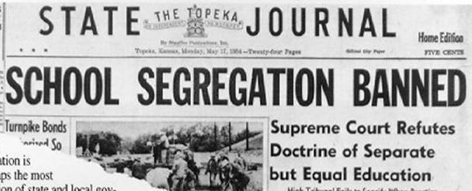
Brown v. Board of Education

Slide 36
Separate Schools – Clarendon County, South Carolina
4,590 black households in 1950
2/3 earned less than $1,000/year ($8,950 today)
Only 280 households earned more than $2,000/year
35% of all black adults were illiterate
Schools
$179 per white child -- $43 per black child
Total value of 61 black schools (attended by 6,531) -- $194,575
Total value of white schools (attended by 2,375) -- $673,850

Slide 37
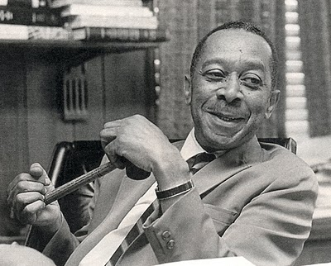
“Adjusting to pathology is not health. The way the northern kids were fighting it can be seen as a better sign. The little southern children would point to a black doll and say, `Oh, yeah, that’s me there – that’s a n_____ -- I’m a n_____,’ and they said it almost cheerfully. In the northern cities, the question clearly through the kids into a much more emotional state and often they’d point to the white doll.”
-- Kenneth Clark

Slide 39
Notes:
Walter White, Houston, others – NAACP Legal Team, 1933

Slide 40
Notes:
School house Virginia

Slide 41
Notes:
Marshall and Houston with Murray

Slide 42
Notes:
School house SC 1936

Slide 43
Freedom Rides
CORE (Congress of Racial Equality)
Founded by James Farmer and Bayard Rustin
Dedicated to Ghandian non-violent direct protest
Organized sit-ins in the North during WWII
1947 “Journey of Reconciliation”
16 black and white men rode a bus into the upper South to test laws prohibiting segregation in interstate transportation
Assaulted and arrested outside Chapel Hill, NC
Sentenced to 30 days on a road gang
In 1961, Farmer and Rustin decided to revive the protest to text segregation in bus terminals used on interstate bus routes

