Slide 1
Civil Rights & the Constitution
Exploring
Brown v. Board of Education
&
The Freedom Riders

Slide 2
Where are we going today?
Learn about resources available from KNPB.
Gain broad and deep knowledge about the landmark case, Brown v. Board of Education.
Engage in a discussion lesson “engagement strategy” called Cross the Line when discussing issues of modern-day segregation.
Learn about an independent reading strategy aligned to goals of the Common Core.
Watch the Freedom Riders documentary and reflect on your learning.

Slide 3
Welcome to KNPB!
Joe Elcano has graciously hosted our visit here today. KNPB is an important partner to our grant, and we are excited about the resources available from KNPB for educators.
Thanks for the cup of Joe, Joe!

Slide 4
It’s hard to make students care.
When composing a discussion lesson, take time to think about a short or extended engagement strategy/opener that will heighten student interest in the topic.
One way to encourage interest in a topic is to create a “silent discussion” through the strategy: Cross the Line.

Slide 5
Engagement Students in the Discussion Topic Before They Even Read!
CROSS THE LINE Strategy Steps:
Tape a line down the center of your room. Label one side “Agree” and the other side “Disagree.”
Come up with statements with which people must agree or disagree (no standing on the line). Try to have less controversial statements precede more controversial statements.
Read these to the class. Have students move without any talking.
Occasionally, ask certain students to justify their positions. There is no arguing during this activity. Only one person talks at a time.
Have students write a short written reflection on the activity.
Lead a whole group talk about what happened (include frustrations and focus on nuances).
Provide your now very interested students with readings to prepare them for a discussion of the topic.
LET’S PRACTICE THE STRATEGY!

Slide 6
Where do you stand?
As was voiced in the opinion in Brown v. Board of Education: Separate schools are inherently unequal.
The federal government should have a role in desegregating schools.
Racial and ethnic diversity is important in schools.
School segregation by race or socio-economic status is highly detrimental to teachers and students of all races.

Slide 7
Where do you stand?
Racially, socially, and economically heterogeneous groups of people make the work of a teacher more difficult.
Racially, socially, and economically heterogeneous groups of people tend to produce more unique ideas and create a more worldly learning environment.
Racially heterogeneous groups often display more conflict and violence.
I believe parents should have the choice to work hard and earn enough money to live in neighborhoods with good schools, whether or not those schools have a really diverse population.

Slide 8
Where do you stand?
Students should attend schools within the community they live.
It would be undemocratic to force parents to bus students out of their neighborhoods for the goal of racial and socio-economic integration.
De facto school segregation based upon housing patterns should not be viewed in the same light as the de jure (legally enforced) segregation of Jim Crow.
Schools with a high number of minorities are not inherently unequal, as they are provided with the same (or probably more) money for teachers and supplies.

Slide 9
Silent Reflection
Quietly reflect on the statements provided to you in written form.
Which were difficult to decide? Why?
For which questions do you wish you had more information before making a decision? Why?
What question would you add to this list?

Slide 10
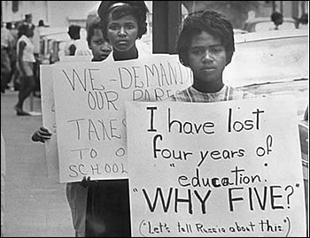
School Segregation Today
Please peruse the readings provided on this issue.
Highlight anything that stands out to you.

Slide 11
Super Short Small Group Seminar
What is a small group seminar?
Is school segregation a problem today?
Small group seminars try to get to the heart of an issue and come to a better understanding of the complexities inherent in the issue.
Like a Socratic Seminar; sometimes used with less time for preparation
With a group of 3 or 4:
Look at the evidence in front of you. What stands out? What is compelling? What troubles you?
Discuss these openly with your group. Make note of the most compelling assertion or question made by another member of your group.

Slide 12
LUNCH!

Slide 13
Close Textual Analysis
Should become central to your pedagogy
Centrality of deep analysis is focused on three ideas:
What method will I employ?
How close do we need to go?
How will I entwine strategies to keep a healthy balance of whole group modeling, small group analysis, and independent reading?
Strategy 1: Whole group text-dependent questions around a central text (trainings provided)
Strategy 2: Small group Super Annotation
Strategy 3: Individual readings with appropriate strategy (like QCQ or something you create that works well with students)

Slide 15
Please read through the short segments from the Freedom Rider’s Teaching Guide (available online).
Fill out the QCQ Textual Analysis form as you read.

Slide 16
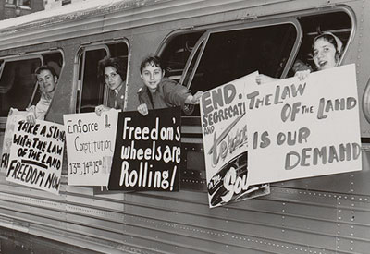
Reflecting on the Film
What questions do you have?
What surprised you?
Could you clips from this film in your own class? If so, for what purpose and in what manner?

Slide 17
Upcoming Events
MS & HS Common Core Trainings for selected participants from each school throughout the month of March
First Draft (complete but not perfect) of Discussion Lesson due to Sue on March 26.
Final lesson (perfect) due by April 16.
History Day: March 31 at Wooster High School
Saturday Seminar: Students & the Constitution on April 21
First draft of paper due on April 26.

