Slide 1
TAH History Cohort
November 2, 2012
Great readers become good writers when provided with writing instruction. Good writers are generally good readers. Let’s make the connections more explicit.

Slide 2
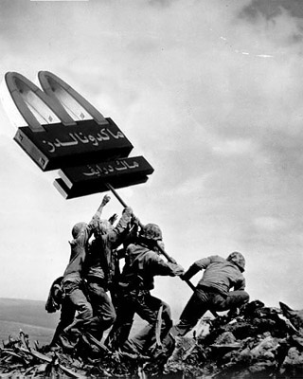
Cultural History Warm-up

Slide 3
Why focus on vocabulary?
Vocabulary is the best single indicator of intellectual ability and an accurate predictor of success at school. -- W.B. Elley
Because each new word has to be studied and learned on its own, the larger your vocabulary becomes, the easier it will be to connect a new word with words you already know, and thus remember its meaning. So your learning speed, or pace, should increase as your vocabulary grows. -- Johnson O'Connor
We think with words, therefore to improve thinking, teach vocabulary. -- A. Draper and G. Moeller

Slide 4
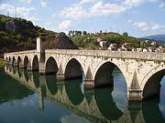
When to Talk & Think About Words
Close Reads
Document Based Questions
Readings for Discussions
Current Events
Etc.
Building bridges to true comprehension…

Slide 5
Three Tiers of Academic Vocabulary
Tier 3: Low frequency, content specific words
Tier 2: High frequency, multiple meanings, found across academic texts
Tier 1: Vocabulary of everyday language

Slide 6
Tier 2 Vocabulary
represent the more sophisticated vocabulary of written, academic texts (used frequently in these types of texts)
the words used by students who have a mature vocabulary
students encounter them less frequently as listeners
the lack of redundancy of Tier 2 in oral language, presents challenges to students who primarily meet them in print.
Tier 1: Words we speak with regularity.
Tier 3: Domain specific words that we won’t often use out of school.

Slide 7
Tier 2 & 3 Words
When choosing what Tier Two or Tier Three words to explicitly teach and reinforce with students, consider the following questions you might ask yourself:
  Which words are most important to understanding the text we are going to read and/or the concept we are about to study?
  Which words do students already have prior knowledge of?
  Which words can be figured out using context clues?

Slide 8
Some CCSS Writing Standards
Use varied transitions and sentence structures to link the major sections of the text, create cohesion, and clarify the relationships among complex ideas and concepts.
Use precise language, domain-specific vocabulary and techniques such as metaphor, simile, and analogy to manage the complexity of the topic; convey a knowledgeable stance in a style that responds to the discipline and context as well as to the expertise of likely readers.
Produce clear and coherent writing in which the development, organization, and style are appropriate to task, purpose, and audience.

Slide 9
Some CCSS Reading Standards
Determine the central ideas or information of a primary or secondary source; provide an accurate summary that makes clear the relationships among the key details and ideas.
Determine the meaning of words and phrases as they are used in a text, including analyzing how an author uses and refines the meaning of a key term over the course of a text (e.g., how Madison defines faction in Federalist No. 10).

Slide 10
Top 60 Words on the Academic Word List
analysis approach area assessment assume authority available benefit concept consistent constitutional context contract create environment | data definition derived distribution economic established estimate evidence export factors financial formula function identified income | indicate individual interpretation involved issues labor legal legislation major method occur percent period policy principle | procedure process required research response role section sector significant similar source specific structure theory variables
Notes:
2 min.
Academic Word List (Coxhead 2002)
3.5 million running words of text from 4 disciplines
560 most common academic word families across disciplines
10% of words in academic texts
www.vuw.ac.nz/lals/research/awl/
Academic vocabulary:
used across ALL content areas
abstract definitions
few concrete synonyms

Slide 11
Highest Frequency Tier 2 Words
accelerate, achieve, adjacent, alternative, analyze, approach, approximate, arbitrary, assert, assess, assign, assume, authorize, automatic,
chapter, compensate, complex, complicate, comply, component, comprehend, conceive, concentrate, concept, conclude, consequence, consist, constant, construct, consult, context, contrast,
contribute, convert, create, criterion, crucial,
data, define, definite, demonstrate, denote, derive, design, devise, devote, dimension, distinct, distort,
element, emphasize, empirical, ensure, entity, environment, equate, equivalent, establish, expand, expose, external,
feasible, fluctuate, focus, formulate, function,
generate, guarantee, hypothesis, identify, ignore, illustrate, impact, implicit, imply, indicate, individual, inhibit, initial, innovation, intense, interpret, intuitive, involve, isolate,
magnetic, magnitude, major, manipulate, mathematics, method, minimum, modify, negative, notion,
obtain, obvious, occur,
passive, period, perspective, pertinent, phase, phenomena, portion, portion, potential, precede, precise, presume, prime, principle, proceed, publish, pursue,
random, range, react, region, require, respective, restrict, reverse, role,
section, segment, select, sequence, series, shift, signify, similar, simultaneous, sophisticated, species, specify, stable, statistic, status, structure, subsequent, suffice, sum, summary,
technique, technology, tense, theory, trace, tradition, transmit,
ultimate, undergo, usage,
valid, vary, verbal, verify, vertical

Slide 12
How might a deep understanding of tier 2 (and to an extent, tier 3) words help students become better writers?
Talk at your table, and come up with at least three tangible answers to this question.

Slide 13

But this isn’t about a list!
As social studies teachers, we need to pay explicit attention to academic vocabulary in the reading and writing for content we do in classes. We do not need to teach another list!

Slide 14
ACADEMIC VOCABULARY
Some Criteria for Identifying Tier Two Words
■ Importance and utility: Words that are characteristic of mature language users and appear frequently across a variety of domains.
■ Instructional potential: Words that can be worked with in a variety of ways so that students can build rich representations of them and of their connections to other words and concepts.
■ Conceptual understanding: Words for which students understand the general concept but provide precision and specificity in describing the concept.

Slide 15
Teaching Tier 2
We must realize that most Tier 2 words have no substantive meaning except as they are found in the context of a sentence or paragraph. That is, the other words that surround it give its meaning. Many words may have totally different meanings depending upon the context in which they are used.
So what types of traditional vocabulary instruction will NOT work well with Tier 2 Vocabulary?

Slide 16
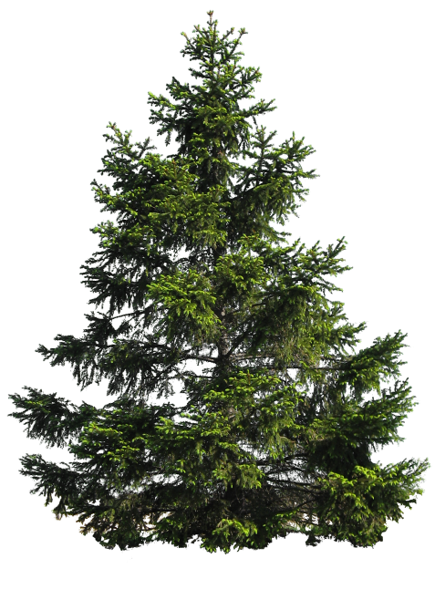
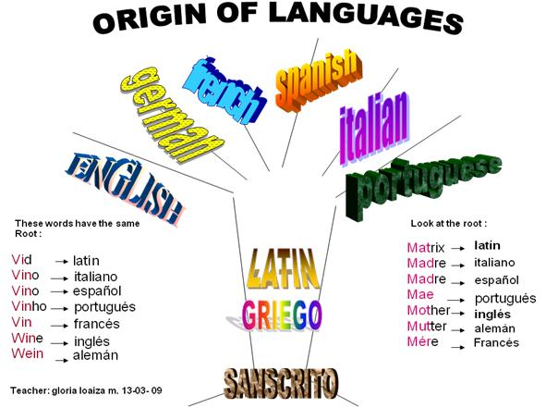
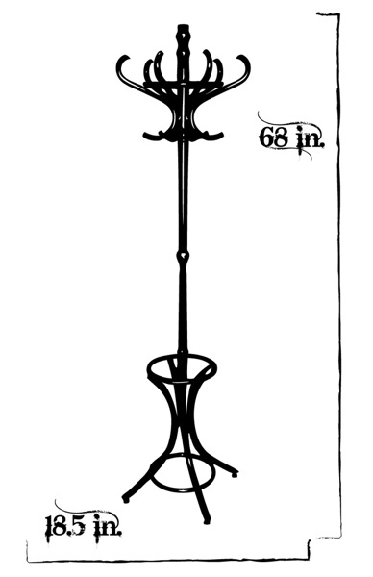
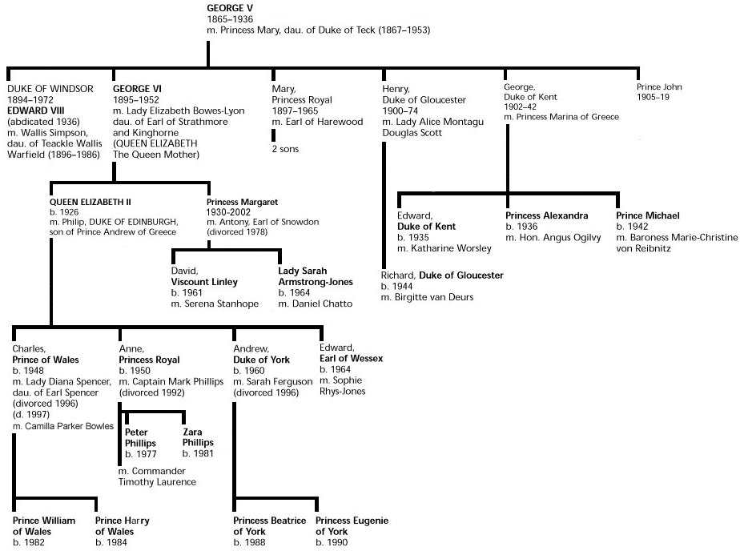
Academic vocabulary should NOT be taught out of context.
“A family tree, a tree of languages-the 'tree' used in that context has little or no relationship to a tree that grows on the ground. And there is a tree that you hang your clothes on at home. The word tree gains its meaning from the sentence and from the way in which the word is used. The word in itself has no meaning. …it is from the total context that the word gains its meaning.”
Dr. Paul Berg

Slide 17

Words with multiple meanings.
Consider: novel – In academic writings, novel
often means “innovative or unique”
Even very simple words like fast have multiple meanings:
The horse runs fast. The horse is tied fast.
Fast by the stream stood a small cottage. My watch is fast.
He did not eat because he was celebrating a religious fast.
She wears color fast clothes. He leads a fast life.
What then does the word 'fast' man? A study of the context will often tell you the meaning of an unknown word. Practice this skill and you will discover that a large percentage of difficult words can be defined by a study of the full context in which the difficult word is used.

Slide 18
Teaching Vocabulary During Reading!
Vocabulary should be taught as it comes up in our readings with students.
PREPPING FOR VOCABUARLY INSTRUCTION
  You will have to identify vocabulary worth talking about.
    Tier 3 words (domain specific) will likely be easy…we GET these.
    Tier 2 words require us to inquire a bit deeper into the text.
What words do I need to define for students?
What words are good Tier 2 words but don’t necessarily need definitions?
What words are both fundamental to understanding the text and have context clues? Now how to do I help students figure this out?

Slide 19
Twenty Most Frequent Prefixes with number of words containing that prefix
un- (not, opposite of) 782
pre- (before) 79
re- (again) 401
inter- (between, among)77
in-, im-, ir-, il- (not) 313
fore- (before) 76
dis- (not, opposite of) 216
de- (opposite of) 71
en-, em- (cause to) 132
trans- (across) 47
non- (not) 126
super- (above) 43
in-, im- (in or into) 105
semi- (half) 39
over- (too much) 98
anti- (against) 33
mis- (wrongly) 83
mid- (middle) 33
sub- (under) 80
under- (too little) 25

Slide 20
Common Latin & Greek Roots
Latin
Greek
Audi (Hear) - Audience, auditorium, audible, inaudible, audition
Dict (Speak) - Dictate, predict, contradict, verdict, diction
Port (Carry) - Import, export, portable, porter, transport
Rupt (Break) - Abrupt, bankrupt, erupt, interrupt, rupture
Scrib/script (Write) Describe, inscribe, prescribe, scribe, describe, script, transcript, prescription
Spect (See) Inspect, respect, spectacles, spectator, suspect, perspective
Struct (Build) Construct, destruct, destruction, instruct, structure
Tract (Pull) Attract, detract, contract, subtract, traction, tractor
Vis (See) Visible, supervise, vision, visionary
Auto (Self) Automobile, automatic, autograph, autotrophy, autobiography
Bio (Life) Biography, biology, biodegradable, biome, biopsy, antibiotic,
Graph (Written/drawn) Graph, graphic, graphite, seismograph
Hydro (Water) Dehydrate, hydrogen, hydrant, hydrodynamic, hydraulic, hydrophobic
Meter (Measure) Barometer, centimeter, diameter, thermometer
Ology (Study of) Geology, biology, hydrology
Photo (Light) Photograph, photocopy, photogenic, photosynthesis, photoelectric
Scope (See) Microscope, periscope, stethoscope, telescope
Tele (Far) Telephone, telescope, telecast, telegram
Therm (Heat) Thermometer, thermos, thermal, thermosphere

Slide 21
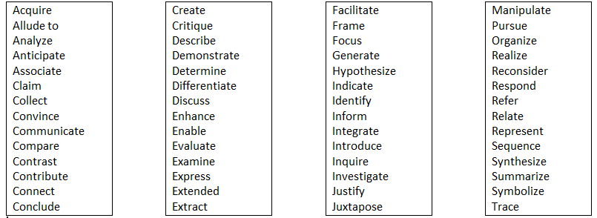
Academic Verbs

Slide 22
TRANSITION & TELLING WORDS/PHRASES
HOWEVER THEREFORE CONSEQUENTLY
REGARDLESS OF WITHOUT REGARD TO E.G. / I.E.
CRITICS MAINTAIN, SITE AS EVIDENCED BY CONVERSELY
LIKELY (UNLIKELY) AT WORST, AT BEST AS A RESULT OF
AFFIRMING THIS LATTER/FORMER ON THE OTHER HAND
DESPITE PURSUANT TO SINGULARLY
ALTHOUGH NOT ONLY, BUT ALSO INDEED
MOREOEVER HENCE
FOR EXAMPLE, FOR INSTANCE WITH PARTICULAR ATTENTION TO
Why would it be important to call attention to words like these (function words)?

Slide 23
Activity to identify Tier 2 words in Text
Is this word important and useful, i.e., is this a word that is going to show up throughout someone's life?
Does this word have all kinds of possibilities for instruction, i.e., can I see numerous ways to teach this word?
Do my students have the background knowledge to understand this new word that I'm teaching--or do I need to provide some context for them, first?
Your time, energy, and effort - as well as your students' time, energy, and effort are precious. You want to invest the bulk of your instructional time for vocabulary teaching Tier 2 words that have transfer to writing and other readings.

Slide 24
Highlight/Underline the Text (different colors)
Tier 2
Tier 3
Words that are important to the meaning of the text;
Not subject specific;
Likely to appear in many academic texts;
Content-specific;
Often unit or topic specific;
Not generally used in non-content texts
COMPARE LISTS WITH A PARTNER. DISCUSS. ARE THERE DISCREPANCIES?

Slide 25
Freedom Walkers Excerpt
From Appendix A of the CCSS
Not so long ago in Montgomery, Alabama, the color of your skin determined where you could sit on a public bus. If you happened to be an African American, you had to sit in the back of the bus, even if there were empty seats up front.
Back then, racial segregation was the rule throughout the American South. Strict laws – called “Jim Crow” laws – enforced a system of white supremacy that discriminated against blacks and kept them in their place as second-class citizens.
People were separated by race from the moment they were born in segregated hospitals until the day they were buried in segregated cemeteries. Blacks and whites did not attend the same schools, worship in the same churches, eat in the same restaurants, sleep in the same hotels, drink from the same water fountains, or sit together in the same movie theaters.
In Montgomery, it was against the law for a white person and a Negro to play checkers on public property or ride together in a taxi.
Most southern blacks were denied their right to vote. The biggest obstacle was the poll tax, a special tax that was required of all voters but was too costly for many blacks and for poor whites as well. Voters also had to pass a literacy test to prove that they could read, write, and understand the U.S. Constitution. These tests were often rigged to disqualify even highly educated blacks. Those who overcame the obstacles and insisted on registering as voters faced threats, harassment, and even physical violence. As a result, African Americans in the South could not express their grievances in the voting booth, which for the most part, was closed to them. But there were other ways to protest, and one day a half century ago, the black citizens in Montgomery rose up in protest and united to demand their rights – by walking peacefully.
It all started on a bus.

Slide 26
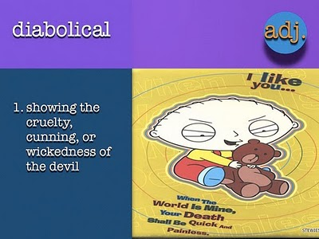
What word(s) in Tier 2 would you choose to focus on? Why?

Slide 27
Appendix A of CCSS, pg. 34
“The first Tier Two word encountered in the excerpt, determined, is essential to understanding the overall meaning of the text. The power of determined here lies in the notion that skin color in Montgomery, Alabama, at that time was the causal agent for all that follows. The centrality of determined to the topic merits the word intensive attention. Its study is further merited by the fact that is has multiple meanings, is likely to appear in future literary and informational texts, and is part of a family of related words (determine, determination, determined, terminate, terminal).
Tier 3 words like segregation should also get attention. But a question about context clues would likely suffice as several related examples appear near in the text (white supremacy, discriminated, second-class, separated by race).

Slide 28
Phew…we sure learned a lot about tier 2 vocabulary!
Write down two things you learned or “un-forgot” about academic vocabulary.
Now let’s practice a bit at “feeling around” what it looks like to prepare a text with attention to academic vocabulary.

Slide 29
Numbered Off Reading Heads:
Please Read…
Number 1s | The Land of Leisure: Why Americans Have Plenty of Time to Read This | Blue
Number 2s | Inconspicuous Consumption: A New Theory of the Leisure Class | Yellow
Number 3s | How the 2 Americas Spend Their Time | Pink
Number 4s | Lazy in America: An Incomplete Social History | Green

Slide 30
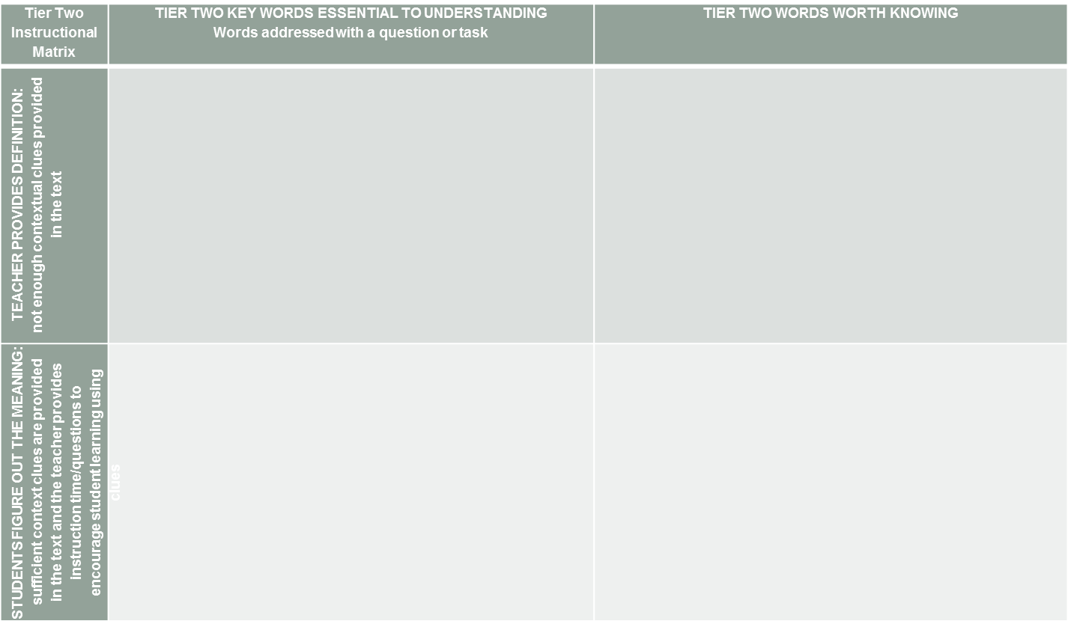
In your numbered group…
Find Tier Two vocabulary that is possibly worth teaching.
Place the word and line number in the appropriate quadrant of the matrix.
Choose a maximum of three words for the bottom left quadrant.
Discuss the best way to instruct students in these words (e.g. text-dependent question, concept mapping, etc.)

Slide 31
Teaching Tier 2
http://www.ldoceonline.com/dictionary/determine
http://www.collinsdictionary.com/dictionary/
What strategies might be helpful in teaching the important Tier 2 words you highlighted in the left hand column of the matrix?
  How do the strategies change when there are ample context clues?

Slide 32
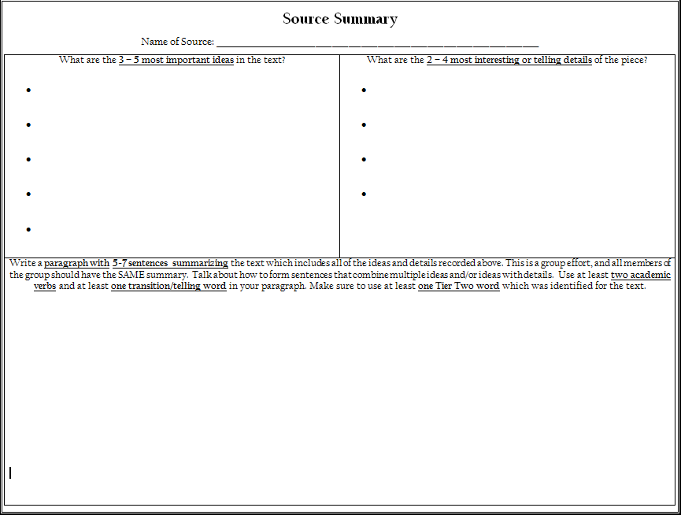
Summarizing the Text

Slide 33
Jigsaw seminar
Compare, Contrast, Synthesize & Make Meaning…
SHARING POINTS OF VIEW WITH MULTIPLE ARTICLES

Slide 34
JIGSAW SEMINAR GROUPS
Number 1s | The Land of Leisure: Why Americans Have Plenty of Time to Read This | Blue
Number 2s | Inconspicuous Consumption: A New Theory of the Leisure Class | Yellow
Number 3s | How the 2 Americas Spend Their Time | Pink
Number 4s | Lazy in America: An Incomplete Social History | Green

Slide 35

JIGSAW SEMINAR INSTRUCTIONS
EXPERT GROUPS
SEMINAR GROUPS
Read the same article.
Discuss article:
  What is the main idea or claim of the article?
  How is this supported?
  What are the most interesting aspects of the article?
Identify a 25-50 word summary of your article to share with your seminar group.
Meet in a group of 4 (representing the 4 articles).
Everyone share their summary.
Go through each of the seminar questions.
Each person must “speak” at LEAST once for each seminar question, noting something from their article that is related to the question.
People can speak generally (without evidence) about the topic after they have shared evidence.

Slide 36
Shared Annotation
Write a few words at the top of each article as people share their summaries with you.
When a person in your group mentions a piece of evidence, they should point out the article and line number.
Each person should then underline, highlight, or mark up that evidence.

Slide 37
Seminar Questions
Is laziness synonymous with leisure?
Who gets leisure time? Are there differences amongst groups and classifications of people? Why or why not?
How is consumption related to the leisure class?
Why is there a debate over leisure time and the leisure class?
Answer questions one at a time in your group.

Slide 38
Note Taking Organizers for Jigsaw Seminar
Consider the use of I-Charts to have students take notes at the end of their discussion.
  Ask students to translate something from their shared annotation for each source and then make meaning of it in a summary.

Slide 39
Time to Reflect
Why use a Jigsaw Seminar?
What types of questions were asked?
How might you tie a writing activity to a Jigsaw Seminar?
How might Accountable Talk complement a JS?
Why is it important for all students to have all copies of all articles?
What extra question would you have asked?
What techniques could you use to increase participation?

Slide 40
Lesson Topics & Discussion Questions
What makes a great discussion question?
  Depends on what type of discussion?
  Controversial Issue? Or seminar to get to the bottom of something? Or comparison and contrast? Or…
Discuss your questions at your table. Help one another refine the question.
Remember, as you develop your sources, you will likely change your question a bit.
Make sure to fill out Sue’s form to get paid your $30!

Slide 41

Conference Registration
Please join us for the annual NNCSS Conference on Saturday, January 26 at
Damonte Ranch.
Learn
Network
Be on the cutting edge
Win prizes

