Slide 1
The Atlantic World: U.S. History in a Global context Part I
TAHP Vanguard, September 13, 2014

Slide 4
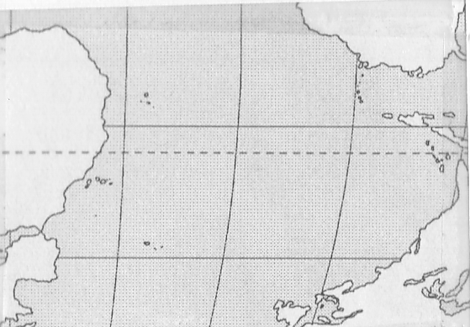
Notes:
Here we will look at some maps with national borders removed – many upside-down or angles changed. The point – we need to free ourselves from the tyranny of national boundaries in order to understand this period during which nearly all of our current boundaries did not exist.

Slide 5
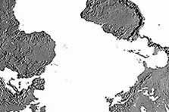

Slide 6
Context

Slide 7
Images of Global Trade
What examples of international trade can you find?

Slide 8
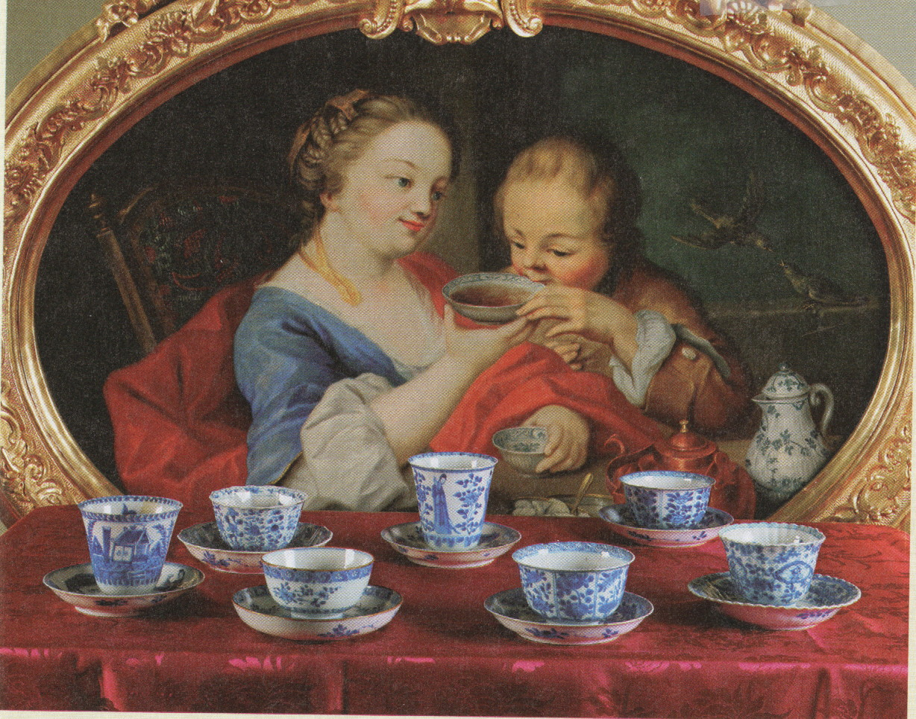

Slide 9
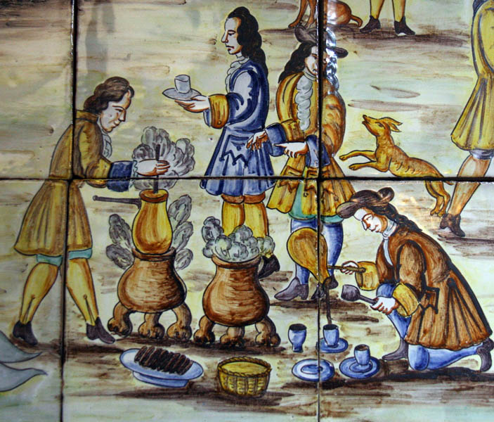

Slide 11
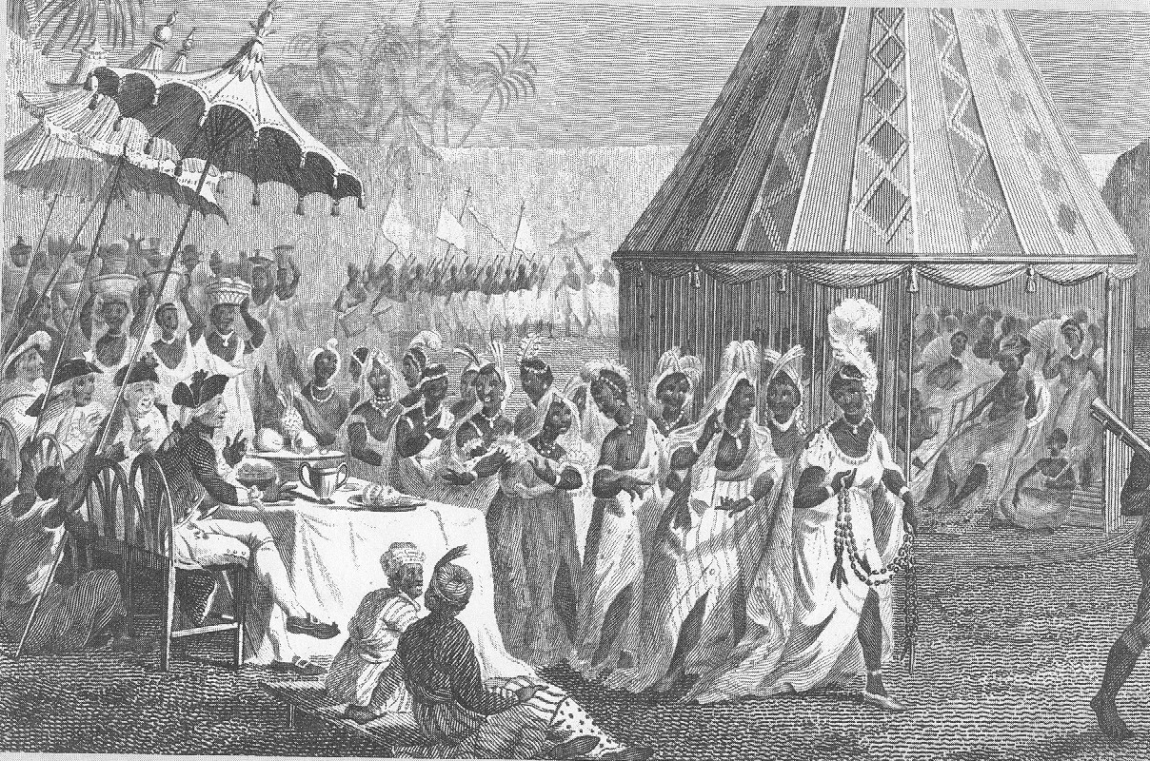

Slide 12
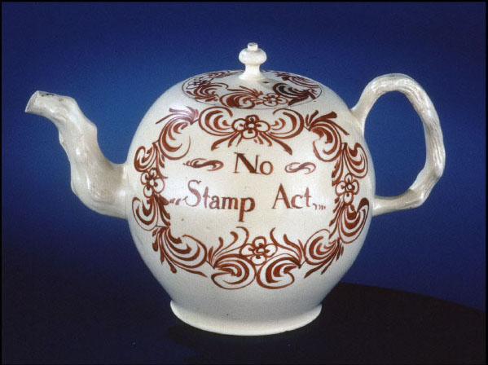

Slide 14
Global Consumer Demand Shapes North America

Slide 15
Moving Beyond Mercantilism
Mercantilism Defined
“Mercantilist theory held that each nation’s power was measured by its wealth, especially in gold. To secure wealth, a country needed to maximize its sale of goods abroad while minimizing foreign purchases and the use of foreign shippers.”
Boyer, et. Al. The Enduring Vision, Eighth Edition
Traditional View: Britain’s decision to enforce its mercantilist policies angered New England elites and led to revolution

Slide 16
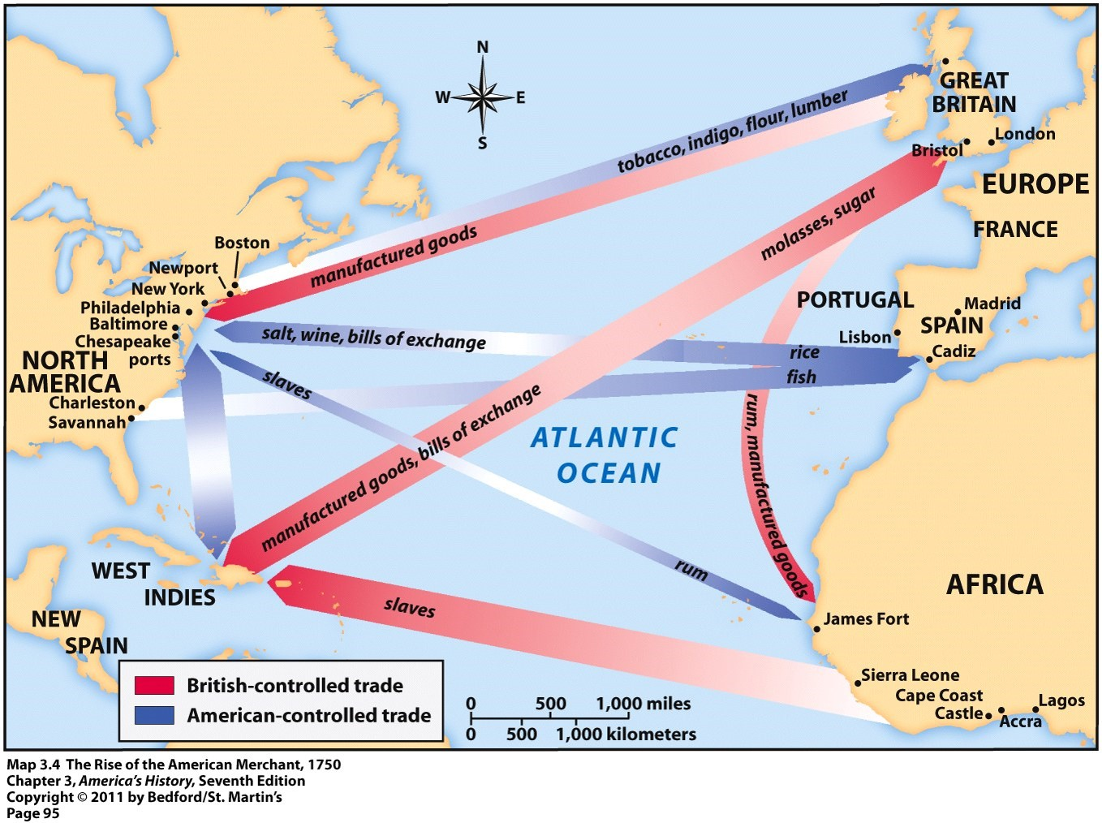

Slide 17
British Ship Routes, 1750-1800

Slide 18
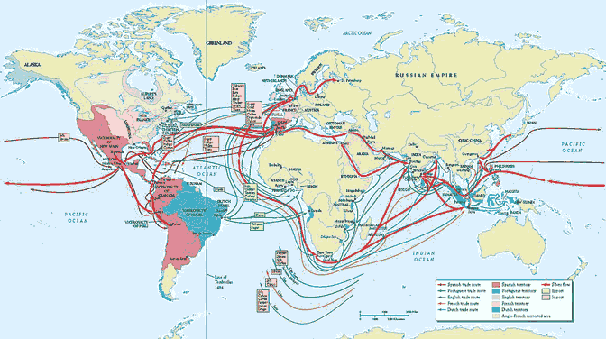

Slide 19
Moving Beyond Mercantilism
The theory/practice of mercantilism, though not false, is too narrow
Revised view: while the concept of mercantilism reflects the official intent of colonial empires, it loses explanatory power when details on the ground are examined

Slide 20
Consumer Demand
A more powerful explanation of American development
Global consumer demand for goods
skyrocketed in the 17th and 18th century
Principal driver of change
Imperial mercantile policies are imperfect reactions to this demand

Slide 21
Primary Demand -- Stimulating Foodstuffs
Demand for Tobacco, sugar, caffeine, chocolate drives expansion and economic growth across entire Atlantic world
By 1700
75% of imports to Amsterdam
85% of imports to London were tobacco or sugar products

Slide 22
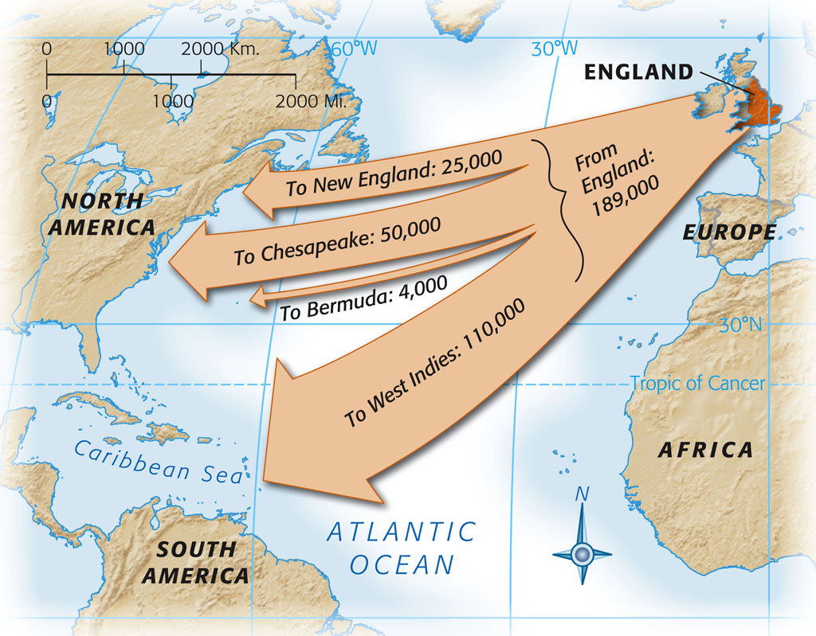

Slide 23
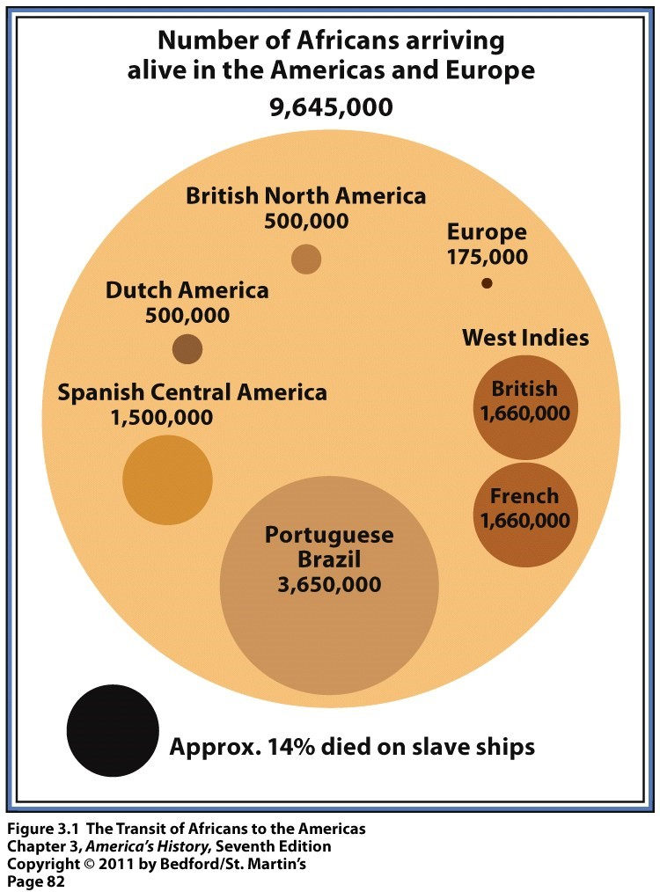

Slide 24
Why has consumption been underestimated?
Most early 20th century history was political history
The pronouncements of political figures was taken to be true, regardless of reality on the ground
Regarding stimulating foodstuffs, they were initially
Opposed by elites
Consumed only by elites
However, by the early 1700s, laboring classes could afford and were consuming these products in large quantities

Slide 25
Consumerism and the American Revolution

Slide 26
Consumerism and the American Revolution
Older view of revolution – colonists decided to throw off mercantilism and embrace economic liberalism
Breen’s Argument
North American colonists had already embraced the commercial revolution of the Atlantic World
the commercial world of plentiful goods united the colonies – it was the one thing they shared

Slide 27
Consumerism and the American Revolution
British restrictions on goods were seen as heavy-handed turning back the clock on a world of consumer choice
Hence the fascination with “non-importation agreements” – an invention of the colonial rebels
While elites argued about the British constitution, the mass mobilization was achieved through politicization of consumer goods

Slide 28
Consumption and American Revolution
Breen shows that ordinary colonists lived a rather austere material life until 1740
By 1750, the colonies had become a virtual “empire of goods”

Slide 29
Rev. James Davenport (1743)
Reverend James Davenport, one of the great awakening ministers

Slide 30
Rev. James Davenport (1743)
In New London, CT he told crowd that they made “Idols of their Gay cloaths.”
The crowd debated and some time later decided to hold a bonfire of the offending clothes in the center of town
Not all were on board: one man “could scarce see how [Davenport’s] disliking the Night-Gown that he had on his back should render him guilt of idolatry.”

Slide 31
Bonfire of the Vanities -- Fail
“The Women brought their Scarlet Cloaks, Velvet Hoods, fine Laces, and every Thing that had two Colours so that it is supposed the Heap of Women’s Idols, and the Men’s wigs, Velvet Collars, &c. &c. is worth three or four hundred Pounds.
Davenport prayed, stripped his clothes, and ordered the bonfire to start
Nothing happened
Citizens rushed to retrieve the clothes
All the clothes were “Reprieved from the Flames . . . And that every Bird has taken its own Feather[s] again.”

Slide 32
Consumerism and the American Revolution
Intolerable Acts
British viewed as singling out the outliers of New England
It was a region unlike any other in the empire
Wouldn’t the southern colonies side with the Carribbean planters against the merchant community of Massachussets?

Slide 33
The declaration of independence in global context

Slide 34
Declaration of Independence
What section is most important?
Lines 27-30
Lines 31-45
Lines 46-93
Lines 94-112

Slide 35
Global Declarations of Independence
What is the name of country and date?
How is this document similar to the U. S. Declaration of Independence?
Language
Structure
What is different? Is anything missing?

Slide 36
The global origins of slavery: The Atlantic plantation System

Slide 37
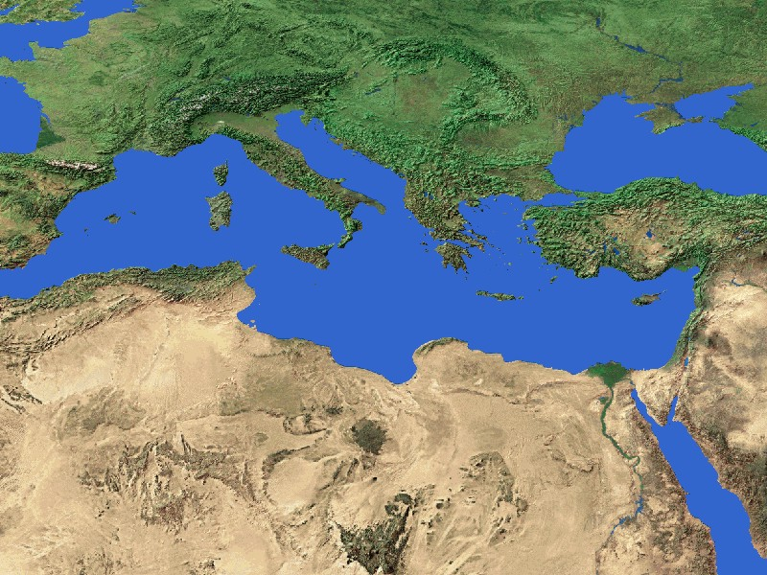

Slide 38
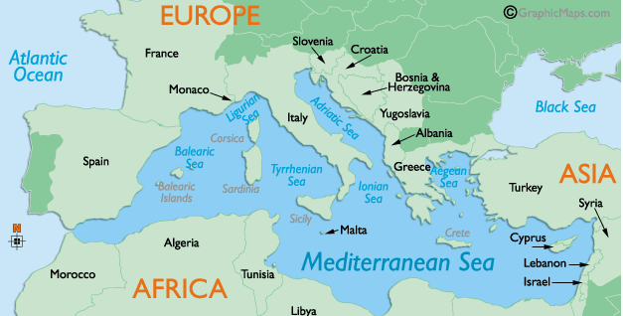
A Very Brief History of Sugar Production
From Bengal to the Mediterranean
Cyprus
Sicily
Iberia
Atlantic Islands
Notes:
Original home – Bengal lowlands
Persia
Arab conquerors took it to shores of Eastern Mediterranean
Sugar cane plantations – similar to those that would spring up in the Americas – were present in the crusader kingdoms of 12th-13th century Palestine.
Cyprus a major producer by 14th century
Created by Catalan and Venetian families, worked by Syrian and Arab slaves
Sicily
Iberian peninsula (brought by Muslim conquest)
Sometime in the 15th century, a new press was created. The original was a stone rolled over cut cane. The new was two stones cogged together that pressed the cane between the stones. This got more juice and eliminated need to cut cane into pieces.
Prince Henry sent scouts to Sicily in 1420s for cane plantings and techniques
Genoese merchants funded sugar mills in Portugal
Genoese merchants were the links – they transferred the techniques, estate management, and commercial organziation from the eastern mediterranean to the west and beyond
16th century cooking manuals show that sugar had found its way into diet of European aristorcracy
First African slaves arrived in Lisbon in 1441 and averaged 800-900 per year
They began being utilized on cane planations in Portugal – thus, the wedding of cane production and African slave labor was European
Azores – 1439, sugar production introduced, but these islands were not well suited to cane, and wheat became main crop.
Madeira – by late 1400s, it was the largest sugar producer in the world
Peak 1470s, declined by 1530s, dead by 1600s (replaced by wine)
Marriage of cane production with an ethnically distinct labor force originated in Mediterranenan

Slide 39
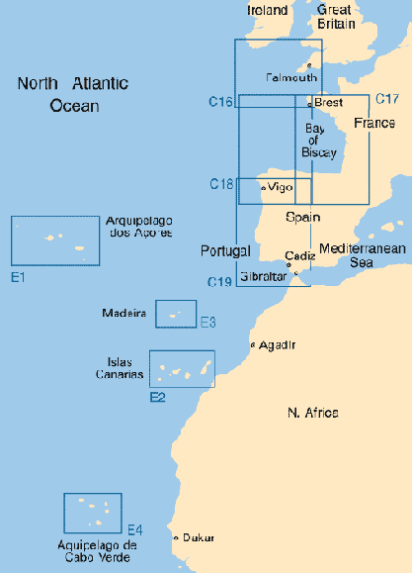
The Spanish and the Atlantic Islands
Azores and Madiera
The Canaries and the Guanche
Notes:
Unlike Africa, the Atlantic islands suggested settlment
They were small, but fertile
The Azores and Madeiras were uninhabited, and the Portuguese setlled these
The Canaries and and the Guanche
Approx 30,000 in 1400
Olive-complexioned people related the North African Berbers from where they had emigrated in about 2,000 B. C and then lost their navigation knowledge and lost contact with the mainlaind
The cultivated wheat, beans, peas and raised goats, pigs, and sheep
No horses, cattle, or metals
No political unity, not even on each of the seven islands– rival chiefdoms
When the Iberians came to settle the Canaries, the Guanche resisted
Their resistance – with stone weapons – led to their capture and enslavement
The Spanish began slave-raiding and using them as labor on sugar plantations on the Madeira

Slide 40
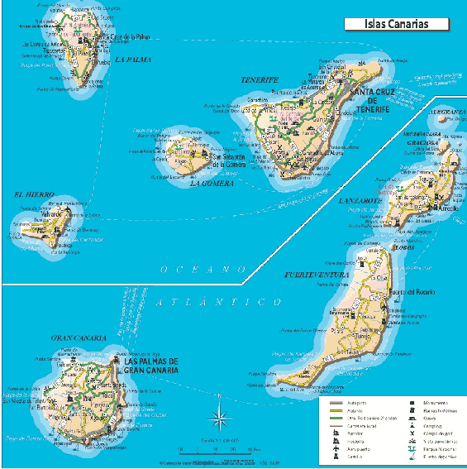

Slide 41
Canary Islands and Sugar Production
Spanish obtain the Canaries – 1479
Sugar Production
50 tons per year
Capital, technical expertise, and labor
The Will of Cristobal Garcia del Castillo -- 1518
Notes:
The Spanish and the Portuguese were interested in making Atlantic possessions PROFITABLE
1479, the Spanish obtained the Canaries from Portugal by treaty, although a number of Castilians had been living there for some time.
Residents on Tenerife and Gran Canaria established sugar mills on the coasts, and the sugar industry took off.
The Canaries began exporting sugar to Europe and competed successfully with the Spanish Carribbean until the 1600s
Like Madeira, they eventually turned to wine as the American producers outstripped them.
In 1526, a visitor described the sugar making – a process that differed little from Madeira or from that used in Brazil.
Insert image from Schwartz p. 7
The Canarian sugar mills could produce 50 tons of sugar a year, and there twenty mills at the height of the sugar boom.
Large capital investments came from Castilian nobles and Genoese merchant-capitlists
Genoese commercial houses had residents in the Canaries and were responsible for much of the distribution to Europe.
The will of Cristobal Garcia del Castillo – filed on Gran Canaria in 1518
Water powered mill, a mill house, a ressidence, a building for kettles and furnaces, a corral, 12 horses, a shed for firewood, slave quarters, residence for paid workers
20 male and two female slaves
With exception of scale, this mirrors sugar production in Brazil and Carribbean
Free men – most often Portuguese from Madeira – directed the technical operations
Guanche were the original slave force, replaced by Africans by 1500s
Foreign merchants, wealthy mill owners, technical specialists, and a captive, ethnically distinct workforce – all transferred to the New World

Slide 42
The Canary Islands and the Guanche
The Guanche and the Spanish
A learning ground for the Spanish – they tested and perfected
The use of steel, horses, and dogs against native populations
The organization of conquest missions far from home
Ways to exploit divisions within native populations.
Using slave sale as a way to finance further conquest
Notes:
The Guanche were the first test of the Spanish and native peoples (as the Irish would be for the English)
The reconquista had created a hard culture in Iberia
Iberians believed that Guanche deserved to be enslaved and conquered for two reasons – neither civilized nor Christian
The Portuguse king had described the Guanche as “like animals”
Also, slavery might save them from eternal damnation (altough this belief was tested when slaves converted and were not freed).
It took the Spanish 5 years to defeat the Guanche on Grand Canary, and not until the 1490s did they succumb on La Palma and Tenerife
The Spanish faced the Guanche on horseback with steel weapons against stone weapons
Disease – the Guanche died by the thousands from bubonic plague, dysentery, pneumonia, and typhus
Spanish friar: “If it had not been for the pestilence, [the conquest] would have taken much longer, the people being warlike, stubborn, and wary.”
By mid-1500s, the Guanche were devastated, and the remaining few were absorbed into the settlers
Only 9 sentences from the Guanche language survive.
Deforestation – by 1500, the Atlantic islands had to import wood for firewood and building
A learning ground for the Spanish – they tested and perfected
The use of steel, horses, and dogs against native populations
The organization of conquest missions far from home
Ways to exploit divisions within native populations.
Using slave sale as a way to finance further conquest

Slide 43
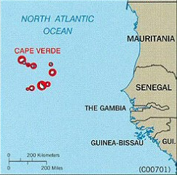
Cape Verde Islands
Too arid for sugar
A way station on the African slave trade
Notes:
Attempt was made to establish a sugar plantation economy
Aridity of climate, undependable rainfall kept it from becoming a large sugar producer
Their economy became based on their role as a way station in the Atlantic slave trade
a provisioning ground for slave ships

Slide 44
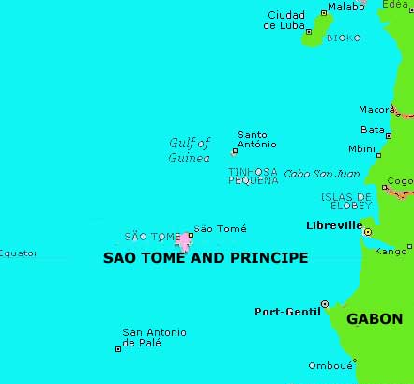
Sao Tome
The closest equivalent to a New World plantation economy
Notes:
Discovered by Portuguese in 1471
Unlike Fernando Po, it had not African population, and its climate was more favorable to Europeans
What emerged was the closest Old World equivalent to a multi-racial plantation economy.
Original charter urged planting of sugar cane
Madeiran and Genoese sugar exports were imported
1550s – 60 mills in operation
Declined by 1635 due to crop failures, competiton, and marauding fugitive slaves
Brought technical skills and organization from Atlantic island together with most consistent and efficient use of African slave labor
1516, 4,000 African slaves unloaded into Sao Tome slave pens
1519, Sao Tome slave trade regulations were established
1554– 600 white settlers and 2,000 plantation slaves (with 5,000 slaves in barracoons waiting for shipment elsewhere)
When sugar declined, this slave provisioning became Sao Tome’s major economic activity.
Scale – the easy and replenishable supply of slaves led to larger plantatins
1554 – plantations with 150-300 slaves reported.
One mystery – unclear if children of slaves were automatically slaves – if so, it is virtually identical to 18th century Jamaica
Another lesson – slave resistance
In 1544, a group of Angolan slaves was shipwrecked on the island and fled to the interior
This group attracted escaped plantation slaves
In 1574, they unleashed a series of attacks – burning plantations, stealing food and guns
As late as 1690, long after the sugar economy was dead, this group staged raids
The New World would have to find ways to prevent the disruptions of marauding slaves
White militias
Agreements with Natives

Slide 45
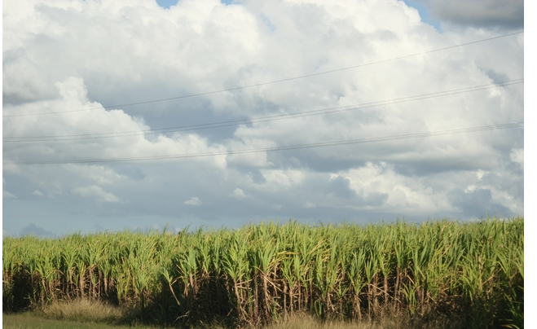
Movement to the New World
Christopher Columbus
Sugar in Santo Domingo
Brazil
Barbados
Notes:
Columbus – lived and married on Madeira
Worked for a Genoese firm involved in the sugar trade
Brought sugar cane plantings with him on his second voyage in 1493
Santo Domingo –
Did not take right away – the colony had an uneven beginning
Turning point – 1530, a Spanish physician set up a sugar mill on Santo Domingo and brought in sugar technicians from the Canaries
Development of sugar was slow there at first though
Brazil
The Sao tome system went to Brazil
Barbados imported experts from Brazil in 1630s

Slide 46
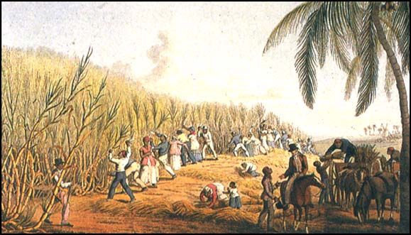
Movement of the Plantation Complex
Cyprus
Crete
Sicily
Portugal and Spain
Canary Islands
1455 Madeira
1480s Sao Thome
1500s Brazil and Caribbean
1600s – North America

Slide 47
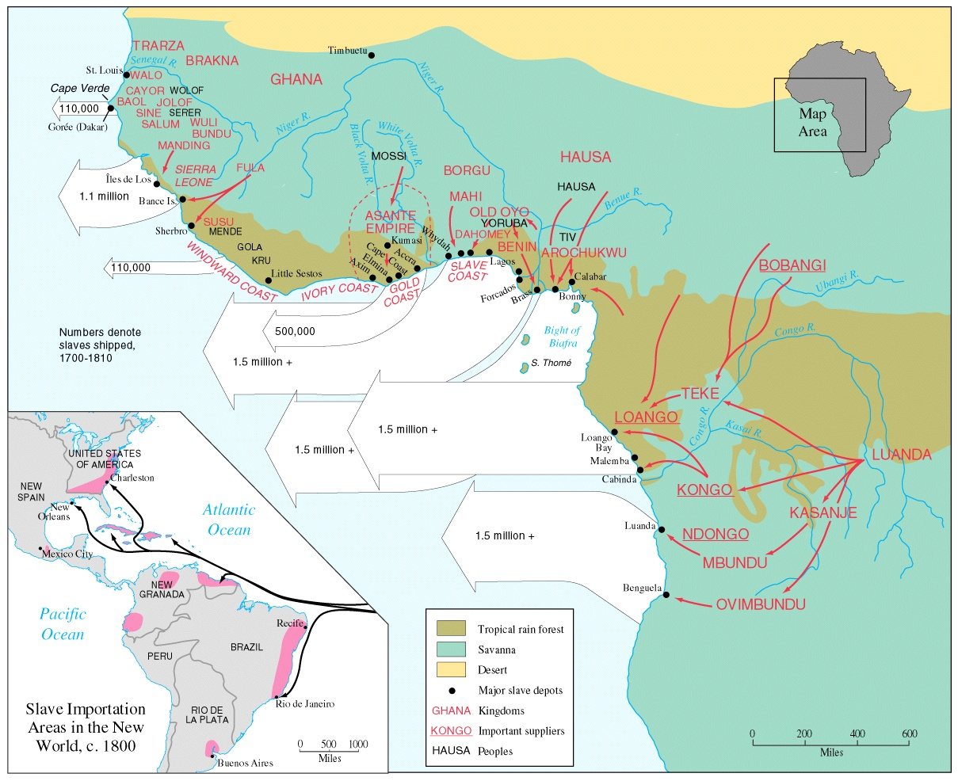

Slide 48
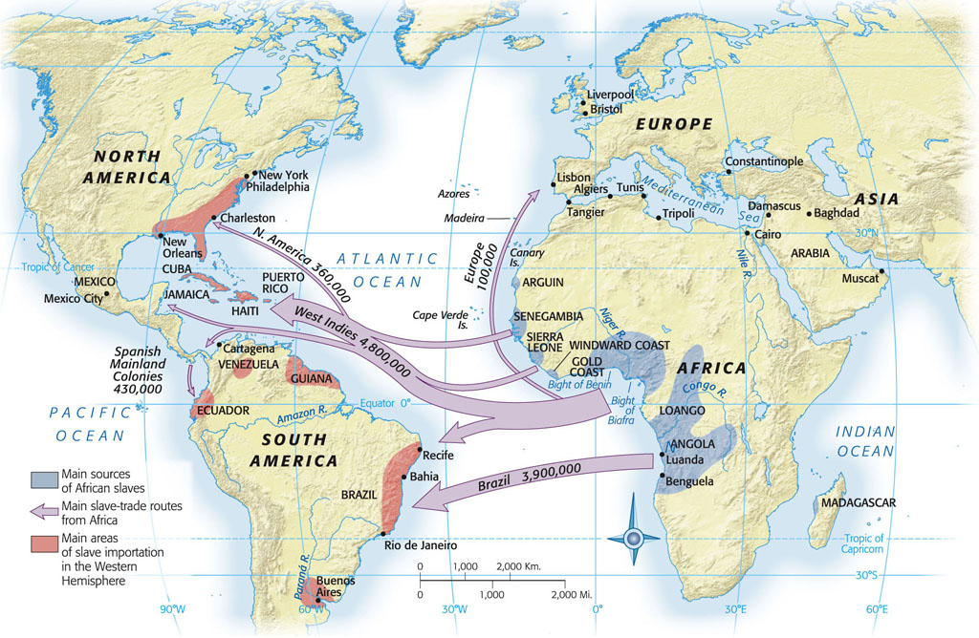
Map 4-2, p. 98
Notes:
MAP 4.2 MAIN SOURCES OF AFRICAN SLAVES, ca. 1500–1800 The vast majority of enslaved Africans were taken to plantation colonies between Chesapeake Bay and the Brazilian coast.

