Slide 1
Heightening Visual Literacy
Using Art as Text in U.S. History

Slide 2
Who we are

Slide 3
Presenter Biographies
Janet Roberts
Katie Anderson
In addition to serving on the board of our local NCSS council and being Nationally Board Certified, Janet works tirelessly with her whole heart and mind at Procter Hug High School- an urban, Title I school with the highest level of diversity in our district. Her confidence in her colleagues is evidenced in the fact that her daughter attends the school. In 2014 she received the NNCSS Teacher of the Year award.
As a content area literacy specialist, Katie works closely with K-12 teachers to develop rich and rigorous core aligned lessons in social studies. Before this, she taught United States History to middle school students and World History to high school sophomores. Katie loves the fact that there isn’t a “right answer” in Social Studies but that through exploration of topic, time period, event, or individual through primary sources and historical narratives, students have the opportunity to engage in the complex and often messy history of our nation and the world.

Slide 4
Washoe county school district social studies
Early implementer of CCSS
American Radio Works Documentary
Fordham Foundation Report
35 Core Advocates for Student Achievement Partners
Center for American Progress Report
20 close read lessons available on www.acheivethecore.org
Nevada Ready Campaign
Grassroots effort to begin with teachers and develop own resources (not a top-down approach)
Focus on close reading, argumentative writing, document based questions, research-based discussion methods

Slide 5
www.projecttahoe.org

Slide 6
Session | Date | Time | Room
“But the Textbook Said”: Bringing Multiple Perspectives to Elementary Classrooms | 11/13/15 | 10:05-10:55 | Room 213
Celebrating Human Rights through Meaningful Discussion in an Accelerated Classroom | 11/13/15 | 11:10-12:00 | #219
New Perspectives on the Faces of the Holocaust (poster presentation) | 11/13/15 | 2:15-3:05 | Exhibit H B
Heightening Visual Literacy: Using Art as Text in U.S. History | 11/13/15 | 5:30-6:20 | R03
Creating Global Citizens through Current Events and Civil Discourse | 11/14/15 | 9:05-9:55 | #226
Student Citizens Conceptualize Revolution with Concept Claim Cards | 11/14/15 | 10:10-11:00 | #228
Wish your Students had Inquiring Minds: Try Question Quads! | 11/14/15 | 2:40-3:30 | Room R01
What makes people bad? Violations of Human Rights and the psychology behind them. | 11/14/15 | 4:50-5:40 | #228

Slide 7
Learning by Doing
Constructivist approach to student learning must begin with a constructivist approach to teacher learning
“We had to do it ourselves to see what it could be.”

Slide 8
Heightening Visual Literacy
Using Art as Text in U.S. History

Slide 9
Art & Argument
All forms of art- painting, photographs, political cartoons, sculptures, even clothing- can be read as text.
Art provides a meaningful visual entrée to writing and substantiating claims.
Appeals to visual learners, English Language learners, special needs students. All Students love analyzing images!
Naturally forces students to think as writers without the intimidation of complex text
Great way to practice. Analyzing art can take less time than reading a traditional text
Art is a valuable tool for building confidence in analyzing primary sources
Art creates an entry point for tackling complex issues and ideas

Slide 10
Visual Literacy and the CCSS
Reading Standard 1: Read closely to determine what the text says explicitly and to make logical inferences from it; cite specific textual evidence when writing or speaking to support conclusions drawn from text.
Reading Standard 2: Determine central ideas or themes of a text and analyze their development; summarize the key supporting details and ideas.
Writing Standard 1: Write argument to support claims in an analysis of substantive topics or texts, using valid reasoning and relevant and sufficient evidence.

Slide 11
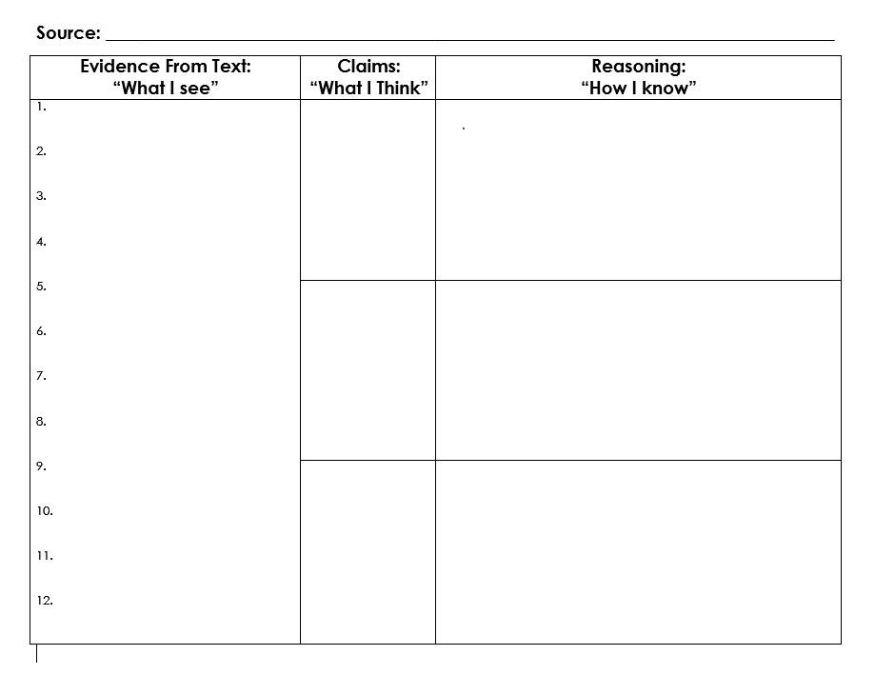
A super simple, easily adaptable, reproducible, template…

Slide 12
An Example
American Progress, John Gast, 1872

Slide 13
The Process: What Students Do
Step 1: Silently examine the image for1 minute.
Step 2: “What I See”
In the first column, make a list of all evidence (details) you notice in the image.
Step 3: Circle 3-4 pieces of evidence that seem to work together.
Step 4: “What I Think”
Now, in the middle column, write a claim based upon three pieces of evidence you linked together.
Step 5: “How I Know”
In the column on the right, use reasoning to explain how the evidence you selected clearly supports your claim.

Slide 14
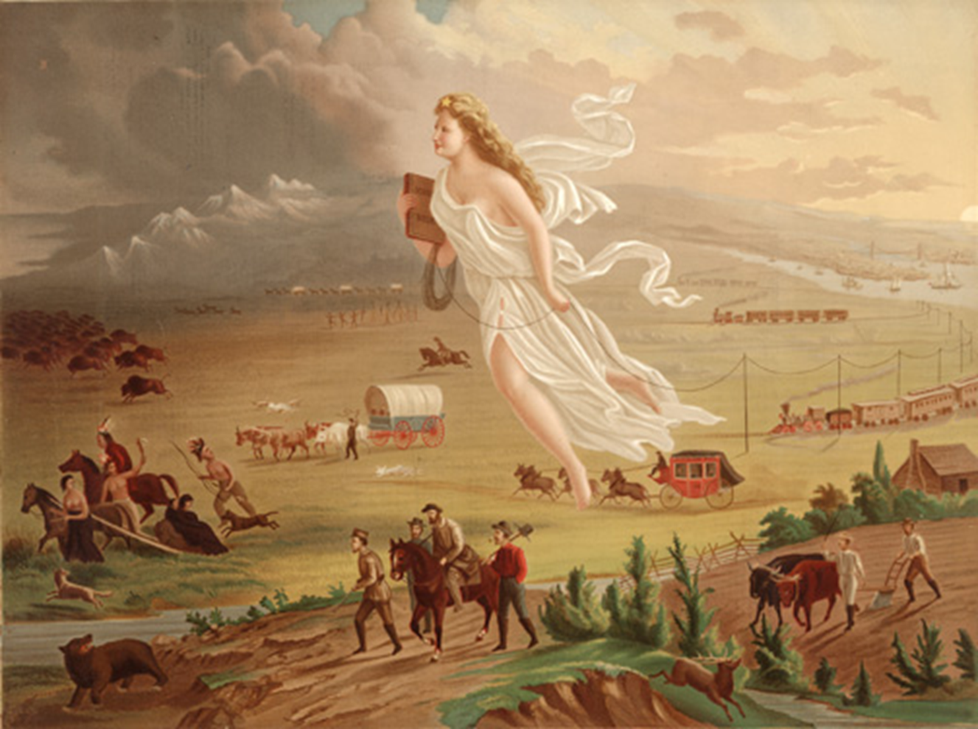
American Progress
John Gast,
1872

Slide 15
An Example:
Evidence “What I see” | Claims “What I think” | Reasoning “How I know”
Native Americans dressed in traditional clothing, animal skins NAs travelling by horse and on foot with some belongings. NAs moving away from the woman and everything that follows behind. Buffalo, bears, deer and other wildlife moving away from the woman. There is no wildlife behind her. | As settlers move west, Native Americans and wild animals are being forced from their traditional homes. (8,9,10,11) | Gast’s painting shows Native Americans travelling by horse and foot, carrying their belongings and looking backwards as though they are fearful of the woman’s presence. In the painting, buffalo, deer, and a bear are shown running away from the woman and everything that follows her. Animals run away from things they are afraid of. Finally, there are no Native Americans or wild animals behind her. They have already been removed from the developed part of the landscape.

Slide 16
It is not necessarily important for students to analyze the artwork “correctly.” What is important is for students to practice making a claim based on evidence in the text and supporting that claim with reasoning.
The opportunity to go further in depth with image remains! Take time to consider and understand the source of the image (the artist, and their position in creating it) the context in which it was created, other images or documents and support or critique the artwork.

Slide 17
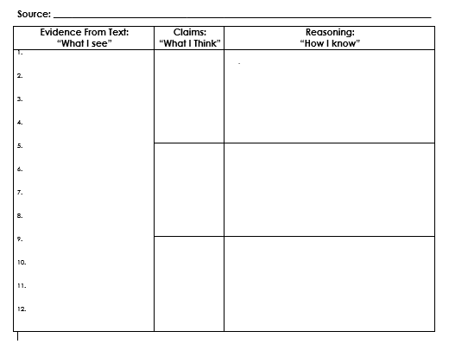
Time to practice!
Step 1: Look at the following painting (1 minute)
Step 2: “ What I See.” Make a list of all evidence (details) you notice in the image. (2 minutes)
Step 3: Circle 3-4 pieces of evidence that seem to work together.
(1 minute)
Step 4: “What I Think. ” Now, write a claim (what you think) based upon three pieces of evidence you linked together. (3 minutes)
Step 5: “How I Know” Use reasoning to explain how the evidence you selected clearly supports your claim. (3 minutes)
We learn by doing…
Grab the blank evidence organizer.

Slide 18
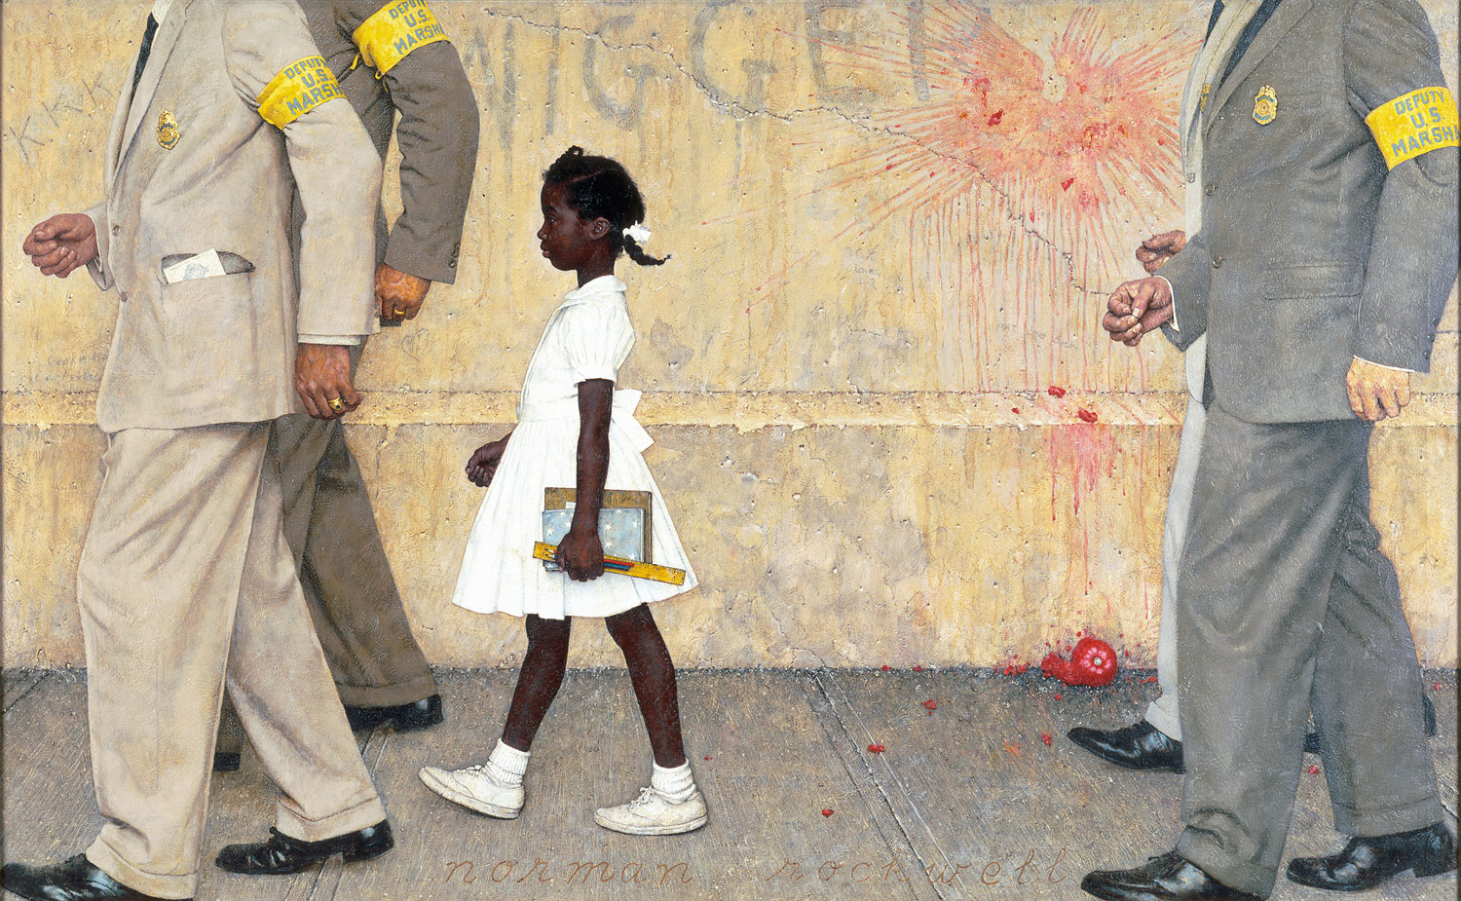
Step 1: Look at the following painting (1 minute)
Step 2: “ What I See.” Make a list of all evidence (details) you notice in the image. (2 minutes)
Step 3: Circle 3-4 pieces of evidence that seem to work together. (1 minute)
Step 4: “What I Think. ” Now, write a claim (what you think) based upon three pieces of evidence you linked together. (3 minutes)
Step 5: “How I Know” Use reasoning to explain how the evidence you selected clearly supports your claim. (3 minutes)
Notes:
The Problem We All Live With: Norman Rockwell, 1964

Slide 19
Share Claims and Reasoning and group Reflection
Sharing Out
Group Reflection
Find someone close to you who you did not work with and share your evidence claims and reasoning.
Describe to a shoulder partner how critical analysis of art can work to develop students argumentative thinking and writing skills.
How might this strategy work in your classroom?
Think of a lesson or unit where you already use art or could use art. How could this exercise enhance your instruction?
When would you reveal the artwork’s title- prior to or after student analysis? Why?

Slide 20
“Historiographical” Comparisons using Art

Slide 21
Historiography
Is the writing of history; the study of historical writing.
For our purposes, we can think of the way the historical narrative changes over time.
You can compare art from different perspectives or time periods to understand arguments within or changes to a historical narrative over time.
How can artistic images contribute to an understanding of an event, time period, person, policy or idea?
Notes:
Historiography, the writing of history, especially the writing of history based on the critical examination of sources, the selection of particular details from the authentic materials in those sources, and the synthesis of those details into a narrative that stands the test of critical examination. The term historiography also refers to the theory and history of historical writing.

Slide 22
Some Examples

Slide 23
Venn Diagram Evidence Collector
Image 1:
Similarities:
Image 2:

Slide 24
The Boston Massacre

Slide 25
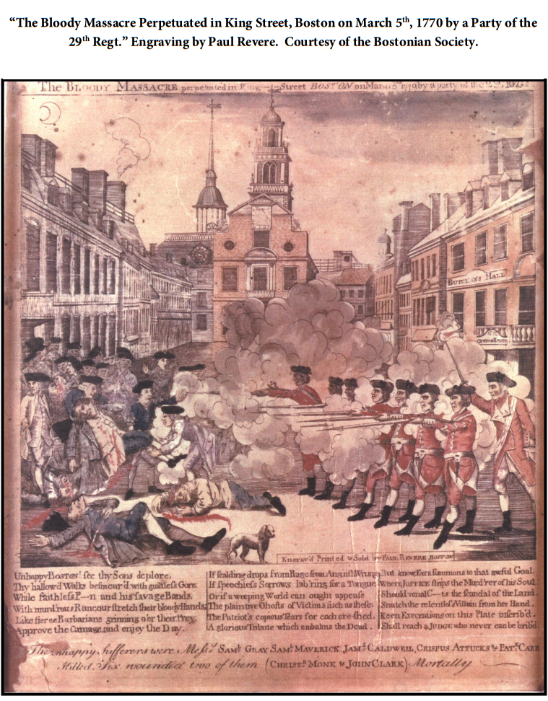
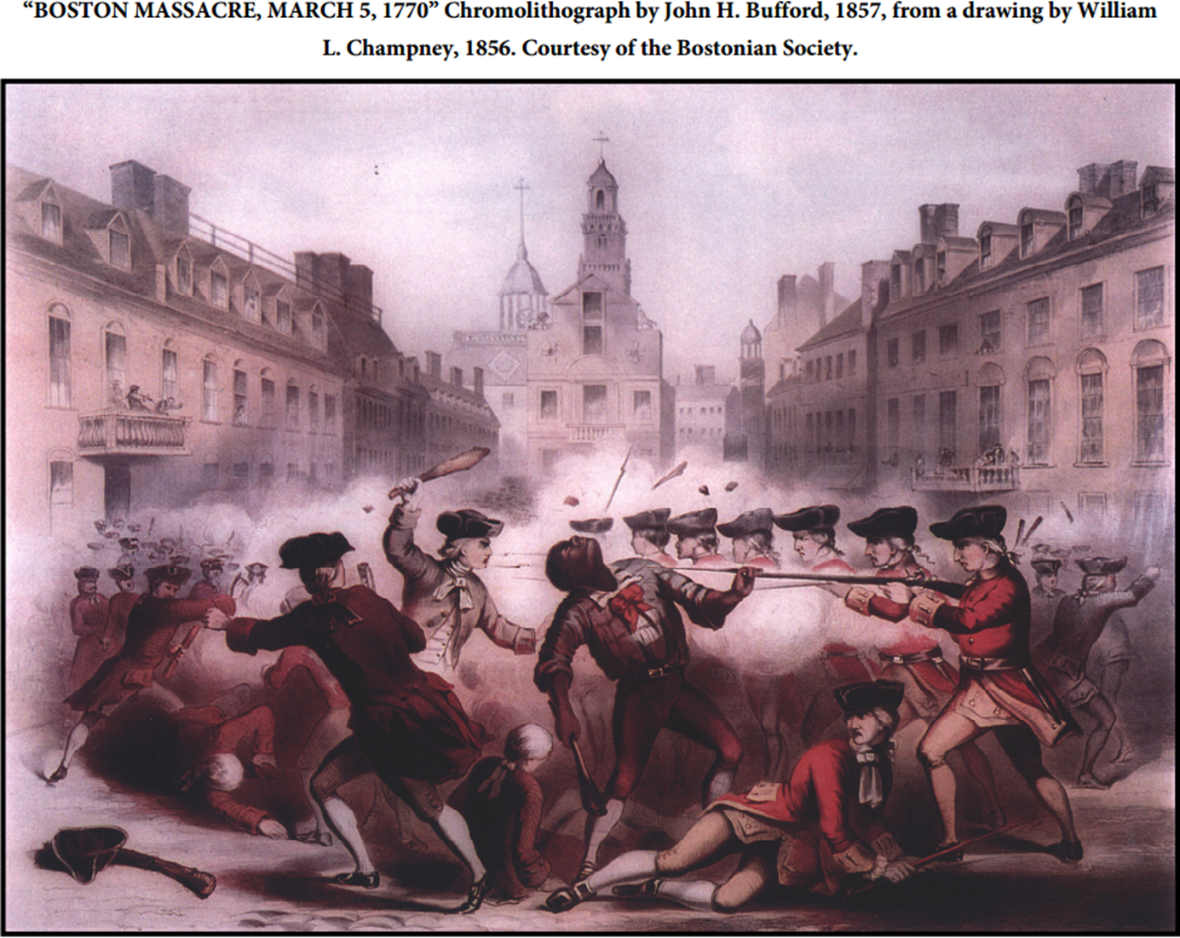
Janet’s use of these images as a US History Assessment

Slide 26
Immigration

Slide 27
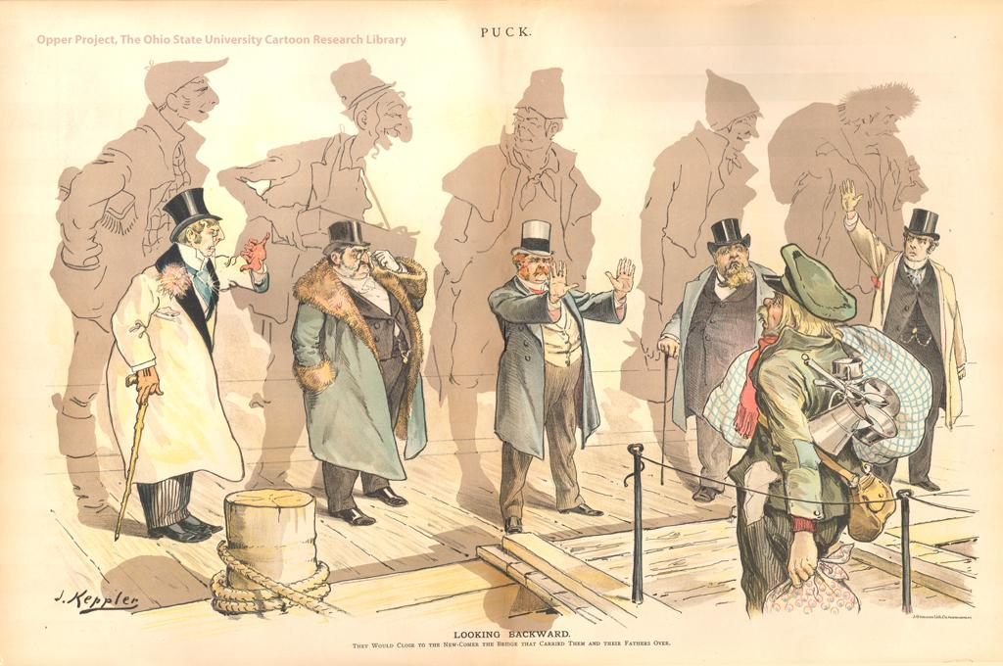
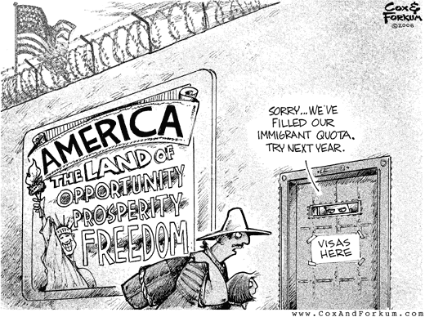
AMERICA:
THE LAND OF OPPORTUNITY PROSPERITY AND FREEDOM Cox and Forcum 2006 (Threesources.com)
Looking Backward Joseph Keppler, 1893 (picturehistory.com)

Slide 28
Gun Control

Slide 29
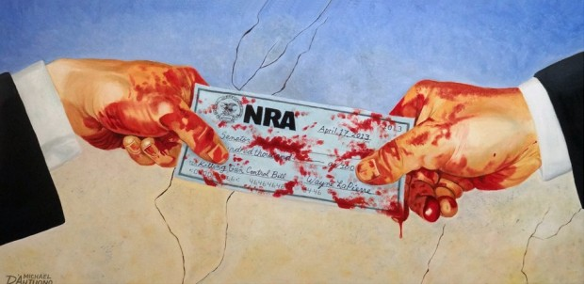
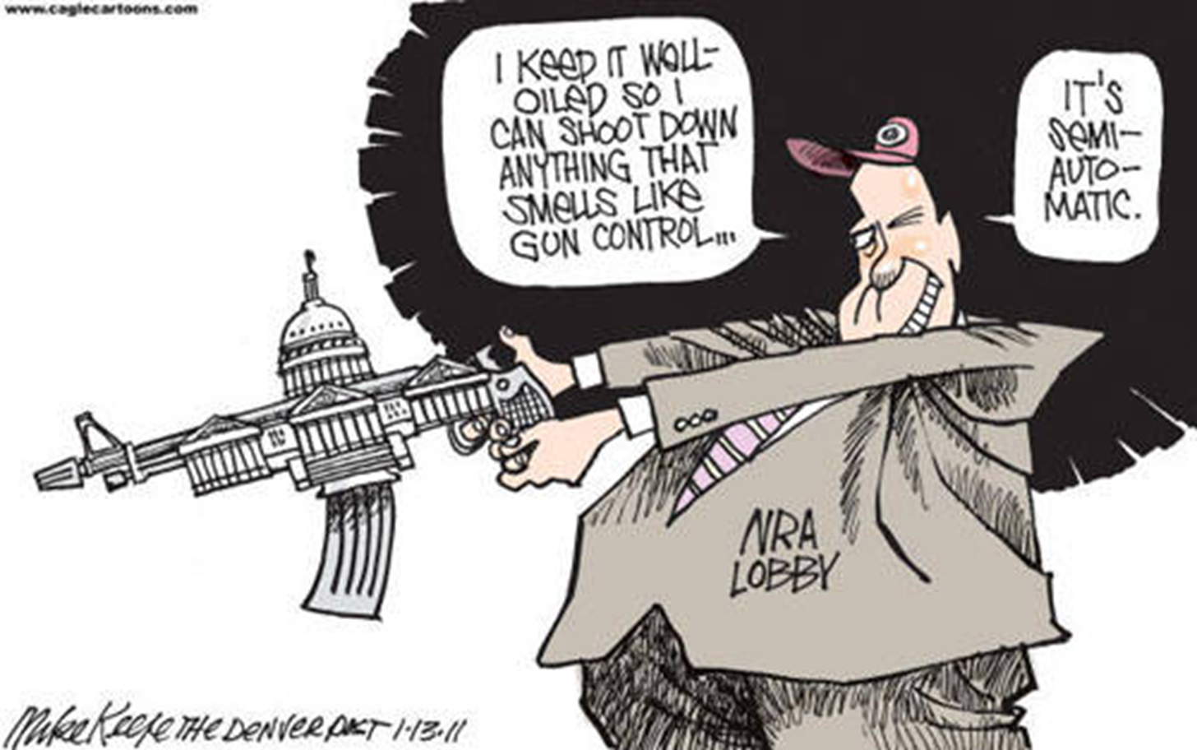
NRA LOBBY AND GUN CONTROL Mike Keel, The Denver Post 2013
BLOOD MONEY Michael d’Antuono , April 17,2013 artandresponse.com

Slide 30
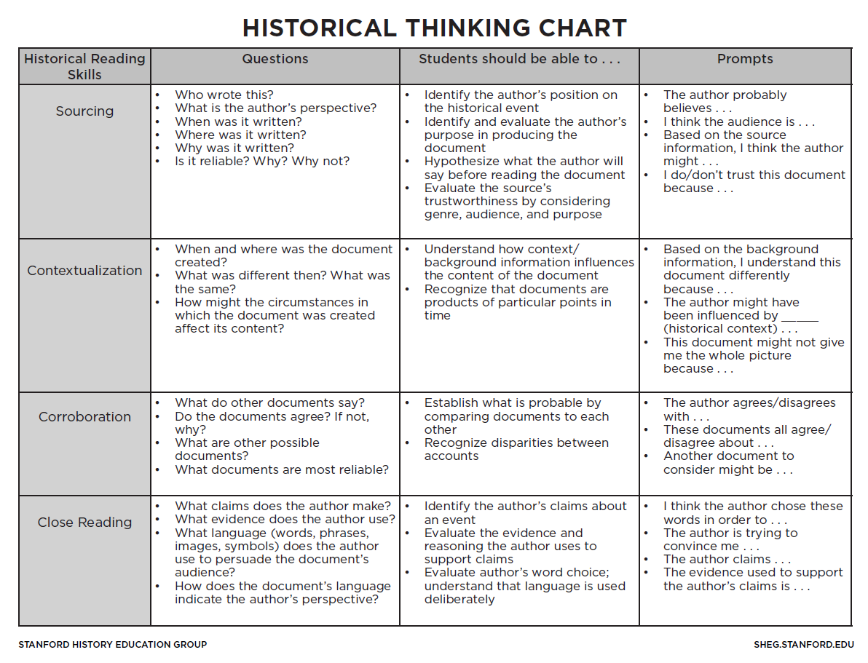
Historical Thinking: The essential Ingredient for Advancing making this type of analysis Successful
Historical Thinking Chart available from the Stanford History Education Group at www.sheg.Stanford.edu

Slide 31
Janet Roberts: jroberts@washoeschools.net
Katie Anderson: kmanderson@washoeschools.net
www.projecttahoe.org

