Slide 1
Teaching american history project
History Cohort
September 27, 2013

Slide 2
Global entanglements in american history
Purposely Weaving Together What We Know About Common Core:
deep reading, argumentative writing, class discussion, document analysis

Slide 3
Some logistics
Sign-in sheets
Stipend forms (some funky dates to make up for crazy business office rules)
NNCSS/Holocaust
What should we do now that we don’t have a catered lunch?
Lessons/learning plans ☺
Discussion, DBQ, close read, argumentative writing, concept
2 people work together to create 2 complementary learning plans
Due dates: Oct 25 and Feb 21 (and maybe May?)

Slide 4
Let’s start with future telling…
Read: “21 Predictions for 1993 from 1893”
What types/categories of predictions are there?
Take two minutes to write your own prediction about the year 2113.
Stand up. At the ringing of the chime, you will:
Find a person who is not sitting at your table.
Introduce yourselves (name, school, grade level).
Share your prediction.
Wait for the chime to do it all again (x 5).

Slide 5
Reviewing & refining annotation

Slide 6
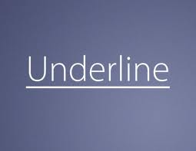
#1 type of ANNOTATion

Slide 7
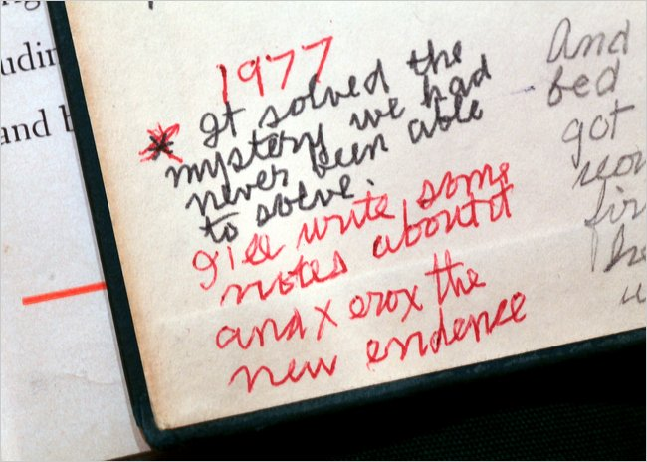
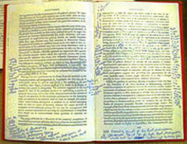
#2 type of annotation

Slide 8
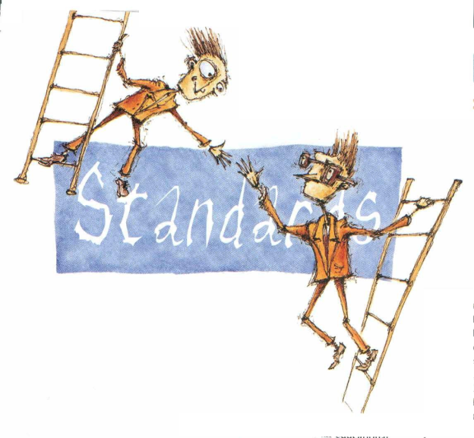
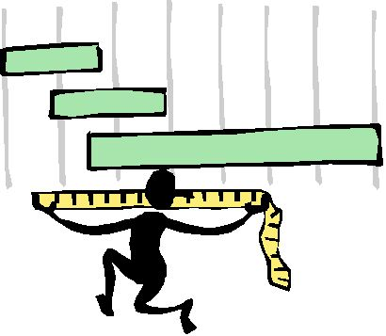
#3 type of annotation

Slide 9
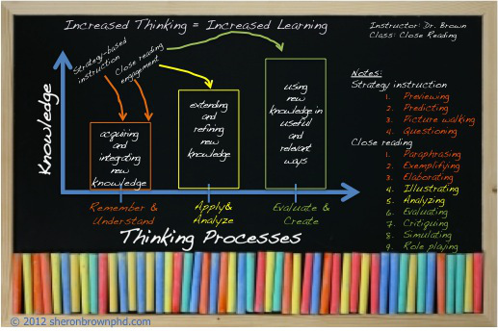
Discuss with your partner…
Is it important for students to learn and practice multiple ways to annotate while closely examining a text? Why or why not?
How does the act of physically marking up text affect student reading? How do you know?
How do you know if students are meeting the reading standards?

Slide 10
Standards based annotation matrix
What is the purpose of this matrix?
How could it be used?
How might it be used INEFFECTIVELY?

Slide 11
Annotation of a page in the readings
Switch American Entanglements Readers with a person at your table.
Take note:
What portions did they annotate?
How do these annotations seem similar to your own?
How are these annotations different?
Why might it be a good idea to allow students to occasionally work in groups to annotate?

Slide 12
Super annotator groups w/ matrix
Silent Room. Individual silent reading.
In your numbered off groups, go to the Washington text on poster paper. (first or second half of address)
Each person in the group will choose one standard and one annotation option from that standard.
The group will work together to complete the annotations of the document together, ONE AT A TIME.

Slide 13
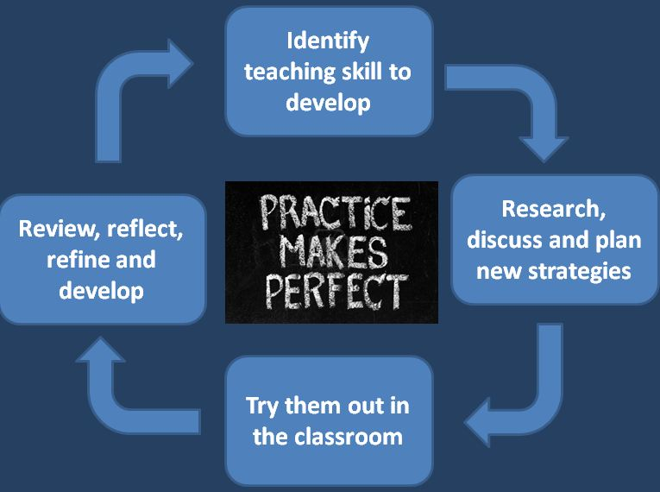
Adding to the annotation matrix
At your table, please share your additions to the matrix.
One group member should compile a list of all of the additions to give to Katie. All additions will be emailed to you.
Debrief…how will you refine your annotation strategies with your students?

Slide 14
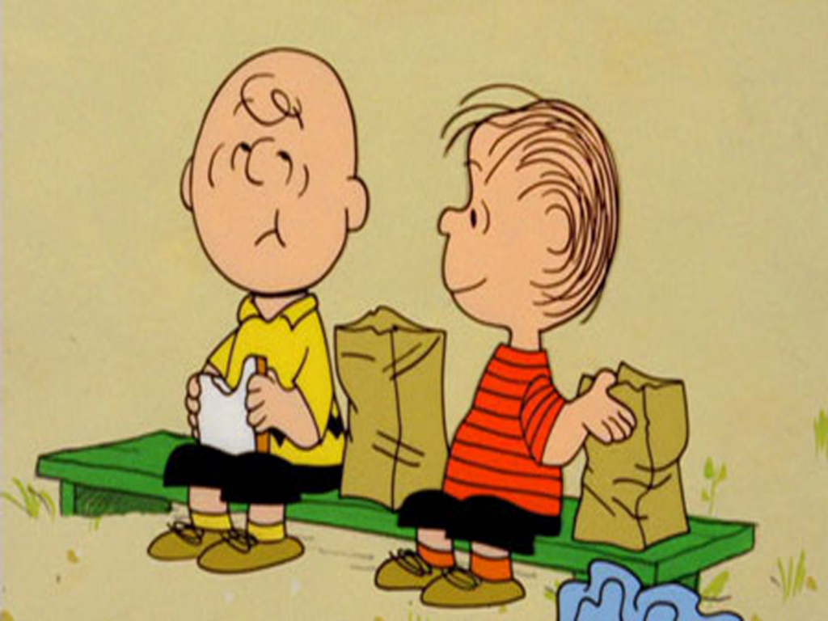
Lunch time

Slide 15
Vocabulary: making choices with complex text
With what particular words will students struggle?
Are they Tier 2 or Tier 3 words? How does this impact how I will deal with them?
Are these words important to understanding the paragraph?
If they are important,
Are there context clues or logic that could be used to come to an understanding of the definition? Can I write a question(s) to get them there?
If there are not adequate clues, what synonym could I provide for students?
Should I take time to explicitly teach this word? Why or why not?

Slide 16
1st paragraph modeling
In the execution of such a plan [to observe good faith and justice towards all nations [and] cultivate peace and harmony with all], nothing is more essential than that permanent, inveterate antipathies against particular nations, and passionate attachments for others, should be excluded;
In order to understand the meaning of the phrase “permanent, inveterate antipathies,” think about the following?
Using the phrases before the first comma, describe to your neighbor the goal of the “plan.”
In order to meet this goal, what two things “should be excluded”?
How does the term “against” and the prefix “anti” help us understand what “permanent, inveterate antipathies” might mean?
Do you think the phrase “and positive attachment for others” is meant to be the same as or opposite of “permanent, inveterate antipathies”? Why?

Slide 17
1st paragraph modeling
In line 4, this clause appears: “and that, in place of them, just and amicable feelings towards all should be cultivated.”
Choose one of the following meanings for the term “just” as it is used in this clause and explain your reasoning.
Exactly (e.g. "just what I need”)
Based on or behaving according to what is morally right and fair (e.g. "a just and democratic society“)
Very recently; in the immediate past (e.g. "I've just seen the local paper“)
With your group, think of another word that includes the word “just” in it that is related to this same definition.

Slide 18
1st paragraph modeling
former – (adjective) first-mentioned of two
latter – (adjective) last-mentioned of two
Look at the proper usage of "former" and "latter" in this sentence:
Jack and Jill went up the hill; the former fell down and broke his crown while the latter came tumbling down after.
Work with a partner to determine to the best of your ability what person or thing could take the place of each “former” and “latter” in the document.
Sympathy for the favorite nation, facilitating the illusion of an imaginary common interest in cases where no real common interest exists, and infusing into one the enmities of the other, betrays the former into a participation in the quarrels and wars of the latter without adequate inducement or justification. . . . And it gives to ambitious, corrupted, or deluded citizens (who devote themselves to the favorite nation), facility to betray or sacrifice the interests of their own country, without odium, sometimes even with popularity . . . . Such an attachment of a small or weak towards a great and powerful nation dooms the former to be the satellite of the latter. . .

Slide 19
1st paragraph modeling
ODIUM (line 9)
Very complex context clues…hard to figure out in context
Important to the meaning of the text
Definition: (noun) general or widespread hatred or disgust directed toward someone as a result of their actions
So I would give a synonym for ODIUM to the right – HATRED.
How does understanding this word help you better understand the sentence?

Slide 20
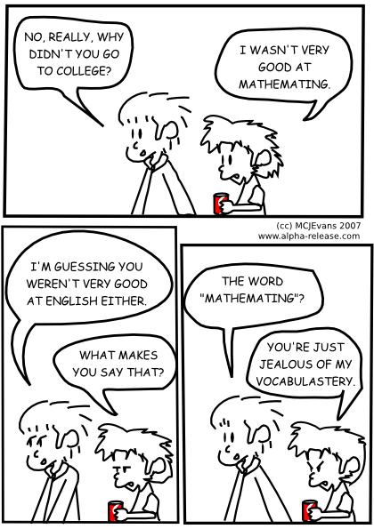
Vocabulary Choices: Small Group work
In a group of three, choose any two paragraphs from the Washington text.
Have a discussion about the vocabulary you would want to work with.
Come up with some activities for students to engage in around these words (or in some cases, find a proper synonym).
Be prepared to share some of you amazing vocabulary ideas.

Slide 21
U | Unilateralism Unilateralism, often mistakenly called isolationism, has formed a powerful and enduring strain in U.S. foreign policy.
I | Ideology & Pragmatism The ideological fervor and messianic streak that have stamped U.S. foreign policy has been balanced by pragmatism.
M | Mixed Views Americans have had decidedly mixed views about the international order and their place in it.
P | Partisanship Partisan politics have shaped foreign policy from the beginning.
O | Omnipotence Despite failures, its overall record of achievement has few precedents in history, but this success spawned the “illusion of American omnipotence.”
S | Separation of Powers The United States’ unique and ambiguous constitutional division of foreign policy powers between the executive and legislative branches has added confusion and conflict.
E | Expansionism The U.S. has in many ways acted like a traditional European power – energetically pursuing vital interests, relentlessly expansionist, exploiting rivalries among competing powers, and using infiltration and subversion as tools of expansion
D | Destiny & Virtue Americans have had a shared faith in the nation’s special virtue and unique destiny -- a chosen people with a providential mission.
THEMES:
U IMPOSED
Look through the quote examples.
Tell your neighbor about the quote that most stood out to you.

Slide 22
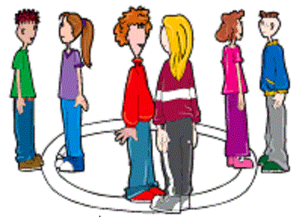
Inside / outside Circles
Description
Inside Outside Circle is a kinesthetic activity that involves all students in the class and that facilitates short exchanges between students.
Method
The teacher:
forms two concentric circles containing the same number of students. Students in the inside circle face a partner standing in the outside circle.
asks students from the inside circle to share something with their partner in timed activity.
has students reverse roles. The students on the outside circle share with their partner,
controls the timing, e.g., “Outside circle, it’s your turn to share for one minute.”
has the inside circle rotate and the students turn to face their new partner and repeats steps 2 and 3.

Slide 23
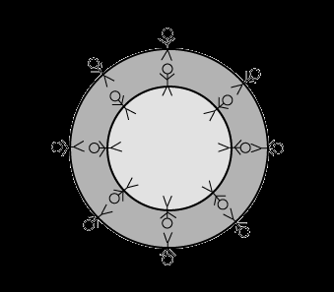
Inside / outside circles
Individuals receive one strip of colored paper with one historical theme from our study of Global Entanglements.
Individuals come up with one example of this theme from the reading, John’s teaching, or their own knowledge of history and write it on their strip.
Pink forms an inside circle with blue as an outside circle. And green forms and inside circle with yellow as an outside circle.
Share your examples. Then, switch your examples before moving.
Listen for the chime to begin and to have the inside circle move.

Slide 24
U-Imposed practice
With a partner, please do the following:
With your partner, think of an example from John’s history lesson that could fit into one of the themes. Find a concise yet specific way to add that to the graphic organizer.
Find one quote from Washington’s Farewell Address to add to the graphic organizer. Determine the theme it best addresses and add it to the organizer.
How does this type of graphic organizer help students track their learning over time?

Slide 25
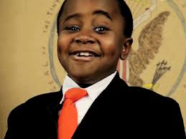
Kid President & Evaluations
http://www.youtube.com/watch?v=RwlhUcSGqgs&list=SPzvRx_johoA-YabI6FWcU-jL6nKA1Um-t&index=2

