Slide 1
Demystifying Documents for Deliberation
Saturday Seminar
January 21, 2012

Slide 2
Norms Review
Huge class size!
Please do not text, unless there is a very important reason (e.g. kid is locked out of the house).
Please remember to keep side conversations to a minimum. We’ve had several comments about how distracting it can be.

Slide 3
Be the first hand raised with the correct answer. From what document in your reading does the following quote come?
“In this condition of the law in respect to suffrage in the several States it cannot for a moment be doubted that if it had been intended to make all citizens of the United States voters, the framers of the Constitution would not have left it to implication….
Women and children are, as we have seen, “persons.”
…but if they were necessarily voters because of their citizenship unless clearly excluded, why inflict the penalty for the exclusion of males along? Clearly, no such form of words would have been selected to express the idea here indicated if suffrage was the absolute right of all citizens.”

Slide 4
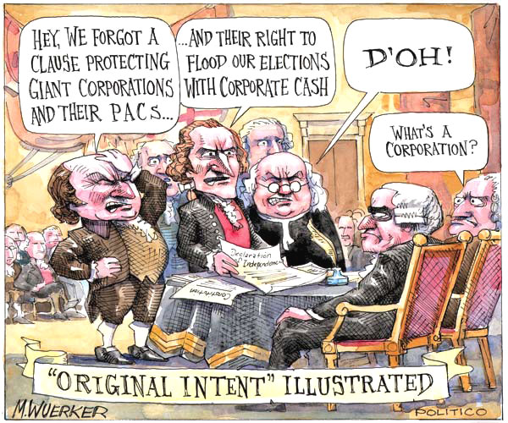
Where are we headed today?
Questions about your paper/lesson?
John on the Slaughterhouse Cases and Corporate Personhood
Annotating Lochner v. New York
John on Mueller
Breaking down Citizens United
Demystifying Controversial Issues for Discussion
Lesson Planning

Slide 5
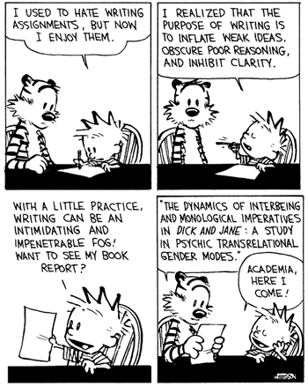
Questions about your Paper
On January 27, you need to email your
Question,
Intro paragraphs,
Brief outline, and
1 in-text citation.
Any citation style with which you are comfortable
Background of the multiple perspectives of your issue
You are becoming the expert, so that you can competently lead a great in-class discussion.
Do not take a position on the argument yourself.
Scholarly, peer-reviewed sources
What questions do you have?

Slide 6
The Amazing John Reid

Slide 7
A Little Perspective & Review From a Renown Scholar

Slide 8
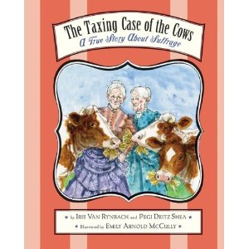
Woman, Taxes, & the Constitution
If you are interested in using children’s literature to teach history, I applaud you! And, I would like to suggest the book:
“The Taxing Case of the Cows: A True Story about Suffrage”
By Iris Van Rynback & Pegi Deitz Shea
This story illuminates the long and hard struggle of two sisters who refused to pay taxes if they could not vote. It explains how the judicial system and the tax authorities try to deny them basic rights and take advantage of their lack of power and how they fought back. It explains how cases like theirs led to the passage of the 19th Amendment.

Slide 9
Preparing Yourself & Your Kids for Discussion of Complex Controversial Issues
Demystifying Documents

Slide 10
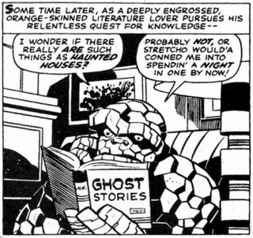
Ways to Help Students Prepare for Discussion
Close reading of the text.
Read-aloud various sections.
Use text-dependent questions.
Force students to go back to the text and refer to line numbers.
Annotate.
Demystify the issue
Determine what the issue is really about.
Discuss the various points of view involved.
Determine why there is controversy.
Create an appropriate and intriguing discussion question.
Choose interesting readings.
Cut down the readings.
Provide vocabulary that cannot be determined within the text (context clues).
Choose the right discussion model.
Plan the lesson, the norms, the room layout, the assessment, and share all of this with students in advance.

Slide 11
Cooperative Activity
Please get into heterogeneous groups (mix of schools and grade levels) of 5 people.
You will be discussing the Citizen’s United articles you read for class. Please have them out on your desks. Clear away extra items.
Choose roles for each member of the group:
NOTETAKER – keeps written track of the group’s ideas
TASK MASTER – keeps the group moving along through the assigned process
EVIDENCE LOCATOR 1 – looks to the articles for evidence of group thinking
EVIDENCE LOCATOR 2 – looks to the articles for evidence of group thinking
LINK MAKER - notes links between previous learning/knowledge and other texts (prior knowledge)

Slide 12
Demystifying Citizens United
Small groups should fill out the demystification handout, focusing their discussion on the following (see TAB 18 in Discussion Reader):
What is the issue about? (Values, Information, Concepts)
What are the arguments? (What is being said, and what support is there for what is said? What criteria are being used to make a judgment?
What assumptions (things deemed self-evident) are intrinsic in each side?
How is the message manipulated? (Who is behind the main messages, and how does that affect their point of view? What are the politics of the issue? To what degree is certain information ignored because it does not support the position?)
Are any of the following strategies used by either or both sides:
Ad hominem, forced “either or,” extreme examples, false analogies, irrelevant appeals, leading statement/slogans, polarized thinking, scapegoats

Slide 14
What ideas about the Citizens United controversy emerged in your group during the demystification process?
Were you able to remain fairly neutral in this process?
Why or why not?

Slide 15
Reflecting on Demystification
Talk to your group: Was this strategy preparation for a discussion or a discussion itself?
What are the benefits of doing this type of strategy (which is often done as a whole class)?
With what types of controversial issues would this type of strategy be most necessary?
What was the most difficult aspect?
Did you leave feeling more or less certain of your own stance after the demystification process?
What type of discussion strategy would work well with the Citizens United controversy?

Slide 16
Grade Level Groups: Lesson Planning
Please meet up in grade level groups of no more than three people.
In your group, discuss the following for each person:
What is your lesson discussion question?
Do you need help determining the right question?
What discussion strategy will you employ for this discussion?
Does the strategy match the question?
What types of reading strategies will you use to prepare students to understand the information?
How will you ensure that students are using evidence in the discussion?
Will your discussion be small group or whole group?
How will you structure the desks/tables in your room?

Slide 17
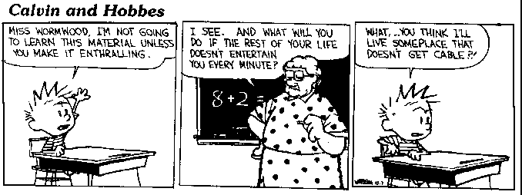
What is the best idea you heard about lesson planning for discussion in your group?
Share out with the whole group.

Slide 18
Upcoming Events
January 27 – paper outline due by email
January 28 – NNCSS Conference
January 30 – Muckrakers Cadre
February 2 – Underground Railroad Cadre
February 8 – Renaissance Cadre
February 9 – David Blight (Yale) at UNR 7:30
February 16 - Next VHT Meeting
February 17 - Next Cohort Meeting
February 24 – student readings and discussion strategy due by email

