Slide 1
The Union and Confederacy Engage Europe
American Entanglements in the Civil War Era

Slide 2
London Morning Herald (9-16-1862)
“Let us do something as we are Christian men. Be it arbitration, intervention, diplomatic action, recognition of the South, remonstrance with the North, friendly interference or forcible pressure of some sort . . . Let us do something to stop this carnage.”

Slide 3
Union and Confederacy Seek European Assistance
The Union sought loans to assist with war costs
The Confederacy sought
Simple recognition as a nation
Loans
War Ships
Union’s Most Important Diplomatic Task: Prevent Recognition of the Confederacy

Slide 4
Union and Confederacy Seek European Assistance
Both sides were consistently frustrated
Union – could not get loans or any assistance because Europeans expected the Union to lose
This didn’t change until the end of 1864
The Confederacy couldn’t even get recognition as a nation
Europe waited to see evidence that the South was capable of standing on its own
Confederates sought recognition up to three months before the war’s end

Slide 5
Union and Confederacy Seek European Assistance
On one thing, both sides agreed
European intervention in the war would be decisive

Slide 6
Types of “Intervention”
Troops – “boots on the ground”
Naval Assistance
Breaking blockades in particular
Loans and/or Supplies
“Recognition”
“Arbitration”
“Mediation”

Slide 7
Confederate Advantages -- Cotton, Cotton, Cotton
20% of the entire workforce of Great Britain made a living from the imported cotton
85% of that cotton came from U.S. South
93% of France’s cotton came from Confederacy
Cotton from other parts of the world was more difficult to process and thus much more expensive

Slide 8
Confederate Advantages -- Cotton, Cotton, Cotton
Cotton from India “yields more waste, that is, loses more in the process of spinning. . . . . the same machinery will give out from 10 to 20% more American yarn than [Indian] yarn.”
-- The Economist, 1861

Slide 9
Help from Europe: Confederate Advantages
First and foremost, both Great Britain and France assumed Confederate victory until late 1864
Lord John Russell, Minister of Foreign Affairs, January 1861
The Union could not be “cobbled together again” and will need to be divided into “one republic constituted on the principle of freedom and personal liberty – the other on the principle of slavery and the mutual surrender of fugitives.”

Slide 10
Help from Europe: Confederate Obstacles
Both Great Britain and France were long-time opponents of slavery
Britain outlawed slavery in its entire empire in 1833
European political situation not optimal for intervention in 1860s
Great Britain concerned about Napoleon III
Napoleon III interested in Mexico and Latin America

Slide 11
Obstacle: Confederate Overestimation of Ability to Bully Europe with Cotton
Senator James Hammond (SC) in 1858: if the South withheld cotton, “England would topple headlong and carry the whole civilized world with her, save the South. No, you dare not make war on cotton. No power on earth dared make war upon it. Cotton is King!”
Senator Louis Wigfall (TX) in Dec. 1860: “I say that cotton is King, that he waves his scepter not only over these thirty-three states, but over the island of Great Britain and over continental Europe.”
Richmond Whig: Confederacy had “its hand on the mane of the British lion, and that beast, so formidable to all the rest of the world, must crouch at her bidding.”
But in 1861, Both Europe and France had a two-year surplus of imported cotton – would not run out until late 1862 (estimate)

Slide 12
Help from Europe: Confederate Obstacles
Secretary of State William H. Seward
Repeatedly threatened war for simple recognition of the
Neither Great Britain nor France relished a war with the Union

Slide 13
Confederate Pursuit of British Recognition
March 1861 – Confederacy appoints William L. Yancey to lead delegation to Europe
To seek “friendly recognition” and treaties of “amity and commerce”
One full month before Fort Sumter attack (April 1861)

Slide 14
The Union Engages Britain
May 1861 – Charles Francis Adams, Sr. (grandson of John) appointed to represent Union in London
On the day of his arrival, Queen Victoria issued a formal proclamation of neutrality
Elevated Confederacy to status of “belligerent” rather than domestic rebellion
France declared neutrality in June

Slide 15
The Battle of Bull Run (July 1861) – Near Disaster for Union
July 1861 - the most significant foreign threat to the U.S. since 1812
Lord Palmerston – snidely refers to the Union retreat as the “Bull’s Run Races”
Confederate Secret Agent James Bulloch suddenly was able to obtain British contracts for “commercial” ships
legal as long as they weren’t outfitted for war in Britain

Slide 16
The Battle of Bull Run (July 1861) – Near Disaster for Union
British Foreign Minister Lord Russell found a loophole in international law – a neutral nation could legally intervene in an ongoing war to stave off “disaster and ruin” and/or if the neutral nation’s own welfare was threatened.
In October 1861, British and French ministers met to discuss joint intervention in the Civil War
Proposed that the two sides should recognize the Confederacy and then warn the Union not to interfere with Atlantic trade
Both agreed that this would need to enforced with (at the least) naval force
Due to the Union’s rebound from Bull Run, though, the time was not right – the Union had regained confidence and would not submit

Slide 17
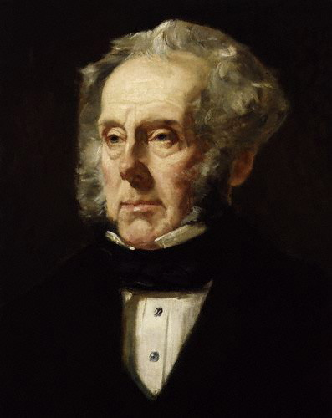
The Battle of Bull Run (July 1861) – Near Disaster for Union
Palmerston Letter, October 1861
“This cotton question will most certainly assume a serious character by the beginning of next year; and if the American civil war has not by that time come to an end, I suspect that we shall be obliged either singly or conjoinly with France to tell the northerners that we cannot allow some millions of our people to perish to please the Northern States and that the blockade of the South must be so far relaxed as to [allow] cotton loaded ships to come out.”
On the other hand, “A Rupture with the United States would at all times be evil.” The war’s battles “have as yet been to indecisive to warrant an acknowledgement of the Southern Union.”

Slide 18
France and Mexico after Bull Run
In late 1861, France invaded Mexico using the government’s suspension of debt payments as excuse
Part of Napoleon III’s Grand American Strategy
Install a sympathetic emperor in Mexico
Recognize and support the Confederacy
Build and control an isthmus canal and thus dominate trade with Asia

Slide 19
The Battle of Bull Run (July 1861) – Near Disaster for Union
All of the elements were present for European intervention except a decisive show of Confederate strength and competence after the Battle of Bull Run
But the Union responded with several victories, in particular Fort Donelson (Feb. 1862) and the capture of New Orleans (April 1862)
These victories discouraged talk of European intervention
Nonetheless, assumption of Southern victory continued, and a string of Confederate military success could have (would have?) brought European intervention

Slide 20
The Emancipation Proclamation and European Intervention

Slide 21
The Emancipation Proclamation and European Intervention
Fear of Foreign Intervention was one of several motives for Lincoln’s increasing focus on slavery
Lincoln to Seward, January 1862: “You may be right. Probably you are. I have been thinking so myself. I cannot imagine that any European power would dare to recognize and aid the Southern Confederacy if it became clear that the Confederacy stands for slavery and the Union for slavery.”
Lincoln Administration did not fully understand Europe’s position on slavery
Slavery not a factor for either Great Britain or France
In fact, Great Britain’s cabinet meetings show great fear of an inevitable “race war” that would follow Lincoln’s reckless policies.

Slide 22
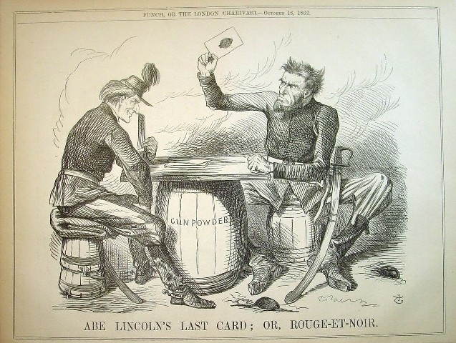
Punch magazine, Oct. 18, 1862
Notes:
Punch, October 18, 1862
Rouge et noir – a game of solitaire using two decks of cards

Slide 23
Notes:
Punch, October 18, 1862
Rouge et noir – a game of solitaire using two decks of cards

Slide 24
Primary Document Exercise
Examine the editorial in the London Evening Herald
What motives does it ascribe to the Lincoln Administration?
What does the article reveal about British thoughts about race?
What does the tone of the article reveal about British opinion of Abraham Lincoln?

Slide 25
Emancipation Proclamation in Britain
Opinion softened over the next year as the anticipated slave rebellion/race war did not occur
August, 1863 – Jefferson Davis removed envoys from Britain and moved them to Paris, essentially giving up on British assistance

Slide 26
France and Recognition of Confederacy, 1863-64
Late 1862, France emerged as the most likely to intervene
A confidential agent reported to Davis that French intervention was almost certain
Napoleon III met with Confederate envoy to propose
Six-month Armistice
If Union declined, he suggested “more active intervention”
Ports opened during Armistice
Building ships for Confederates in France
January 1863, Confederate victory at Fredericksburg further encouraged France

Slide 27
Once Again, Union Victories Discourage Intervention
Union wins in Gettysburg and Vicksburg (July 1863) cooled French interest
By March 1864, Napoleon III Administration stopped talking to Confederate envoys
Ships built for Confederates were sold elsewhere
Early 1865, Louisiana Congressman Duncan Kenner to Britain and France with instructions to offer emancipation of slaves in return for recognition
Rebuffed everywhere

Slide 28
Why did the Confederacy fail to win recognition?
Davis was a poor diplomat
Lincoln’s flexibility and ability to make meaningful public pronouncements
Overestimated importance of Cotton (and ability to control flow of cotton)
Russia was consistently pro-Union and would not join any Anglo-French intervention
The great majority of French and British workers did not support the Confederacy because of the slavery issue
Seward’s repeated threats of war deterred intervention
The risks of war with the Union were always greater than what Europe stood to gain from intervention

Slide 29
American Imperialism and the Dawn of the American Century

Slide 30
Frederick Douglass Goes to Haiti
1889 – Douglass appointed as minister to Haiti
Asked to negotiate with Haiti’s unstable government for a naval base on Haiti
Why Douglass?
An ardent expansionist

Slide 31
Frederick Douglass on Santo Domingo
“The United States needs land just as [much as] any despotic government . . . Nations must be able to exist either by love or fear and Santo Domingo can win neither love nor fear . . . Small and weak nations are plainly out of joint with our times and are going out of fashion”

Slide 32
The U.S. in Haiti, 1889
A War between two factions broke out with France supporting the existing government
The U.S. North Atlantic Squadron broke the government’s blockade and allowed rebel government to receive arms shipments
As a reward, they hoped to win lease of Mole St. Nicholas

Slide 33
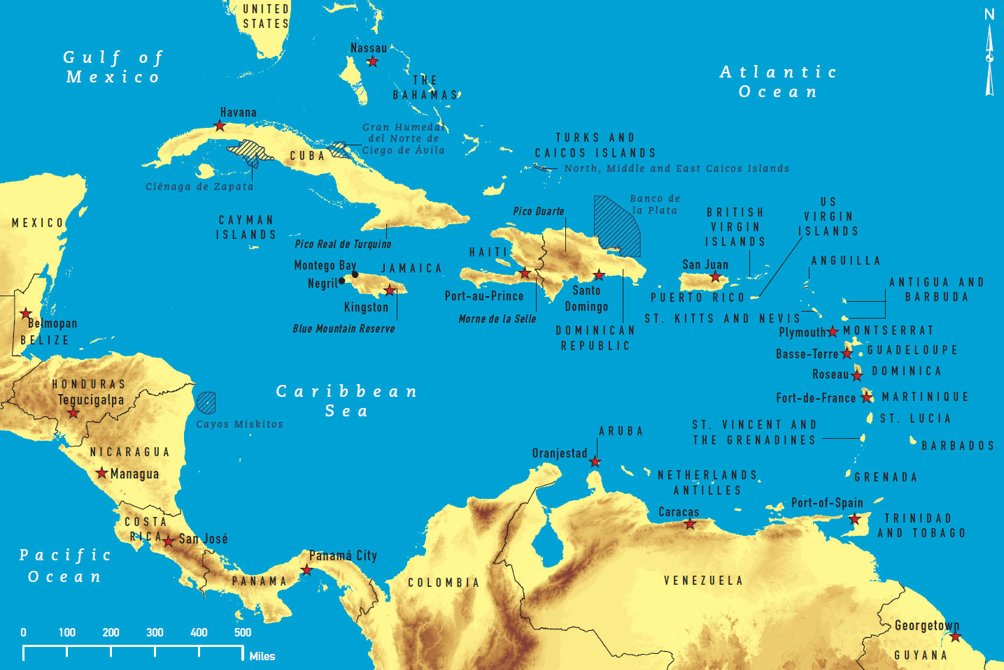
Guantanamo Bay

Slide 34
Douglass in Haiti
Douglass supported the idea of a naval base in Haiti, but he balked at the Administration’s insistence that it be a 99-year lease for U.S. use only
This seemed to deny Haitian sovereignty over their own land
Haiti government ultimately rejected offer

Slide 35
Douglass in Haiti
Douglass straddled the line between American ideals and expansionist desires
His refusal to compromise support for self-determination placed him in the minority in an increasingly expansionist Republican Party

Slide 36
Manifest Destiny Goes Overseas
Conventional View – Cuba (and especially Maine) Draws U.S. into an unexpected war
Reality: The War of 1898 was a logical expression of a vigorous expansionist viewpoint, especially within a wing of the Republican Party

Slide 37
Aggressive Foreign Policy Before 1898
Haiti incident just one aspect of the expansionist foreign policy initiated in the 1880s during the Harrison Administration
James “Jingo Jim” Blaine – Secretary of State
Encouraged coup in Hawaii
Threatened war against Chile for arrest of two sailors for drunken brawl
The aggressive policies of the late 1890s were an extension fruition of the expansionist policies of a wing of the Republican Party in the 1880s/1890s

Slide 38
Spur to Expansion: the Depression of 1893-97
Shocks the Nation
15,000 businesses fail in first year
Persistent 17% unemployment with no social safety net
Fuels Expansionism
Henry Cabot Lodge – an aggressive foreign policy could “knock on the head . . the matters which have embarrassed us at home.”
Texas Dem rep Thomas Paschal: “One cannon shot across the bow of a British boat in defense of this principle will knock more pus out of [anarchistic, socialistic, populist boil] that would suffice to inoculate our people for the next two centuries.”

Slide 39
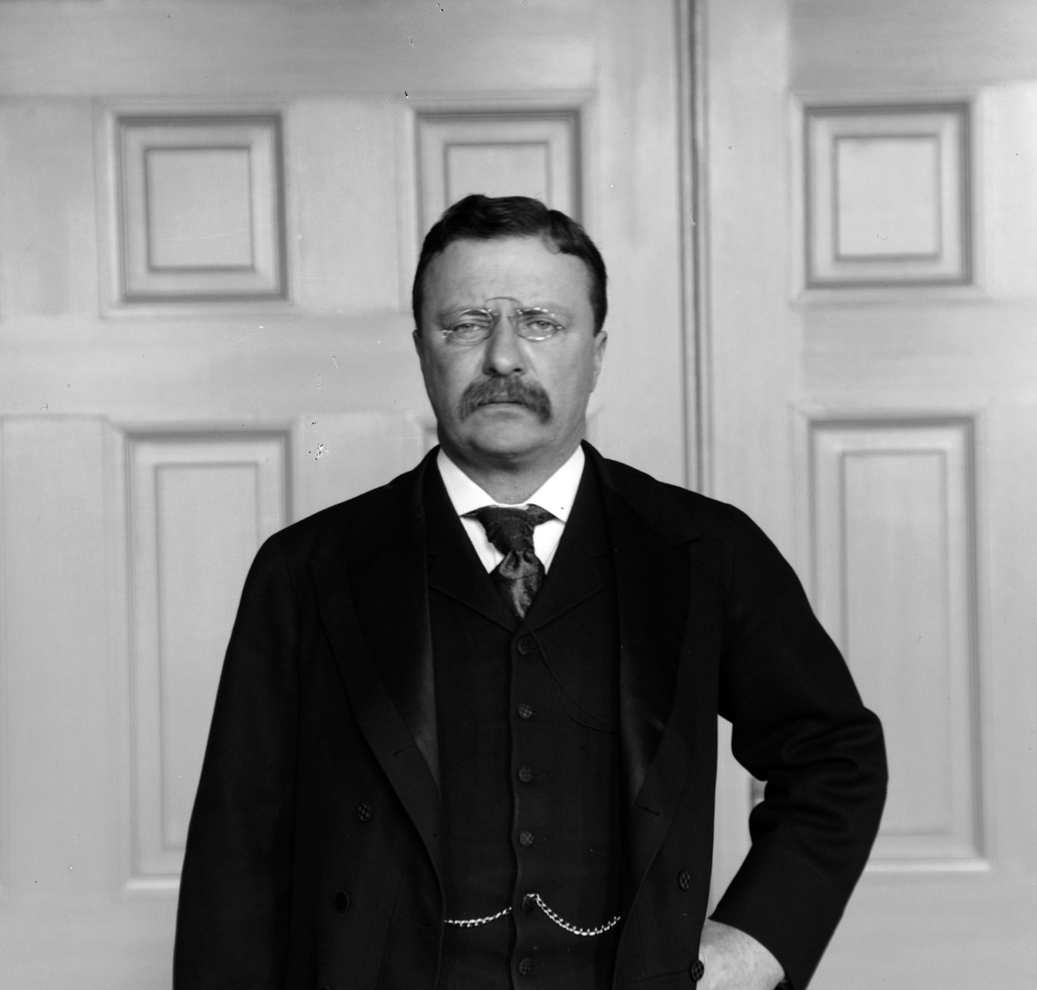
Lodge, Mahan, and TR: The “Large Policy”

Slide 40
The “Large Policy” Defined
The TR, Lodge, Mahan “Large Policy” sought to “make the United States the indisputably dominant power in the Western hemisphere, possessed of a great navy, owning and controlling an Isthmian canal, holding naval bases in the Caribbean and the Pacific, and contesting on at least even terms with the greatest powers, the naval and commercial supremacy of the Pacific Ocean and Far East.” -- Julius Pratt, 1936

Slide 41
The “Large Policy”
Mahan’s books changed “ the landscape of America’s strategic policy by making the case for naval strength, the necessary bases, and the isthmian canal.”
Lodge was the most powerful official advocate of these expansionist policies
Roosevelt charmed, cajoled, and pressured the McKinley administration to go to war with Spain, annex Hawaii, and colonize the Philippines
Lodge and TR seem to have sent the order to attack Manila

Slide 42
Theodore Roosevelt’s Review of Mahan
What military approach does Roosevelt recommend?
What (if any) parallels do you see with today’s United States defense posture?

Slide 43
Venezuela Conflict and Partisan Pressure
Grover Cleveland (D) – Second Term (1893-97)
Puts a hold on annexation of Hawaii
1894 Midterm Elections
Republicans gain 111 seats – from 133/357 to 244/357
Congress passes resolution to force British to arbitration in the case
Cleveland administration invokes the Monroe Doctrine

Slide 44
Monroe Doctrine (1823)
Stated in Monroe’s 1823 State of the Union Address
“. . . we should consider any attempt on their [European powers] to extend their system to any portion of this hemisphere as dangerous to our peace and safety. With the existing colonies or dependencies of any European power we have not interfered and shall not interfere. But with the Governments who have declared their independence and maintain it . . . we could not view any interposition for the purpose of oppressing them, or controlling in any other manner their destiny, by any European power in any other light than as the manifestation of an unfriendly disposition toward the United States.”

Slide 45
Monroe Doctrine (1823)
Asserts American Hemisphere as separate sphere of influence
Ignored internationally – U.S. too weak to enforce it
British support it – they want to trade freely with newly independent Latin American nations
Invoked in 1844 to tell Britain that Hawaii was part of U.S. sphere of influence
Phrase “Monroe Doctrine” first used in 1853 when some began arguing for removal of Spain from Cuba

Slide 46
The Olney Memorandum
Lines 11-21 – Does Olney fairly represent the meaning of Monroe’s Address?
Lines 23-35 – How does Olney argue that the Monroe Doctrine applies to Venezuela?
Lines 37-55 – What reason(s) does Olney give in this paragraph for invoking the Monroe Doctrine in this case?
Lines 57-63 – This is the paragraph that makes this document famous. Why?

Slide 47
Result of Venezuela Crisis
British Administration ignores Olney memo for four months, then sends dismissive reply
Cleveland responded with ultimatum – a committee to investigate and arbitrate the issue or . . .
British blink and agree to arbitration
Three years later, committee splits the difference and no one notices
Shows the emerging power of the expansionists (especially the expansionist Republicans)
War threatened over a non-issue

Slide 48
The War of 1898 (the war formerly known as the Spanish-American War)
Uses Spanish missteps in Cuba to rationalize and extraordinary land grab.

Slide 49
Context: Imperialism
Imperialism: the imposition of power upon a foreign people (almost always involving coercion)

Slide 50
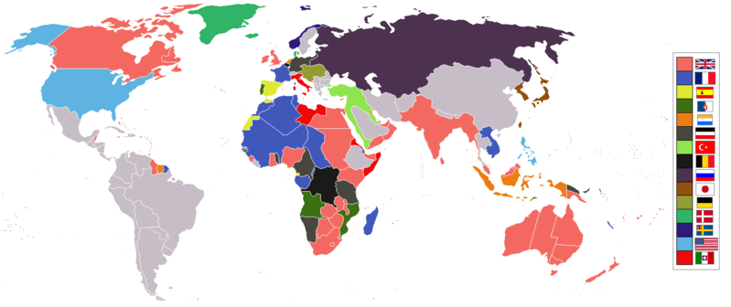

Slide 52
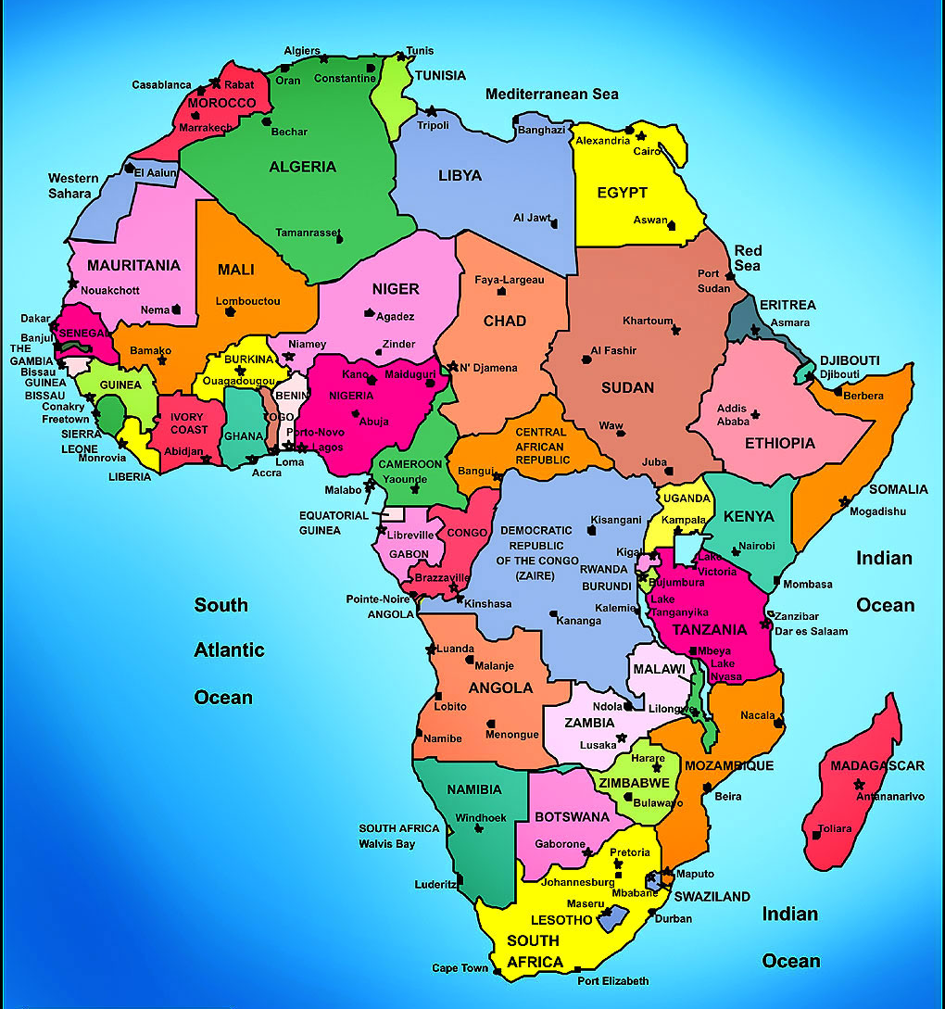

Slide 54
United States’ Era of Imperialism
Cuba – despite Teller Amendment, becomes a U.S. “protectorate” (autonomous, but owes obligation to protecting power in exchange for defense)
The lease on Guantanamo Bay – became “perpetual” in 1934
Puerto Rico – taken after Spanish defeat in Cuba – colony established
Philippines – attacked, subdued, colony established
Hawaii – annexed – needed for protection of Philippines
Wake Islands – needed for communication with Philippines
Guam – needed as coaling station for ships on way to Philippines and Asia

Slide 55
Consequences of War of 1898
For Cuba, Puerto Rico, and the Philippines, it exchanged one master for another
For Spanish it was “the disaster”. “Everything is broken in this unhappy country”
Woodrow Wilson: “No war ever transformed us quite as the war with Spain transformed us. The nation has stepped forth into the open arena of the world.”
Hyperbole, but more than a grain of truth

Slide 56
Consequences of War of 1898
US became full-blown member of the imperial club
Protectorate over Cuba
Colonial control over Hawaii, Puerto Rico, and the Philippines.
“The War of 1898 reinforced Americans’ sense of their rising greatness and reaffirmed their traditional convictions of national destiny.”
It sealed the post-Civil War reconciliation with the South – South eagerly accepted the War with Spain as a chance to show its loyalty

Slide 57
Consequences of War of 1898
Marked the onset of a new era in world politics
The revolts in Cuba and the Philippines and the conflicts that followed set the tone for a struggle between colonizers and colonized that was one of the major phenomena of the twentieth century.
Sealed demise of Spain
Symbolically and tangibly the emergence of US as a world power
Although not at all clear at the time, the War of 1898 marked the beginning of the American Century

