Slide 1
Defining Judicial and Executive Powers: from the Constitution to Today
Northern nevada teaching american history project
November 2011

Slide 2
Starting with the Constitution
Article II: defining the Presidency
Section 1: election, eligibility, $$, oath
Section 2 & 3: powers & responsibilities
Section 4: impeachment

Slide 3
Starting with the Constitution
Article II: defining the Presidency
Section 1: election, eligibility, $$, oath
Section 2 & 3: powers & responsibilities
Section 4: impeachment
Article III: defining the judicial branch
Section 1: the federal courts; term; $$
Section 2: powers & jurisdiction
Section 3: defining “treason”

Slide 4
4 Questions about any provision in the Constutution
1. What is it saying? (In other words, “huh?”)

Slide 5
4 Questions about any provision in the Constutution
1. What is it saying? (In other words, “huh?”)
2. Why is this provision in the Constitution? (In other words, what other options did they consider at the time?)

Slide 6
4 Questions about any provision in the Constutution
1. What is it saying? (In other words, “huh?”)
2. Why is this provision in the Constitution? (In other words, what other options did they consider at the time?)
3. How is it connected to other parts of the Constitution? (In other words, look for linkages elsewhere in the document.)

Slide 7
4 Questions about any provision in the Constutution
1. What is it saying? (In other words, “huh?”)
2. Why is this provision in the Constitution? (In other words, what other options did they consider at the time?)
3. How is it connected to other parts of the Constitution? (In other words, look for linkages elsewhere in the document.)
4. What additional action is contemplated—and by whom (branches), and at what level (federalism)?

Slide 8
Example: Article II, section 2, para. 1-2
The President shall be Commander in Chief of the Army and Navy of the United States, and of the Militia of the several States, when called into the actual Service of the United States; he may require the Opinion, in writing, of the principal Officer in each of the executive Departments, upon any subject relating to the Duties of their respective Offices, and he shall have Power to grant Reprieves and Pardons for Offenses against the United States, except in Cases of Impeachment.
He shall have Power, by and with the Advice and Consent of the Senate, to make Treaties, provided two thirds of the Senators present concur …
Q1: What is this saying? (I.e., “Huh?”)

Slide 9
Q2. Why is this provision in the Constitution? (In other words, what other options did they consider at the time?)
The President shall be Commander in Chief of the Army and Navy of the United States, and of the Militia of the several States, when called into the actual Service of the United States; he may require the Opinion, in writing, of the principal Officer in each of the executive Departments, upon any subject relating to the Duties of their respective Offices, and he shall have Power to grant Reprieves and Pardons for Offenses against the United States, except in Cases of Impeachment.
He shall have Power, by and with the Advice and Consent of the Senate, to make Treaties, provided two thirds of the Senators present concur …

Slide 10
Q3. How is it connected to other parts of the Constitution? (In other words, look for linkages elsewhere in the document.)
The President shall be Commander in Chief of the Army and Navy of the United States, and of the Militia of the several States, when called into the actual Service of the United States; he may require the Opinion, in writing, of the principal Officer in each of the executive Departments, upon any subject relating to the Duties of their respective Offices, and he shall have Power to grant Reprieves and Pardons for Offenses against the United States, except in Cases of Impeachment.
He shall have Power, by and with the Advice and Consent of the Senate, to make Treaties, provided two thirds of the Senators present concur …
Article I, section 8, ¶11-16: Congress’s powers related to war, armies, navy, militia
Article I, section 2, ¶5; Article I, section 3, ¶6-7: role of House and Senate in impeachment

Slide 11
Q4. What additional action is contemplated—and by whom (branches), and at what level (federalism)?
The President shall be Commander in Chief of the Army and Navy of the United States, and of the Militia of the several States, when called into the actual Service of the United States; he may require the Opinion, in writing, of the principal Officer in each of the executive Departments, upon any subject relating to the Duties of their respective Offices, and he shall have Power to grant Reprieves and Pardons for Offenses against the United States, except in Cases of Impeachment.
He shall have Power, by and with the Advice and Consent of the Senate, to make Treaties, provided two thirds of the Senators present concur …

Slide 12
Article III: the judicial branch
Hamilton, Federalist 78: what objections does he address?

Slide 13
Article III: the judicial branch
Hamilton, Federalist 78: what objections does he address?
Tenure “for good behavior” (a.k.a. life)—see Article III, Section 1
Possibility of over-powerful judiciary (where’s the real danger, according to Hamilton?)
Fears of judicial review (what’s its purpose, according to Hamilton?)
Definition of “judicial review”
(from Benedict, The Blessings of Liberty):
“treating the Constitution as law implied that courts must refuse to enforce state and federal laws that violated it.”

Slide 14
Article III: the judicial branch
Hamilton, Federalist 78: what objections does he address?
Tenure “for good behavior” (a.k.a. life)—see Article III, Section 1
Possibility of over-powerful judiciary (where’s the real danger, according to Hamilton?)
Fears of judicial review (what’s its purpose, according to Hamilton?)
Article III, Sections 1 and 2
Section 1: Creation of federal judiciary (but not very specific)

Slide 15
Article III: the judicial branch
Hamilton, Federalist 78: what objections does he address?
Tenure “for good behavior” (a.k.a. life)—see Article III, Section 1
Possibility of over-powerful judiciary (where’s the real danger, according to Hamilton?)
Fears of judicial review (what’s its purpose, according to Hamilton?)
Article III, Sections 1 and 2
Section 1: Creation of federal judiciary (but not very specific)
Section 2, para 1: Overview of federal judicial authority

Slide 16
Article III: the judicial branch
Hamilton, Federalist 78: what objections does he address?
Tenure “for good behavior” (a.k.a. life)—see Article III, Section 1
Possibility of over-powerful judiciary (where’s the real danger, according to Hamilton?)
Fears of judicial review (what’s its purpose, according to Hamilton?)
Article III, Sections 1 and 2
Section 1: Creation of federal judiciary (but not very specific)
Section 2, para 1: Overview of federal judicial authority
Section 2, para 2: Supreme Court: original vs. appellate jurisdiction

Slide 17
Article III: the judicial branch
Hamilton, Federalist 78: what objections does he address?
Tenure “for good behavior” (a.k.a. life)—see Article III, Section 1
Possibility of over-powerful judiciary (where’s the real danger, according to Hamilton?)
Fears of judicial review (what’s its purpose, according to Hamilton?)
Article III, Sections 1 and 2
Section 1: Creation of federal judiciary (but not very specific)
Section 2, para 1: Overview of federal judicial authority
Section 2, para 2: Supreme Court: original vs. appellate jurisdiction
Article VI
“judges in every State” must consider US Const., laws, & treaties “supreme law of the land” (implies judicial review over state laws)

Slide 18
Creating the federal judiciary, 1789-1803
Judiciary Act of 1789 (fleshes out Article III)
Establishes federal court system (district & circuit courts)
Creates jurisdiction & rules of those courts

Slide 19
Creating the federal judiciary, 1789-1803
Judiciary Act of 1789 (fleshes out Article III)
Establishes federal court system (district & circuit courts)
Creates jurisdiction & rules of those courts
Federalists vs. Jeffersonian Republicans on the role of the federal judiciary

Slide 20
Creating the federal judiciary, 1789-1803
Judiciary Act of 1789 (fleshes out Article III)
Establishes federal court system (district & circuit courts)
Creates jurisdiction & rules of those courts
Federalists vs. Jeffersonian Republicans on the role of the federal judiciary
Federal court system, or local juries and state courts?

Slide 21
Creating the federal judiciary, 1789-1803
Judiciary Act of 1789 (fleshes out Article III)
Establishes federal court system (district & circuit courts)
Creates jurisdiction & rules of those courts
Federalists vs. Jeffersonian Republicans on the role of the federal judiciary
Federal court system, or local juries and state courts?
When (if at all) can a state case move into federal courts?

Slide 22
Creating the federal judiciary, 1789-1803
Judiciary Act of 1789 (fleshes out Article III)
Establishes federal court system (district & circuit courts)
Creates jurisdiction & rules of those courts
Federalists vs. Jeffersonian Republicans on the role of the federal judiciary
Federal court system, or local juries and state courts?
When (if at all) can a state case move into federal courts?
J.A. of 1789, Section 25: appeal to Supreme Court whenever a state supreme court upheld state constitutional provision, law, or action against claim that it violates US Constitution

Slide 23
Creating the federal judiciary, 1789-1803
Judiciary Act of 1789 (fleshes out Article III)
Establishes federal court system (district & circuit courts)
Creates jurisdiction & rules of those courts
Federalists vs. Jeffersonian Republicans on the role of the federal judiciary
Federal court system, or local juries and state courts?
When (if at all) can a state case move into federal courts?
J.A. of 1789, Section 25: appeal to Supreme Court whenever a state supreme court upheld state constitutional provision, law, or action against claim that it violates US Constitution
Can state courts determine how federal laws & treaties operate within the state? (Ware v. Hylton, 1796: no.)

Slide 24
Creating the federal judiciary, 1789-1803
Judiciary Act of 1789 (fleshes out Article III)
Establishes federal court system (district & circuit courts)
Creates jurisdiction & rules of those courts
Federalists vs. Jeffersonian Republicans on the role of the federal judiciary
Federal court system, or local juries and state courts?
When (if at all) can a state case move into federal courts?
J.A. of 1789, Section 25: appeal to Supreme Court whenever a state supreme court upheld state constitutional provision, law, or action against claim that it violates US Constitution
Can state courts determine how federal laws & treaties operate within the state? (Ware v. Hylton, 1796: no.)
By late 1790s, Repubs. see federal courts as part of Fed. conspiracy

Slide 25
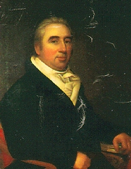
Marbury v. Madison (1803) and judicial review
Background: the Federalists’ Judiciary Act of 1801; the “midnight judges” (including William Marbury)

Slide 26
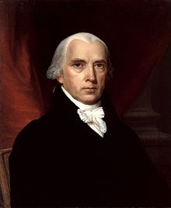
Marbury v. Madison (1803) and judicial review
Background: the Federalists’ Judiciary Act of 1801; the “midnight judges” (including William Marbury)
James Madison (new secretary of state under Jefferson) refuses to deliver Marbury’s commission

Slide 27
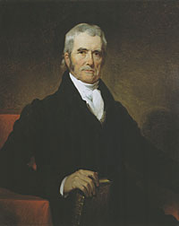
Marbury v. Madison (1803) and judicial review
Background: the Federalists’ Judiciary Act of 1801; the “midnight judges” (including William Marbury)
James Madison (new secretary of state under Jefferson) refuses to deliver Marbury’s commission
John Marshall’s dual role
Until March 4, 1801: secretary of state
(signed the commissions)
After February 4, 1801: chief justice
(appointed by Adams)

Slide 28
Marbury v. Madison (1803) and judicial review
Background: the Federalists’ Judiciary Act of 1801; the “midnight judges” (including William Marbury)
James Madison (new secretary of state under Jefferson) refuses to deliver Marbury’s commission
John Marshall’s dual role
Until March 4, 1801: secretary of state (signed the commissions)
After February 4, 1801: chief justice (appointed by Adams)
Marshall’s challenge:

Slide 29
Marbury v. Madison (1803) and judicial review
Background: the Federalists’ Judiciary Act of 1801; the “midnight judges” (including William Marbury)
James Madison (new secretary of state under Jefferson) refuses to deliver Marbury’s commission
John Marshall’s dual role
Until March 4, 1801: secretary of state (signed the commissions)
After February 4, 1801: chief justice (appointed by Adams)
Marshall’s challenge:
Assert the power of the federal judiciary (he’s a strong Federalist)

Slide 30
Marbury v. Madison (1803) and judicial review
Background: the Federalists’ Judiciary Act of 1801; the “midnight judges” (including William Marbury)
James Madison (new secretary of state under Jefferson) refuses to deliver Marbury’s commission
John Marshall’s dual role
Until March 4, 1801: secretary of state (signed the commissions)
After February 4, 1801: chief justice (appointed by Adams)
Marshall’s challenge:
Assert the power of the federal judiciary (he’s a strong Federalist)
BUT in a way that won’t lead President Jefferson (his cousin and political nemesis) to undercut the Court

Slide 31
Marbury v. Madison (1803) and judicial review
Marshall encourages Marbury to sue in the Supreme Court for a writ of mandamus ordering Madison to deliver the commission.
Three questions for the Supreme Court (MP p. 122):
Has the applicant a right to the commission he demands?
If he has a right, and that right has been violated, do the laws of the country afford him a remedy?
If they do afford him a remedy, is it a mandamus issuing from the court?
What’s Marshall’s political dilemma? his judicial dilemma?

Slide 32
Marbury v. Madison (1803) and judicial review
Three questions for the Supreme Court (MP p. 122):

Slide 33
Marbury v. Madison (1803) and judicial review
Three questions for the Supreme Court (MP p. 122):
Has the applicant a right to the commission he demands?
YES: Madison is WRONG not to deliver the commission. (A poke in Jefferson’s eye.)

Slide 34
Marbury v. Madison (1803) and judicial review
Three questions for the Supreme Court (MP p. 122):
Has the applicant a right to the commission he demands?
YES: Madison is WRONG not to deliver the commission. (A poke in Jefferson’s eye.)
If he has a right, and that right has been violated, do the laws of the country afford him a remedy?
YES: “the laws of the country afford him a remedy.”

Slide 35
Marbury v. Madison (1803) and judicial review
Three questions for the Supreme Court (MP p. 122):
Has the applicant a right to the commission he demands?
YES: Madison is WRONG not to deliver the commission. (A poke in Jefferson’s eye.)
If he has a right, and that right has been violated, do the laws of the country afford him a remedy?
YES: “the laws of the country afford him a remedy.”
If they do afford him a remedy, is it a mandamus issuing from the court?
NO: Why not? Because the Supreme Court’s power to issue writs of mandamus is in the Judiciary Act of 1789 (section 13)—BUT look at Article III again (original vs. appellate jurisdiction). Did Congress have the power to grant such authority to the Supreme Court? NO.

Slide 36
Marbury v. Madison (1803) and judicial review
What has Marshall just done?
He has poked Madison and Jefferson in the eye, but not forced them to deliver Marbury’s commission.

Slide 37
Marbury v. Madison (1803) and judicial review
What has Marshall just done?
He has poked Madison and Jefferson in the eye, but not forced them to deliver Marbury’s commission.
He has declared unconstitutional a part of the Judiciary Act of 1789—an act that Jeffersonians mostly hated (so Jefferson can’t object to his doing so)

Slide 38
Marbury v. Madison (1803) and judicial review
What has Marshall just done?
He has poked Madison and Jefferson in the eye, but not forced them to deliver Marbury’s commission.
He has declared unconstitutional a part of the Judiciary Act of 1789—an act that Jeffersonians mostly hated (so Jefferson can’t object to his doing so)
BUT he has also created the opportunity to declare that the Supreme Court has the power of judicial review: “It is emphatically the province and duty of the judicial department to say what the law is.” (p. 125) (Take that, Jefferson.)

Slide 39
Marbury v. Madison (1803) and judicial review
What has Marshall just done?
He has poked Madison and Jefferson in the eye, but not forced them to deliver Marbury’s commission.
He has declared unconstitutional a part of the Judiciary Act of 1789—an act that Jeffersonians mostly hated (so Jefferson can’t object to his doing so)
BUT he has also created the opportunity to declare that the Supreme Court has the power of judicial review: “It is emphatically the province and duty of the judicial department to say what the law is.” (p. 125) (Take that, Jefferson.)
(He could have done this without declaring Section 13 unconstitutional. The Court could have dismissed the case, without deciding whether Marbury was entitled to his commission. But then Marshall wouldn’t have had the opportunity to make the larger statement.)

Slide 40
Marbury v. Madison (1803) and judicial review
What did Marbury v. Madison establish?

Slide 41
Marbury v. Madison (1803) and judicial review
What did Marbury v. Madison establish?
The judiciary’s right to decide whether a law was unconstitutional

Slide 42
Marbury v. Madison (1803) and judicial review
What did Marbury v. Madison establish?
The judiciary’s right to decide whether a law was unconstitutional
NOT the judiciary’s sole right to do so: other branches could (and still did) make those determinations too. (Think of Andrew Jackson’s refusal to enforce the Cherokee decision—or of recent Presidents’ “signing statements.”)

Slide 43
Marbury v. Madison (1803) and judicial review
What did Marbury v. Madison establish?
The judiciary’s right to decide whether a law was unconstitutional
NOT the judiciary’s sole right to do so: other branches could (and still did) make those determinations too. (Think of Andrew Jackson’s refusal to enforce the Cherokee decision—or of recent Presidents’ “signing statements.”)
How did the Court use the power of judicial review?
From 1803 until the 1850s: only to strike down state laws

Slide 44
Marbury v. Madison (1803) and judicial review
What did Marbury v. Madison establish?
The judiciary’s right to decide whether a law was unconstitutional
NOT the judiciary’s sole right to do so: other branches could (and still did) make those determinations too. (Think of Andrew Jackson’s refusal to enforce the Cherokee decision—or of recent Presidents’ “signing statements.”)
How did the Court use the power of judicial review?
From 1803 until the 1850s: only to strike down state laws
Marbury v. Madison was the first Supreme Court decision to strike down a federal law. What was the second?

Slide 45
Marbury v. Madison (1803) and judicial review
What did Marbury v. Madison establish?
The judiciary’s right to decide whether a law was unconstitutional
NOT the judiciary’s sole right to do so: other branches could (and still did) make those determinations too. (Think of Andrew Jackson’s refusal to enforce the Cherokee decision—or of recent Presidents’ “signing statements.”)
How did the Court use the power of judicial review?
From 1803 until the 1850s: only to strike down state laws
Marbury v. Madison was the first Supreme Court decision to strike down a federal law. What was the second?
Dred Scott v. Sandford (1857)—strikes down the Missouri Compromise

Slide 46
Questions?

Slide 47
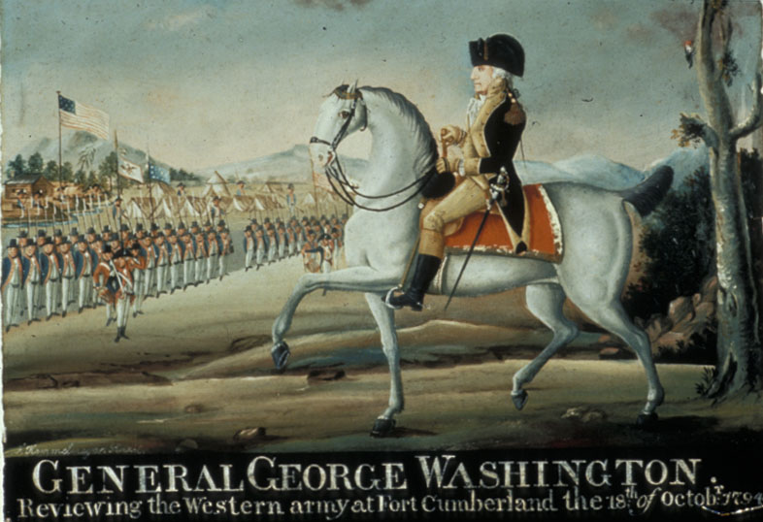
Uses and Definitions of Presidential Power, 1789-1860
Washington: “invents” the office (President & the people; President & department heads; President & army)

Slide 48
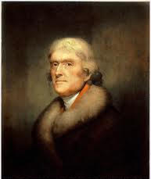
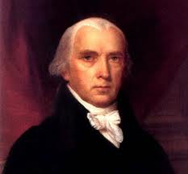
Uses and Definitions of Presidential Power, 1789-1860
Washington: “invents” the office (President & the people; President & department heads; President & army)
Jefferson/Madison: strict construction (what about the Louisiana Purchase?)

Slide 49
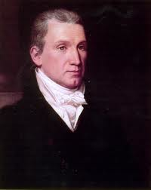
Uses and Definitions of Presidential Power, 1789-1860
Washington: “invents” the office (President & the people; President & department heads; President & army)
Jefferson/Madison: strict construction (what about the Louisiana Purchase?)
Monroe: President as symbolic “head of state” too

Slide 50
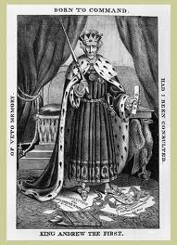
Uses and Definitions of Presidential Power, 1789-1860
Washington: “invents” the office (President & the people; President & department heads; President & army)
Jefferson/Madison: strict construction (what about the Louisiana Purchase?)
Monroe: President as symbolic “head of state” too
Jackson: President as “people’s tribune”

Slide 51
Uses and Definitions of Presidential Power, 1789-1860
Washington: “invents” the office (President & the people; President & department heads; President & army)
Jefferson/Madison: strict construction (what about the Louisiana Purchase?)
Monroe: President as symbolic “head of state” too
Jackson: President as “people’s tribune”
Between Jackson and Lincoln

Slide 52
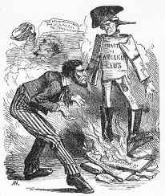
Lincoln and the Civil War (more in December)
The problem of habeas corpus (see Article I, sec. 9)

Slide 53
Lincoln and the Civil War (more in December)
The problem of habeas corpus (see Article I, sec. 9)
Relations between branches of government

Slide 54
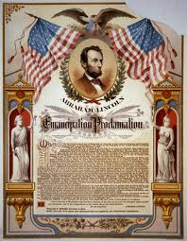
Lincoln and the Civil War (more in December)
The problem of habeas corpus (see Article I, sec. 9)
Relations between branches of government
The Emancipation Proclamation

Slide 55
20th-Century Growth of Presidential Power: Why?

Slide 56
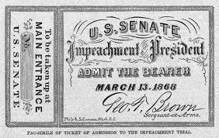
20th-Century Growth of Presidential Power: Why?
Constriction of presidential power after Lincoln

Slide 57
20th-Century Growth of Presidential Power: Why?
Constriction of presidential power after Lincoln
How and why did the presidency—and the executive branch—expand (mostly) in the twentieth century?

Slide 58
20th-Century Growth of Presidential Power: Why?
Constriction of presidential power after Lincoln
How and why did the presidency—and the executive branch—expand (mostly) in the twentieth century?
The US in the world

Slide 59
20th-Century Growth of Presidential Power: Why?
Constriction of presidential power after Lincoln
How and why did the presidency—and the executive branch—expand (mostly) in the twentieth century?
The US in the world
New expectations of national government (related to an increasingly “national” economy and society)

Slide 60
20th-Century Growth of Presidential Power: Why?
Constriction of presidential power after Lincoln
How and why did the presidency—and the executive branch—expand (mostly) in the twentieth century?
The US in the world
New expectations of national government (related to an increasingly “national” economy and society)
Expansion of the executive branch (esp. since New Deal)

Slide 61
20th-Century Growth of Presidential Power: Why?
Constriction of presidential power after Lincoln
How and why did the presidency—and the executive branch—expand (mostly) in the twentieth century?
The US in the world
New expectations of national government (related to an increasingly “national” economy and society)
Expansion of the executive branch (esp. since New Deal)
New connections to the people (“bully pulpit”)

Slide 62
20th-Century Growth of Presidential Power: Why?
Constriction of presidential power after Lincoln
How and why did the presidency—and the executive branch—expand (mostly) in the twentieth century?
The US in the world
New expectations of national government (related to an increasingly “national” economy and society)
Expansion of the executive branch (esp. since New Deal)
New connections to the people (“bully pulpit”)
Post-9/11: National security state (“war on terror”)

Slide 63
20th-Century Growth of Presidential Power: Why?
Constriction of presidential power after Lincoln
How and why did the presidency—and the executive branch—expand (mostly) in the twentieth century?
The US in the world
New expectations of national government (related to an increasingly “national” economy and society)
Expansion of the executive branch (esp. since New Deal)
New connections to the people (“bully pulpit”)
Post-9/11: National security state (“war on terror”)
Other explanations?

Slide 64
Questions? Discussion?

