Slide 1
The First Amendment: freedom of speech and press
Northern nevada teaching american history project
February 2012

Slide 2
Reading the First Amendment
Congress shall make no law

Slide 3
Reading the First Amendment
Congress shall make no law
respecting an establishment of religion,

Slide 4
Reading the First Amendment
Congress shall make no law
respecting an establishment of religion,
or prohibiting the free exercise thereof;

Slide 5
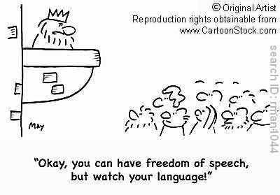
Reading the First Amendment
Congress shall make no law
respecting an establishment of religion,
or prohibiting the free exercise thereof;
or abridging the freedom of speech,

Slide 6
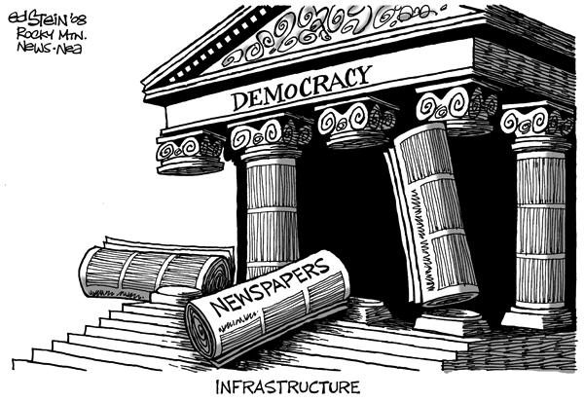
Reading the First Amendment
Congress shall make no law
respecting an establishment of religion,
or prohibiting the free exercise thereof;
or abridging the freedom of speech,
or of the press,

Slide 7
Reading the First Amendment
Congress shall make no law
respecting an establishment of religion,
or prohibiting the free exercise thereof;
or abridging the freedom of speech,
or of the press,
or of the right of the people peaceably to assemble,

Slide 8
Reading the First Amendment
Congress shall make no law
respecting an establishment of religion,
or prohibiting the free exercise thereof;
or abridging the freedom of speech,
or of the press,
or of the right of the people peaceably to assemble,
and to petition the Government for a redress of grievances.

Slide 9
Sources of the First Amendment
Handout: new state constitutions, 1776-1784
Which part of the First Amendment gets the most attention? (Why?)

Slide 10
Sources of the First Amendment
Handout: new state constitutions, 1776-1784
Which part of the First Amendment gets the most attention? (Why?)
Which gets the least? (Where is freedom of speech?)

Slide 11
Sources of the First Amendment
Historian Leonard W. Levy, Emergence of a Free Press:
The phrase “freedom of speech” originated in Anglo-American history during the struggle of Parliament to achieve the privilege of free debate, and in that sense it has a history separate from the history of free speech as a civil liberty. Until the last quarter of the eighteenth century, freedom of speech referred not to a civil right but primarily to a parliamentary right: the legislator’s immunity from punishment for anything said by him in his official capacity during a legislative session. The citizen’s personal right of freedom of speech evolved as an offshoot of freedom of the press and of freedom of religion—the freedom to speak openly on religious matters.
… of the original thirteen states only Pennsylvania acted to protect free speech. The First Amendment’s guarantee that freedom of speech shall not be abridged was therefore almost without precedent.

Slide 12
Sources of the First Amendment
Handout: new state constitutions, 1776-1784
Which part of the First Amendment gets the most attention? (Why?)
Which gets the least? (Where is freedom of speech?)
English common law on “freedom of the press”
Freedom from “prior restraint”
But NOT freedom from prosecution for what one publishes, under the law of “seditious libel” (actually 4 classes of libel—blasphemous, obscene, private, and seditious)

Slide 13
Sources of the First Amendment
Blackstone on freedom of the press:
The liberty of the press is indeed essential to the nature of a free state; but this consists in laying no previous restraints upon publications, and not in freedom from censure for criminal matter when published. Every freeman has an undoubted right to lay what sentiments he pleases before the public: to forbid this is to destroy the freedom of the press: but if he publishes what is improper, mischievous, or illegal, he must take the consequences of his own temerity. … Thus the will of individuals is still left free; the abuse only of that free-will is the object of legal punishment.

Slide 14
Sources of the First Amendment
Blackstone on freedom of the press:
The liberty of the press is indeed essential to the nature of a free state; but this consists in laying no previous restraints upon publications, and not in freedom from censure for criminal matter when published. Every freeman has an undoubted right to lay what sentiments he pleases before the public: to forbid this is to destroy the freedom of the press: but if he publishes what is improper, mischievous, or illegal, he must take the consequences of his own temerity. … Thus the will of individuals is still left free; the abuse only of that free-will is the object of legal punishment.
NOTE: The First Amendment did NOT reflect its framers’ rejection of “seditious libel” doctrine. Nor did it immediately change people’s definitions of “freedom of the press.”

Slide 15
The Sedition Act, 1798
In the 1790s in Britain and (to a lesser extent) America: seeds of a libertarian argument for freedom of the press
Sedition Act: passed by Federalist Congress, signed by Federalist President Adams (Major Problems pp. 87-88)—but note that even this act incorporated some new ideas (requirement to show criminal intent; criminalization of “false, scandalous and malicious writing or writings…”)
Enforcement: 14 people arrested, 10 convicted
Response to Sedition Act: Virginia and Kentucky Resolutions—issue was as much federalism as freedom of the press

Slide 16
19th-century developments
Not a single Supreme Court case dealing with First Amendment “freedom of speech”

Slide 17
19th-century developments
Not a single Supreme Court case dealing with First Amendment “freedom of speech”
Civil War: opposition press remains free to challenge Lincoln administration—though the military could suppress distribution of newspapers opposed to governmental authority (typically in occupied parts of the South; outcry and reversal when practiced in the North)

Slide 18
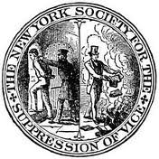
19th-century developments
Censorship (“Victorian morality”)
Punishments for blasphemy (pre-Civil War) and for “disturbing the peace” by publicly blaspheming God or religion (post-CW)
Anti-vice movement of the late 19th century: 1873 federal “Comstock law” (Anthony Comstock) makes it illegal to import, transport, or mail pornography or “any article of indecent or immoral nature, or any article of medicine … for causing abortion”
Numerous state “little Comstock laws” follow, criminalizing production and sale of such materials
1914: Margaret Sanger indicted under the Comstock law for advertising birth control in her magazine (charges dropped; indicted in 1917 for opening birth-control clinic)

Slide 19
19th-century developments—and into the 20th
The “Bad Tendency” test:
Part of the general 19c movement toward censorship
Does the speech in question have the “tendency” to cause illegal action? If so, then the speech can be prosecuted (under English common law of libel)

Slide 20
19th-century developments—and into the 20th
The “Bad Tendency” test:
Part of the general 19c movement toward censorship
Does the speech in question have the “tendency” to cause illegal action? If so, then the speech can be prosecuted (under English common law of libel)
Two Supreme Court decisions written by Oliver Wendell Holmes:
Patterson v. Colorado (1907)—regarding newspaper criticism of judicial behavior in pending cases
Fox v. Washington (1915): upholds state statute defining as misdemeanor the publishing of written matter “having a tendency to encourage or incite the commission of any crime, breach of the peace or act of violence”

Slide 21
The Great War (later called WWI)
Expansion of government authority: Congress passes draft law; authorizes President to regulate and/or take control of RRs & communication, prevent strikes, operate factories producing war material, issue rules governing food sales and prices, etc.
(Note: in some ways, these expansions follow upon Progressive ideas about governmental action. But they also expand national government power extensively.)
Similar expansion in the realm of press and speech
“alien enemy” regulations declared by President Wilson, 1917 (MP pp. 313-14)
Espionage Act, 1917 (amended 1918, MP pp. 314-15)
Schenck v. United States, 1919: close reading (MP pp. 315-316)

Slide 22
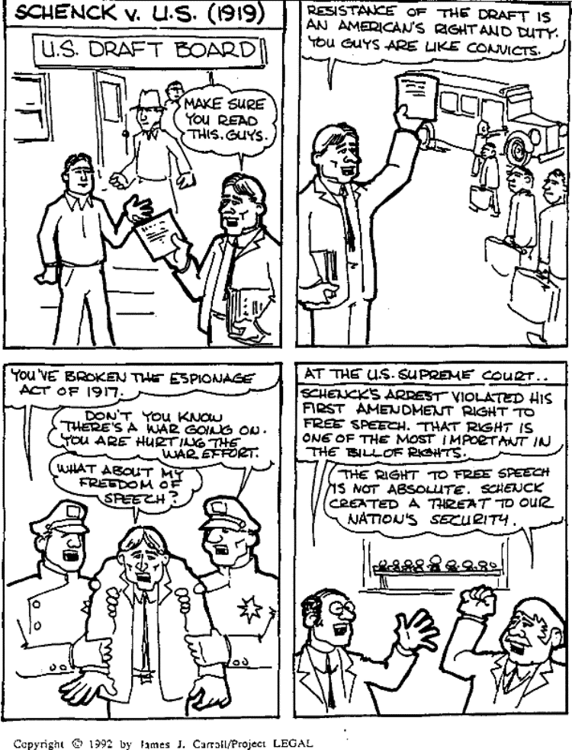
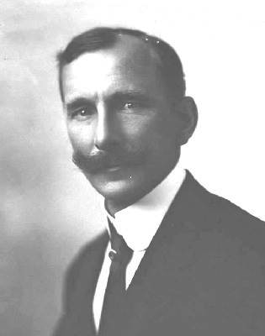

Slide 23
A few key points about Schenck v. U.S.
It was one of three 1919 cases on the Espionage Act: the others were Frohwerk v. United States and Debs v. United States.
In all three, Justice Holmes applied the “Bad Tendency” test—which he called a principle “too well established and too manifestly good sense to need citation of the books.”

Slide 24
A few key points about Schenck v. U.S.
It was one of three 1919 cases on the Espionage Act: the others were Frohwerk v. United States and Debs v. United States.
In all three, Justice Holmes applied the “Bad Tendency” test—which he called a principle “too well established and too manifestly good sense to need citation of the books.”
These cases would mobilize a constituency for “civil liberties” (the organization later called the ACLU).
The Court would continue to use this test through the 1920s … but Holmes would change his view.

Slide 25
From Schenck to Abrams (1919) and Gitlow (1925)
Abrams v. United States: what are the key issues (from your close analysis)?
Of the majority opinion (by Justice Clarke)
Of the dissent (by Justice Holmes)

Slide 26
From Schenck to Abrams (1919) and Gitlow (1925)
Abrams v. United States: what are the key issues (from your close analysis)?
Of the majority opinion (by Justice Clarke)
Of the dissent (by Justice Holmes)
Gitlow v. New York: what are the key issues?
Of the majority opinion (by Justice Sanford)
Of the dissent (by Justice Holmes)

Slide 27
From Schenck to Abrams (1919) and Gitlow (1925)
Abrams v. United States: what are the key issues (from your close analysis)?
Of the majority opinion (by Justice Clarke)
Of the dissent (by Justice Holmes)
Gitlow v. New York: what are the key issues?
Of the majority opinion (by Justice Sanford)
Of the dissent (by Justice Holmes)
Note: Gitlow also incorporates the freedom of speech clause of the First Amendment, to apply to states (using the due process clause of the Fourteenth Amendment)

Slide 28
From Schenck to Abrams (1919) and Gitlow (1925)
Abrams v. United States: what are the key issues (from your close analysis)?
Of the majority opinion (by Justice Clarke)
Of the dissent (by Justice Holmes)
Gitlow v. New York: what are the key issues?
Of the majority opinion (by Justice Sanford)
Of the dissent (by Justice Holmes)
Note: Gitlow also incorporates the freedom of speech clause of the First Amendment, to apply to states (using the due process clause of the Fourteenth Amendment)
How has Holmes’s view changed since Schenck? Thoughts about why his view now differed from before?

Slide 29
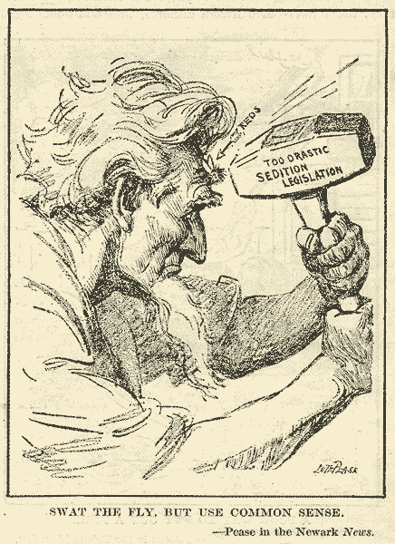

Slide 30
Three “tests” for free speech cases
“Bad Tendency” test (19th century, used in Schenck and in majority opinions in Abrams and Gitlow)

Slide 31
Three “tests” for free speech cases
“Bad Tendency” test (19th century, used in Schenck and in majority opinions in Abrams and Gitlow)
“Clear and Present Danger” test
term appears in Holmes’s majority opinion in Schenck
but he’s still in the “Bad Tendency” vein then
becomes more distinct from “Bad Tendency” in his dissents in Abrams and Gitlow
becomes the Court’s major test in free speech cases in mid-20th century

Slide 32
Three “tests” for free speech cases
“Bad Tendency” test (19th century, used in Schenck and in majority opinions in Abrams and Gitlow)
“Clear and Present Danger” test
term appears in Holmes’s majority opinion in Schenck
but he’s still in the “Bad Tendency” vein then
becomes more distinct from “Bad Tendency” in his dissents in Abrams and Gitlow
becomes the Court’s major test in free speech cases in mid-20th century
“Imminent Lawless Action” test replaces it, in Brandenburg v. Ohio (1969)
Government may only limit speech that incites unlawful action sooner than police can arrive to prevent the action.

Slide 33
Thought Exercise: Creating a First Amendment “Case Study” for 2012
The First Amendment in today’s world
Defining “speech” (what is “speech”? where is “speech”?)
What’s “the press” (not just newspapers and printing presses)
New meanings of “assembly” (in a world of Facebook and Occupy Wall Street)

Slide 34
Thought Exercise: Creating a First Amendment “Case Study” for 2012
The First Amendment in today’s world
Defining “speech” (what is “speech”? where is “speech”?)
What’s “the press” (not just newspapers and printing presses)
New meanings of “assembly” (in a world of Facebook and Occupy Wall Street)
The contexts we live in (or live with)
Perpetual war? (and war undeclared by Congress)
The guidance and challenges provided by precedent (earlier laws, Supreme Court decisions, etc.)

Slide 35
Last thoughts or questions?

