Slide 1
Mesopotamia Zoom In
Created by:
J. Johnson, S. March, T. O’Brien, and J. Trevino
6th Grade Social Studies
Traner Middle School

Slide 2
What do notice about this image? What do you think this is?

Slide 3
What additional details do you now notice?

Slide 4
Write a claim about what you think this is image represents.

Slide 5
What additional details do you notice about this image?

Slide 6
Who do you think these people are? What clues do you have?

Slide 7
What do you see now? Is this a part of the previous images? How do you know?

Slide 8
What do you think this image represents?

Slide 9
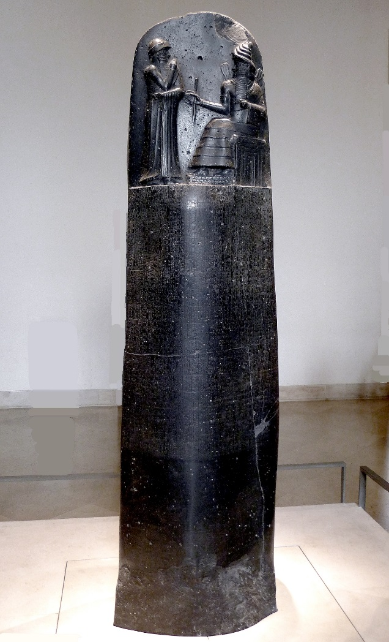
What do you see now? What new information do you have? How does this perspective change your understanding of the image?

Slide 10
Who do you think created this? Why might this be important and what could the purpose of this be?

Slide 11
Write a title for this image based on the new information you have.

Slide 12
This is a Stele or statue of Hammurabi with the Sun God, who was the God of Justice, along with his laws engraved below. Hammurabi was the King of Babylon in the 18th century BCE.

