Slide 1
Teaching American History Project
The end to an excellent adventure…
And the beginning of a sequel

Slide 2
Our Sequel
Sign up on Solutionwhere if interested
Once a month meetings (sub one month/Sat. morning the next)
John Reid!! and other historians
$900 stipend or two credits(cannot sub, credit, or stipend anyone out of District now that the grant is over)
(a little note about stipends for this year)

Slide 3
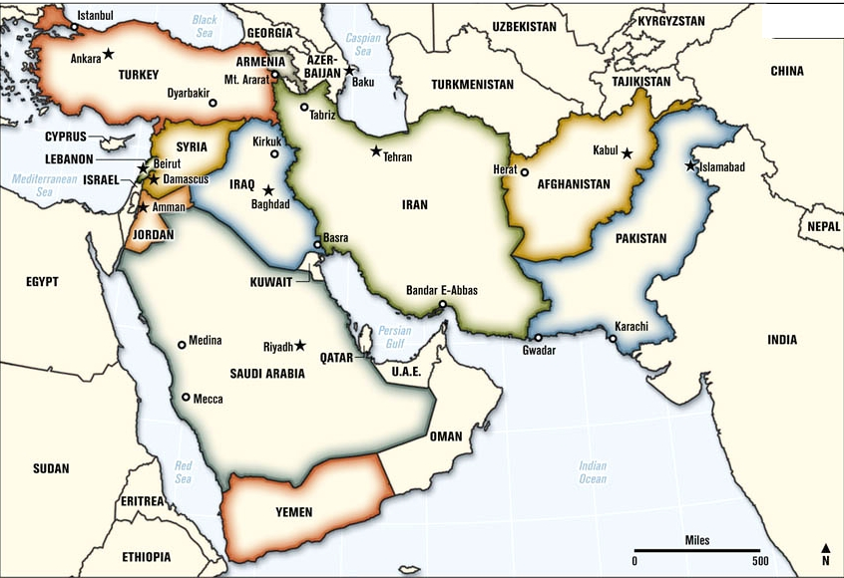
The Middle East & American History
John Reid with…

Slide 4
Reciprocal Annotation
re·cip·ro·cal (adjective)
1. given or felt by each toward the other; mutual: reciprocal respect.
2. given, performed, felt, etc., in return: reciprocal aid.
3. corresponding; matching; complementary; equivalent: reciprocal privileges at other health clubs.
4. expressing mutual relationship or action: “Each other” and “one another” are reciprocal pronouns.

Slide 5
Arab Spring Countries Find Peace is Harder than Revolution
Individually read through the article. Mark it up as you see fit.
Work with a partner to try to make sense of the annotations. Discuss:
What system is being used here? What is this person doing with the reading?
What makes sense to us? What is hard to wrap our heads around?
What annotation made us stop and think differently about the reading than if we had read it without annotations?
What questions do I have for the annotator?

Slide 6
Reciprocal Annotation: Why?
As modeling of annotation
As a way to focus on important content in reading
As a deep reading strategy
As a guided discussion strategy
How might you use this strategy with students?

Slide 7
Stereotypes in History
Can be caused by:
Lack of classroom diversity and perspectives
Lack of primary and secondary sources depicting certain groups
Abundance of similar popular culture images that stereotype
_______________

Slide 8
Read & Reflect: Native Americans as an Example
A study by Wills demonstrated that although teachers are concerned with challenging stereotypical representations of Native Americans, they often struggled to move past overly simplistic portrayals. Refuting one stereotype of Natives as uncivilized savages, teachers perpetuated another: the romanticized image of Natives as buffalo-hunting nomads. American history classrooms are often characterized by a dominant narrative of perpetual progress wherein Americans of European descent drive history forward to produce expanded rights and opportunities, with the exception, as one teacher put it, of “a few black marks.” The consequence of this is that racial and ethnic minorities remain largely incidental to the story.
Wills showed that despite changes in textbooks, Native Americans were still confined to a small place in popular historical narratives. Natives only “fit” into the story during the period of westward expansion, when nomadic Plains Indians presented an obstacle to settlers. Because this was the established “place” of Native Americans in the popular story of American history, they were predominantly represented as nomadic, buffalo-hunting Plains Indians.
Even with more racial and ethnic minorities, Wills argues, that as long as these images are framed by the dominant narrative of perpetual progress, students’ understandings will be limited and compromised by stereotypes of these groups.

Slide 9
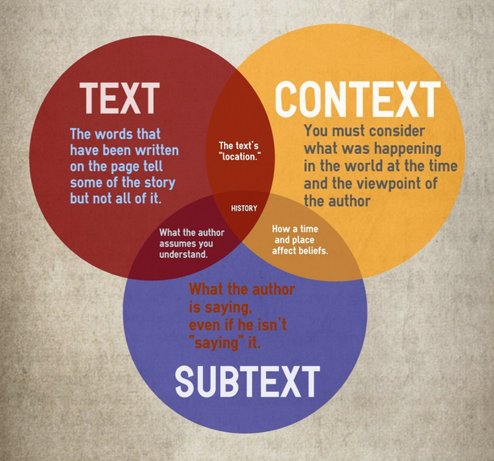
Historical thinking as a bridge towards mitigating stereotypes

Slide 10
Sourcing Documents
Before analyzing a document ask yourself:
• Who created this?
• What is the author’s perspective?
• Why was it created?
• When was it created?
• Where was it created?
• Is it reliable? Why? Why not? How do you know?

Slide 11
Contextualizing Documents
Contextualization asks students to locate a document in time and place and to understand how these factors shape its content. Students should ask:
When and where was the document created?
What do I already know about that time period? What was different then? What was the same?
How might the circumstances in which the document was created affect its content?

Slide 12
Corroboration of Sources
Corroboration asks students to consider details across multiple sources to determine points of agreement and disagreement. •
What do other documents say?
Do the documents agree? If not, why?
What are other possible documents?
Would other authors have a reason to disagree? Why?
What documents are most reliable?

Slide 13
Revisiting Arab Portrayals
Assign sources to small groups.
Review meanings of text, context, and subtext.
Review sourcing, contextualizing, and corroboration.
Group analysis of the source for these elements.
Discuss as a whole group.

Slide 14
Implementing: Reading Like a Historian
How can you encourage sourcing, contextualizing, and corroboration?
How might you use text-specific questions to lead students to these understandings?

Slide 15
Reflection Questions
What makes someone a great social studies teacher?
How would you describe the impact (if any) of this class on your teaching?
Has student learning and/or achievement differed since you started implementing ideas from this class? Is this different for different student groups?
What has been the result of collaborating closely with your peers?
What else would you like to reflect on?

