Slide 1
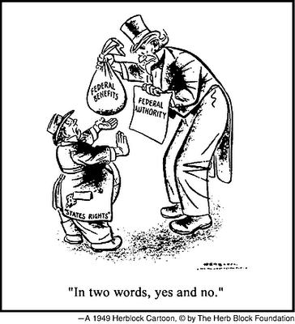
Welcome VHT and History Cohort!
EXAMINING THE COMPLEXITIES INHERENT IN THE U.S. SYSTEM OF FEDERALISM

Slide 2
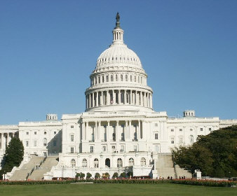
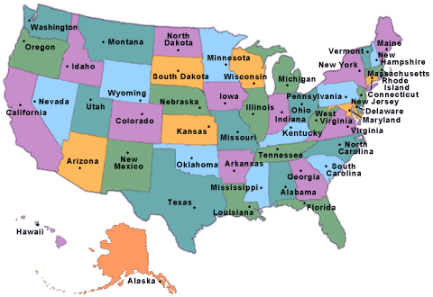
Does a limited or an energetic (National) government serve the people best?
Essential Question:

Slide 3
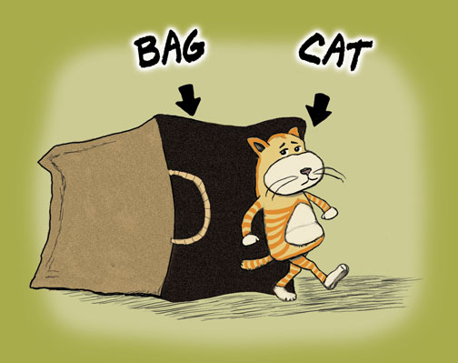
THE CAT’S OUT OF THE BAG! FEDERALISM IS CONFUSING.
According to Madison in Federalist 39:
The proposed Constitution, therefore, is, in strictness, neither a national nor a federal Constitution, but a composition of both. In its foundation it is federal, not national; in the sources from which the ordinary powers of the government are drawn, it is partly federal and partly national; in the operation of these powers, it is national, not federal; in the extent of them, again, it is federal, not national; and, finally, in the authoritative mode of introducing amendments, it is neither wholly federal nor wholly national.
HUH?
WHAT?

Slide 4
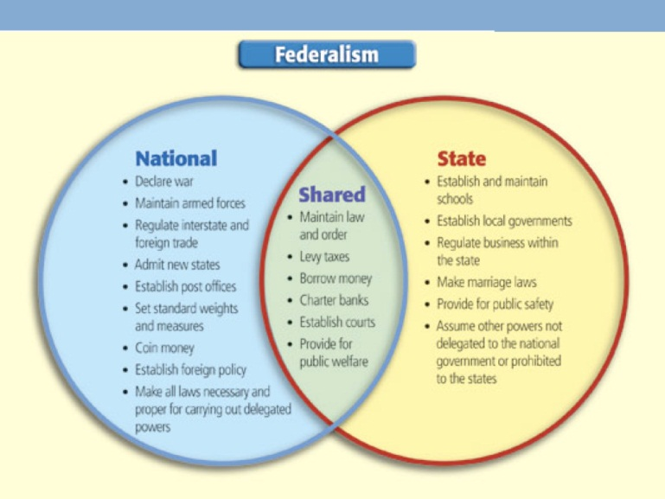
BUT IT DOESN’T HAVE TO BE SO CONFUSING…
Student-friendly definition:
Sometimes a visual representation makes this easier for students to understand. Tried and true visuals:
The layer cake turns into a marble cake
The Venn Diagram
What do you use?
And the Federalism Gas Station (my favorite!)
Federalism is a form of government wherein the people have the power. They give some powers to the national government, some powers to the states, some powers to local government, and keep some powers for themselves.

Slide 5
People’s Power Station
What do you see?
Please relate the following with what you know about federalism. Be as descriptive as possible.
name of station:
vehicle labeled with “people”:
vehicle labeled with “federal”:
vehicle labeled with “state”:
gas pumps:
sign with business hours:
car getting worked on:
“pay first” sign:
How and why do the state and federal
cars look different? What does this mean?
What clause in the Constitution would support this?

Slide 6
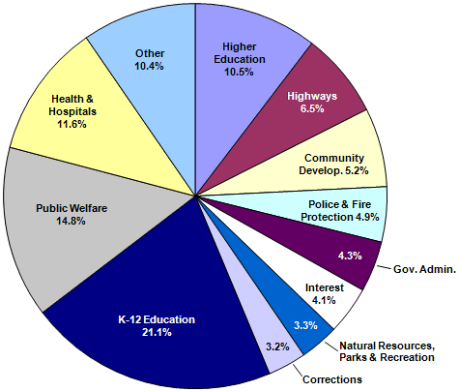
Did you know?
There are ________ government entities in the U.S.
Answer: more than 87,000
Discuss with a partner:
What does this mean for citizenship?
Which government entities affect our lives the most?
How does this illuminate issues of bureaucracy with which we can become frustrated?
State & Local Government Expenditures By Function (Census Bureau 2008)

Slide 7
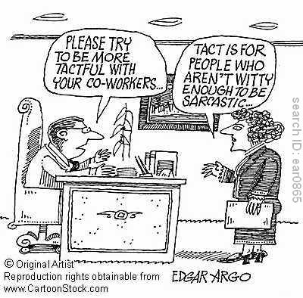
Professor John reid!
Please welcome the indelibly charming and witty

Slide 8
Major Problems: Ideas to Consider
Alexander Hamilton, writing in Federalist No. 28, suggested that both levels of government would exercise authority to the citizens’ benefit: “If their [the people’s] rights are invaded by either, they can make use of the other as the instrument of redress.”
“Prior to 1787, most believed that sovereignty could not be divided – that two governments could not simultaneously maintain authority over the same people” (p. 484).
What specific historical evidence suggests that two governments CAN maintain authority over the same people?
View the following equation. Is there a Y? What could Y be?
10th Amendment + Y =
supremacy clause + necessary & proper clause + commerce clause + 14th Amendment

Slide 9
Socratic Seminar Purpose
A Socratic discussion is a text-based discussion in which an individual sets their own interpretations of the text alongside those of other participants. The aim is a mutual search for a clearer, wider and deeper (‘enlarged’) understanding of the ideas, issues, and values in the text at hand. It is shared inquiry, not debate; there is no opponent save the perplexity all persons face when they try to understand something that is both difficult and important.
— Walter Parker, PhD, University of Washington
Sue’s boyfriend, Walter

Slide 10
Socratic Seminar Norms
• Introduce the seminar and its purpose:
to facilitate a deeper understanding of the ideas and values in the text through shared discussion
• Have students read the text. Open-ended questions offer a way to open up the discussion and prepare students to ask questions. These can be used as the ‘ticket’ to participate in the seminar.
• Review the Discussion Norms
• In addition to the classroom discussion norms you may have already set, it is important to include the following norms, or ones that are similar:
• Don’t raise hands
• Listen carefully
• Address one another respectfully
• Base any opinions on the text
• Address comments to the group (no side conversations)
• Use sensitivity to take turns and not interrupt others
• Monitor ‘air time’
• Be courageous in presenting your own thoughts and reasoning, but be flexible and willing to change your mind in the face of new and compelling evidence

Slide 11
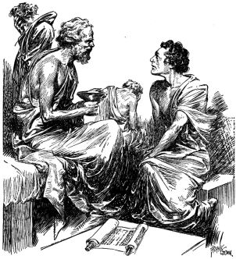
Remember…
The teacher is not “Socrates” in the Socratic Seminar! Don’t be tempted to intervene often. You may occasionally redirect with a new question or clarify misconceptions, but most of your work is done in preparing the seminar and the students.
Assessment could initiate from a roster wherein you keep track of individual comments and participation, from students tracking one other person (see handout), or from students turning in something tangible (e.g. poker chips – blue for questions, red for comments, etc.), or from general self-reflections.
By beginning with open-ended questions, there is less demand for students to have their own interpretation. Make sure that questions are deemed as important as statements.
It helps to sit with students instead of walking around (less intimidation).

Slide 12
Background Building
Review fundamental and/or academic vocabulary in the text. All students should have equal access to the information available in the text.
Providing a vocabulary side bar is a good idea.
Remember not to define words that can be interpreted based upon context clues. (Common Core Shift 4 Tip)
With a partner review the Constitutional clauses by defining:
Necessary and proper clause
Commerce clause
10th Amendment
14th Amendment

Slide 13
U.S. v. Lopez (1995)
Alfonso Lopez, Jr. was an 18 year old 12th grade student in San Antonio, Texas. On March 10, 1992 he carried a concealed .38 caliber revolver, along with five cartridges, into the school. He was confronted by school authorities and admitted to having the weapon. The next day, he was charged with violation of the federal Gun-Free School Zones Act of 1990.
Lopez moved to dismiss the indictment on the ground that of the Act was "unconstitutional as it is beyond the power of Congress to legislate control over our public schools." The trial court denied the motion, ruling that the Act was "a constitutional exercise of Congress' well defined power to regulate activities in and affecting commerce, and the 'business' of elementary, middle and high schools . . . affects interstate commerce."
Lopez was tried and convicted. He appealed to the Fifth Circuit Court of Appeals, claiming that the Act exceeded Congress' power to legislate under the Commerce Clause. The Fifth Circuit agreed and reversed his conviction. The Government petitioned for Supreme Court review and the Court accepted the case.

Slide 14
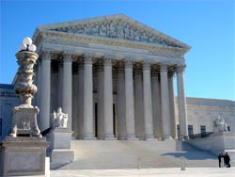
Close Reading to Prepare
Please re-read the U.S. v. Lopez (1995) case and take notes as you read.
The document is a bit longer than the Major Problems version, although I have still cut out portions.
Answer the open-ended questions when you are finished reading.
Use the line numbers to help you discuss specific passages with others in the Seminar.

Slide 15
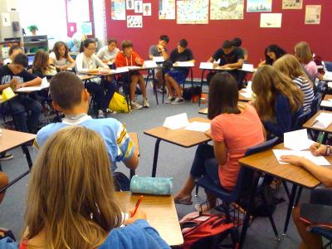
Socratic Seminar Directions
Choose a discussion leader who will help to navigate the discussion.
The discussion should first allow all people to ask questions about meaning in the document. Clearing up confusion should be the first order of the seminar.
Then, the discussion should focus on the sub-questions as a way to understand the issues and values in the overarching question.
The discussion should remain text-based as much as possible.

Slide 16
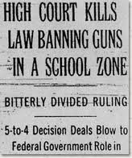
What is the proper interpretation of the commerce clause?
Socratic Seminar Overarching Question
Sub-Questions
Which arguments of the supreme court in U.S. V. Lopez (1995) are the most logical? Persuasive?
Does Congress take too much power from the states in legislation based on the commerce clause?
What are possible repercussions of strict interpretation of Congress’ use of the commerce clause?
What is the most difficult issue to reconcile in this case?

Slide 17
Discussion Reflection
The aim is a mutual search for a clearer, wider and deeper (‘enlarged’) understanding of the ideas, issues, and values in the text at hand. It is shared inquiry, not debate; there is no opponent save the perplexity all persons face when they try to understand something that is both difficult and important. (Parker)
Do you personally feel that you have an enlarged understanding of the ideas and issues in the text?
Did your initial ideas shift at all in the discussion?
Was their any particular point made that really got you thinking?
What worked well in the Socratic Seminar model?
What would you change about the model to make it effective in your own classroom?

Slide 18
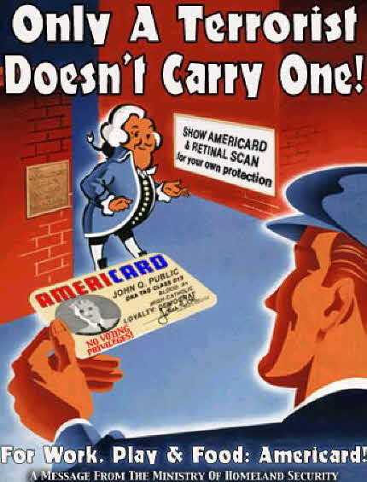
Socratic Seminars Inform Future Understandings
Because seminars help students really understand the values and ideas in a work, if you choose a text that models an enduring issue, students will be able to use their broad understanding of that issue again and again.
How did reading one court case, U.S. v. Lopez, help you to better understand recent conundrums of federalism? Talk with your partner about a specific example.

Slide 19
Applying Federalism to the Classroom
Quickly skim the current events articles. Highlight/underline all of the important terms and statements about federalism in these articles.
How does our work today help you to frame these issues? That is, in what way will you help students see the tensions in federalism through these issues?
What are some modern issues of federalism that you could discuss with your classes?
Why is it important to understand the complexity of federalism as a citizen of the United States? Where in your curriculum could you add discussions of federalism?

Slide 20
Upcoming Events
December 2 – email your paper idea and at least two scholarly resources to Sue
Vertical History Team Cadre Meetings (December 5-7)
Saturday Seminar on Race & Rights in the Constitution on December 17
Register now for the NNCSS Conference on January 28.
Presenter applications are due December 7
Interested in We the People? Please attend the District Competition at the U.S. District Court on Saturday, December 10 at 9 a.m.

Slide 21
Please don’t forget to fill out your satisfaction survey.
Thank you so much for sharing part of your Saturday with us. Enjoy your weekend and Thanksgiving. I am thankful to work with such wonderful people! And I’m thankful for this picture, too.

