Slide 1
Teaching American History Project
Saturday Seminar
February 8, 2014

Slide 2
Art & Argument
Art sources can provide a great visual entrée to writing and substantiating claims.
Appeals to visual learners
Forces students to think as writers without the intimidation of complex text
Great way to practice as using art can take less time than reading a traditional text

Slide 3
Zoom-In
One approach to helping students to focus in on certain areas of a visual source to find evidence
Great to use for a “great reveal” or for a visual with lots of detail
We will provide you with directions.

Slide 4
What claim can you substantiate with at least three pieces of evidence from the text? Use reasoning to explain how the evidence supports the claim.
Step 1: Make a list of all evidence.
Step 2: Write a claim based upon that evidence (at least three pieces of evidence used together).
Step 3: Use reasoning to make sure that your evidence clearly supports the claim.

Slide 5
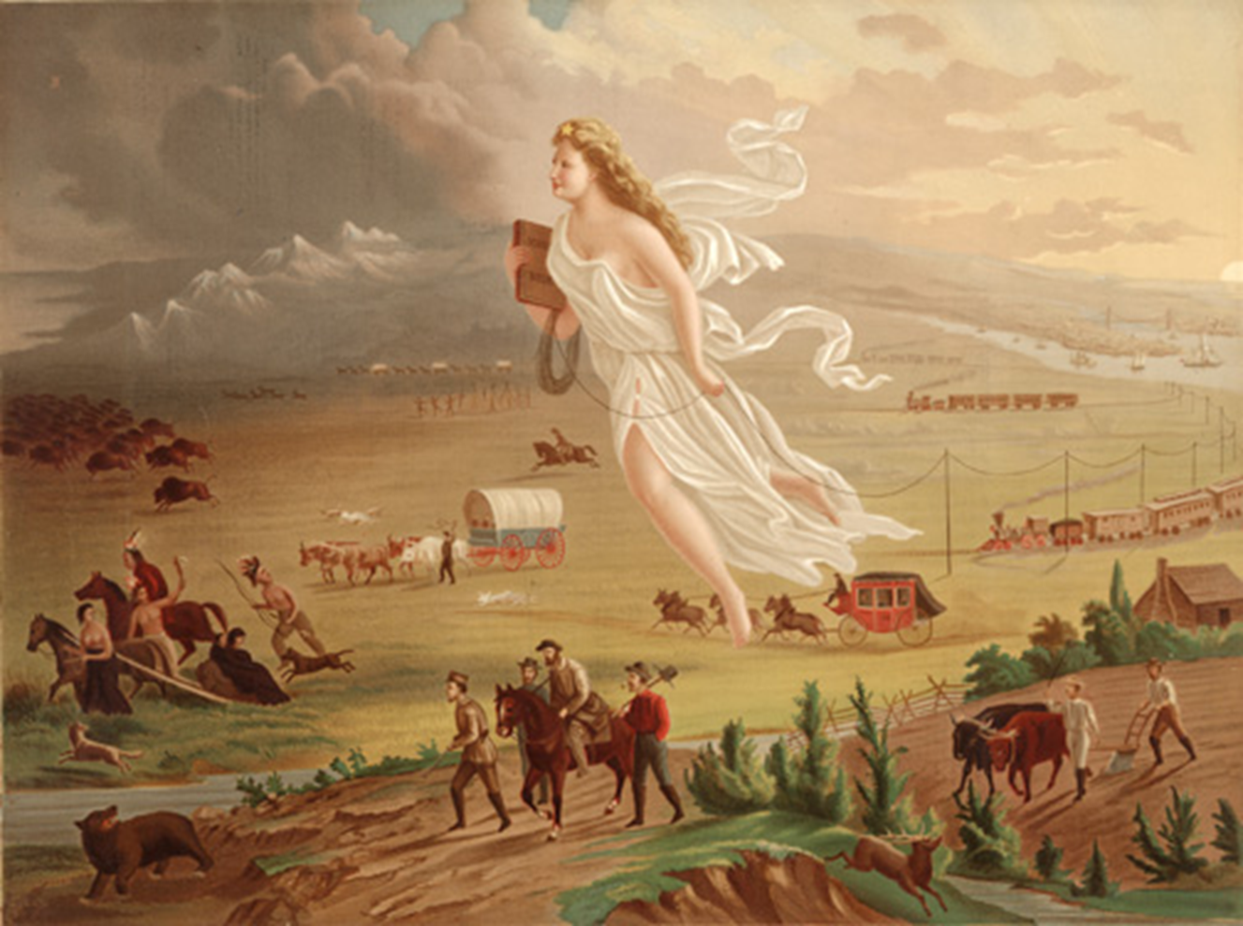
American Progress John Gast, 1872

Slide 6
An Example: Evidence
ce
“What I see”
Native Americans are dressed in traditional clothing, animal skins
NA travelling by horse and on foot with some belongings.
They are moving away from the woman and all that follows her.
Buffalo, bears, deer and other wildlife are also moving away from the woman. There is no wildlife behind her.

Slide 7
An Example: Constructing a Claim
As settlers move west, Native Americans and wild animals are being forced from their homes. They are fearful of her and what follows.
(8,9,10,11)

Slide 8
An Example:
Evidence “What I see” | Claims “What I think” | Reasoning “How I know”
Native Americans are dressed in traditional clothing, animal skins NA travelling by horse and on foot with some belongings. They are moving away from the woman and all that follows her. Buffalo, bears, deer and other wildlife are also moving away from the woman. There is no wildlife behind her. | As settlers move west, Native Americans and wild animals are being forced from their homes. They are fearful of her and what follows. (8,9,10,11) | The painting shows Native Americans travelling by horse and foot, carrying their belongings and looking backwards as though they are fearful of the woman’s presence. In the painting, buffalo, deer, and a bear are shown running away from the woman and everything that follows her. Finally, there are no Native Americans or wild animals behind her. They have already been removed from the developed part of the landscape.

Slide 9
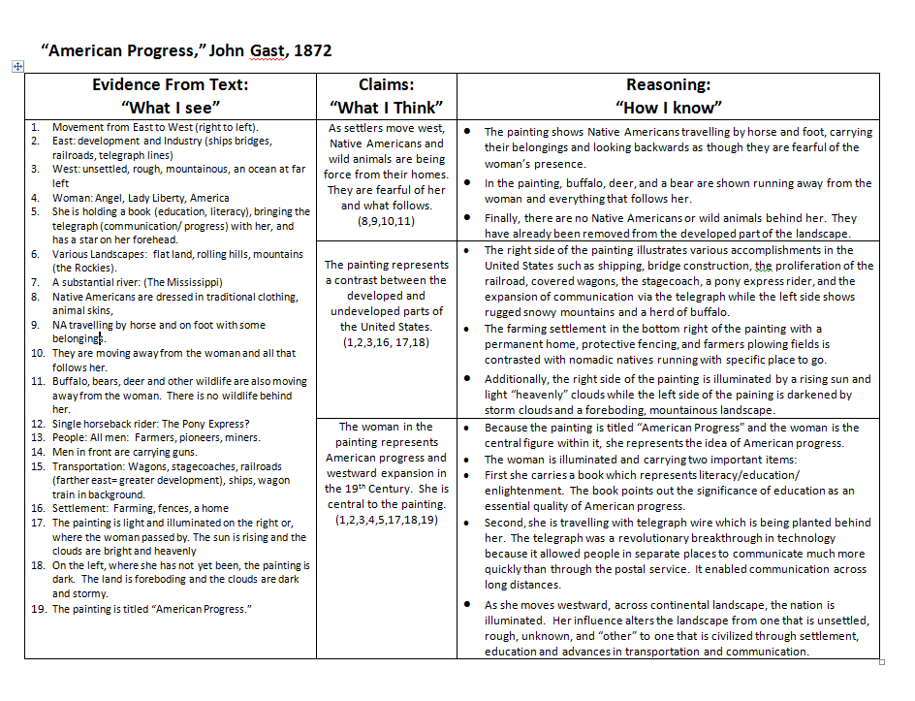

Slide 10
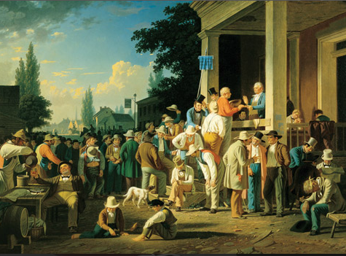
The County Election, 1852 George Caleb Bingham (picturingamerica.neh.gov)

Slide 11
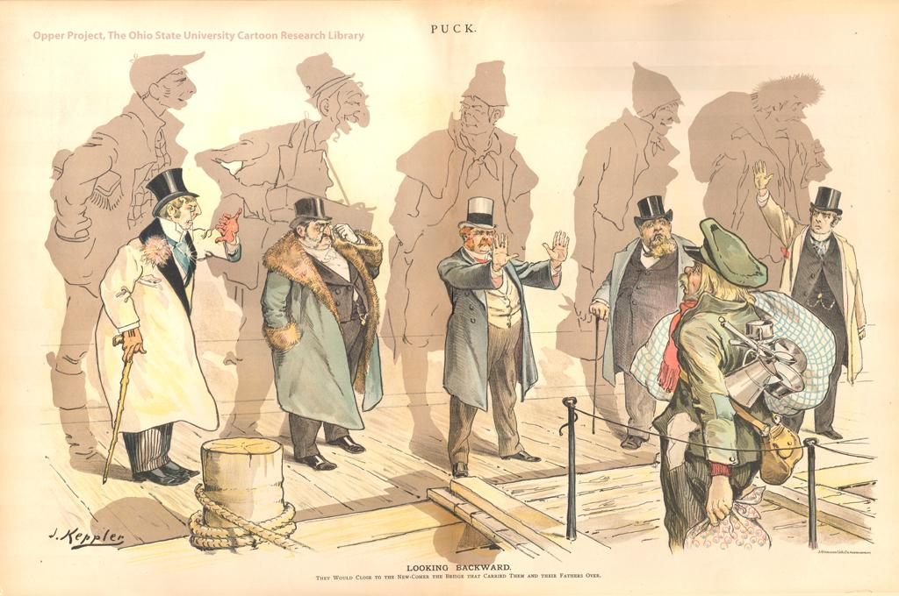
Looking Backward Joseph Keppler, 1893 (picturehistory.com)

Slide 12
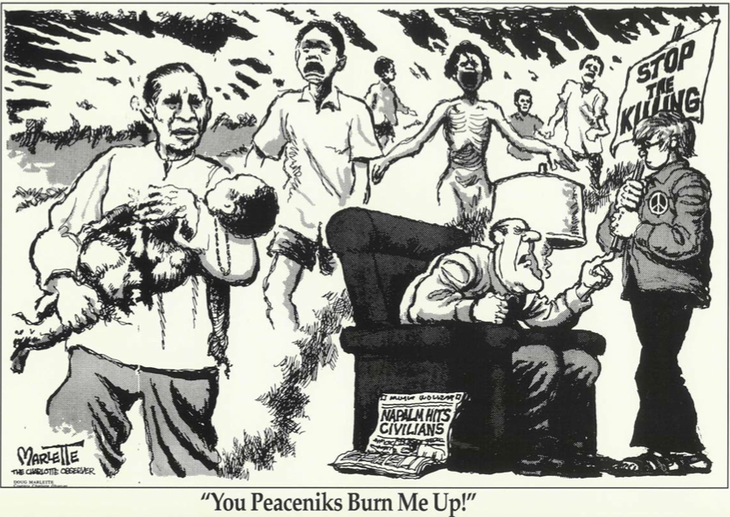
“You Peaceniks Burn Me Up!” sharepdfoneline.com

Slide 13
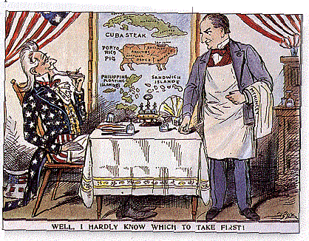
Well, I hardly know which to take first! 1898 (loc.gov)

Slide 14
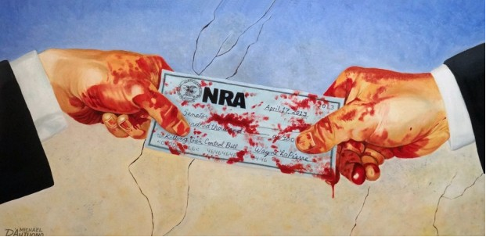
Blood Money Michael d’Antuono April 17,2013 artandresponse.com

Slide 15
Nazi Propaganda Poster (infothread.org)

Slide 16
Share and Reflect
Share a your Evidence, the Claim you arrived at and your sentence using reasoning.
What do you like about this method?
What makes it challenging?
How will you use this in your classroom?

