Slide 1
WELCOME TO The Constitution: Controversies & Conversations
Now let’s play ball!

Slide 2
The Business of Ball
Sue says, “Look through your “equipment bag” to see all of your super cool goodies. “
Welcome VHT!
Equal play time on a big team
Sign-in sheets
Binders
Books
Discussion Readings
Materials
Leave forms
PLC norms and contacts
Graduate Credit
Notes:
10 mins

Slide 3
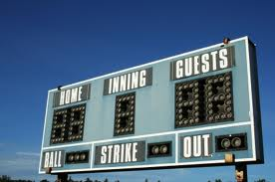
How do we score big in this crazy game?
Attend and participate in meetings (see calendar)
Complete interim assignments (more later about this)
Turn in final assignment
And then you score big: $ 1140!
Notes:
5 mins

Slide 4
Pre-Test Time
No need to be a fire baller or power pitcher!
You’re “safe” even if you don’t know the answers.
Don’t eat up our practice time working out the best possible answer…just get ‘er done!
Practice makes perfect, and we’ll be practicing all season.
PUT YOUR LAST 4 DIGITS OF SOCIAL SECURITY NUMBER INSTEAD OF YOUR NAME ON THE TEST!
If you finish early, please start reading Major Problems, Chapter 2.
Notes:
25 mins

Slide 5
It’s about more than just winning the game!
Learning Objectives for Today (SWBAT):
Recall how you have taught the Framing era;
Apply an understanding of the context of the Framing era to issues at the Constitutional Convention;
Analyze and synthesize information garnered from a group reading of a primary source to develop a visual representation of that source;
Cogently explain the primary source under study to other groups;
Link habits of historical thinking to learning;
Discover some elements that help students prepare for a discussion;
Annotate sources to prepare for a discussion;
Find and use applicable websites and information.
Notes:
2 mins

Slide 6
Let’s cover the Founding Era.
I’m sure this video meets at least seven standards.
So take notes, and here we go!
Notes:
5 mins

Slide 7
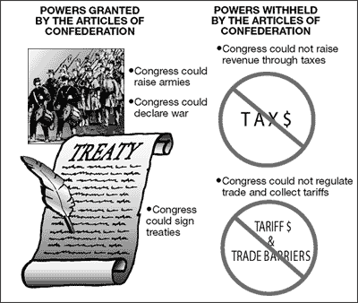
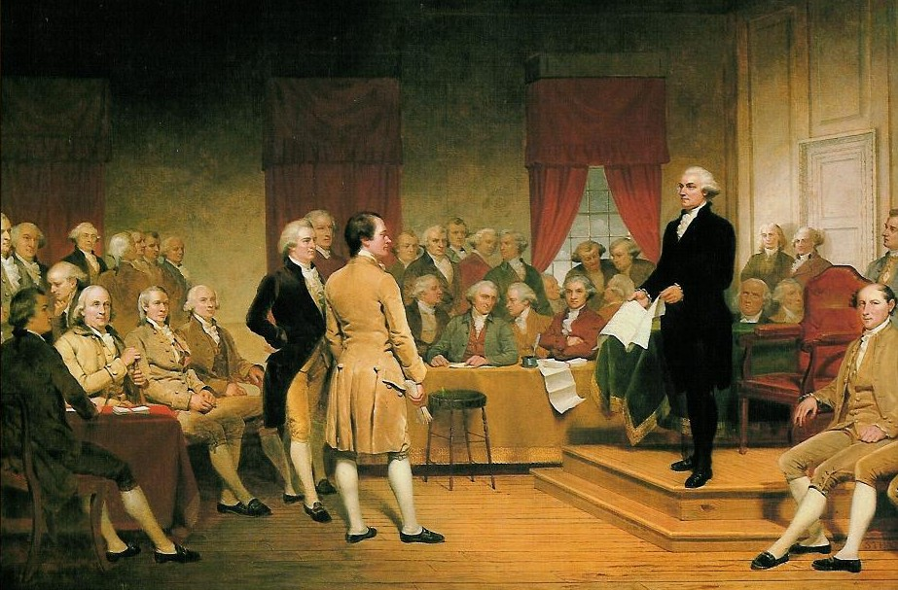
How do you teach the Articles of Confederation and Framing of the Constitution?
Think, Pair, Share
On what major ideas do you focus?
What strategies do you use?
Notes:
10 mins

Slide 8
Dr. Scott Casper
Background of the Framing
Context of the Constitutional Convention
Three Plans: An Exercise in Historical Thinking
Notes:
9:30-12:00 & 12:30-1:00

Slide 9
Historical Thinking Skills
Review Scott’s presentation with a partner: What is one thing you learned in the Framing of the Constitution presentation about each of the Five Habits of Historical Thinking?
Five Habits of Historical Thinking
History Is Not the Past Itself (We never have all of the details.)
The Detective Model: Problem, Evidence, Interpretation (Historians make interpretations based on sound evidence.)
Time, Change, and Continuity (Over time, some things change, some do not.)
Cause and Effect (What made this happen? What happened as a result?)
As They Saw It: Grasping Past Points of View (How can we best try to determine the thoughts of people in the past?)
Notes:
5 mins (12:35 end)

Slide 10
Definitions of Classroom Discussion
Hmmm… it looks like students must have to have the same background knowledge and this must include diverse points of view!
Definitions
“competent and focused exchange of ideas and view rooted in knowledge” (Hess, 2004)
“a kind of shared inquiry, the desired outcomes of which rely on the expression and consideration of diverse view points” (Parker, 2003, p. 129)
“Instead of seeing discussion as a stumbling block in the way of action, we think it an indispensable preliminary to any wise action at all.”
(Pericles, Ancient Athenian Leader)
Notes:
2 mins (12:40 end)

Slide 11
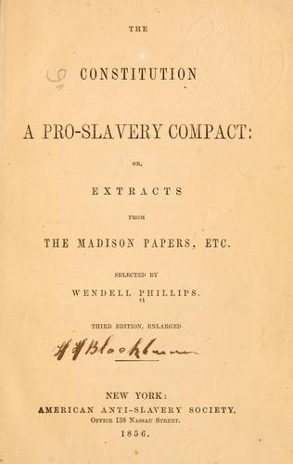
Historical Controversy & Discussion
How can we get our students to engage in meaningful discussions about the past?
Strategies we will discuss today:
STEP 1: Using a student friendly question
STEP 2: Building background and context
STEP 3: Group annotating as a preparation strategy – “The Huddle”
We will move quickly today but will go through all of these steps again later.
Notes:
2 mins

Slide 12
STEP 1: Formulating a Student Friendly Question
Student friendly means:
No unknown vocabulary words
Not convoluted (direct and to the point)
Multiple perspectives and ways to answer
Make sure its answerable and requires evidence
Should gay marriage be allowed?
Should the Supreme Court use the 14th Amendment to find the Defense of Marriage Act unconstitutional?
Should the states or the national government legislate the issue of gay marriage?
Keep it simple!
You can add sub-questions later if need be.
Why is this a bad question?
Why is this question better?
Why is this question better?
Notes:
5 mins

Slide 13
STEP 2: Providing Background
Was the Constitution a proslavery document?
What do we already know from this morning’s background building lecture?
Why did the Constitution provide protections for slavery?
Why didn’t the Constitution ever use the word “slave?”
What if the North had refused to include the slavery protections?
What other context would we need to provide for students?
What vocabulary would be essential for them to understand before preparing for a discussion?
How are you preparing students to understand multiple perspectives?
Make sure all students are privy to a lot of background information.
Notes:
5 mins

Slide 14
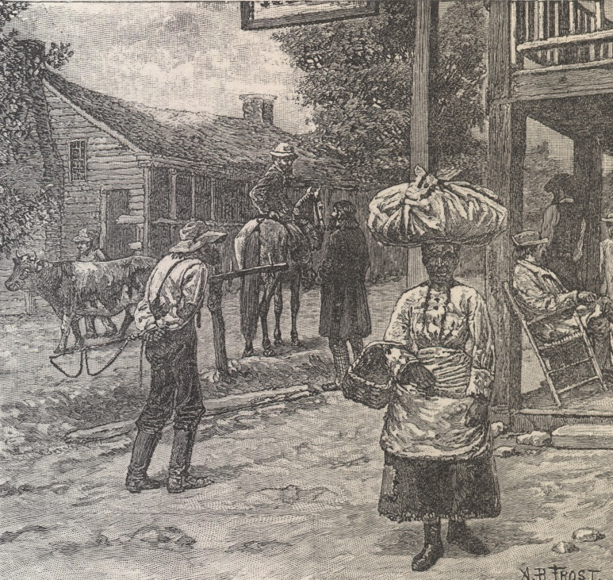
Let’s Look at a Great Resource!
The Historian’s Apprentice: The Constitution & Slavery
Resource for our discussion question
Student friendly vocabulary (p. 7)
Building Background Essay (p. 11)
Background PowerPoint (on cd in front cover)
Primary Sources (p. 15-18) with some analysis questions (p. 19-28)
Secondary Sources (p. 30-31)
Take one per school!
Notes:
5 mins

Slide 15
Background You May Want to Cover
Notes:
3 mins

Slide 16
STEP 3: Provide Reading/Viewing Strategies
High level discussion preparation should ALWAYS include reading and/or viewing which incorporates multiple perspectives.
You should provide guidance, support, and explicit scaffolding. Have students follow a specific strategy for reading or viewing.
Review readings with students to make sure everyone is on the same page.
MODEL THE STRATEGY WITH STUDENTS!
Look for some ideas in your discussion reader.
Notes:
2 mins (end at 1:00)

Slide 17
Today’s Reading Strategy: Annotation
Scaffold
Model
Engage
Why annotate?
When annotating a text, the reader:
Formulates questions in response to what he is reading
Analyzes and interprets elements of the text (e.g. argument, persuasion, evidence)
Draws conclusions and makes inferences based on explicit and implicit meaning
We have to make sure that students are prepared for a discussion. Assume no knowledge or inaccurate knowledge!
Scaffold, Model, Engage
Let’s look at the handout for Text Annotation. Highlight one idea that stands out to you.
Notes:
5 mins

Slide 18
Common Core State Standards (CCSS) for Reading in the Content Area
Read closely to determine what the text says explicitly and to make logical inferences from it;
Cite specific textual evidence when writing or speaking to support conclusions drawn from the text.
Determine central ideas or themes of a text and analyze their development; summarize the key supporting details and ideas.
Assess how point of view or purpose shapes the content and style of a text.
Integrate and evaluate content presented in diverse media and formats, including visually and quantitatively, as well as in words.
Delineate and evaluate the argument and specific claims in a text, including the validity of the reasoning as well as the relevance and sufficiency of the evidence.
Analyze how two or more texts address similar themes or topics in order to build knowledge or to compare the approaches the authors take.
OMG! This is social studies teaching and learning!
COOL BEANS!
In what area do you students struggle the most?
Notes:
3 mins

Slide 19
Individual Annotation & The Huddle
In small groups, complete the following:
The teacher reads through the document.
As a group, circle all vocabulary on which you need clarification. (smart board or overhead) Discuss what you believe the definitions are and/or look them up.
Individually annotate. (We will skip this step for time’s sake.)
Huddle, discuss, super annotate.
Notes:
3 mins

Slide 20
The Huddle: Group Expertise for Super Annotation
Pedagogical goals:
Learn to write scholarly annotations on a primary source text
Work collaboratively to annotate a text
Work collaboratively to decide on a rationale for annotation
Focus on the skills in the Common Core State Standards
After reading the text through carefully, have each group discuss the following questions in preparation for the annotation process:
What aspects of the text most need explanation for an audience? (For instance, unfamiliar names, references to places and events, unfamiliar words, historical and political background, information about the author’s life, etc.)
What historical background needs to be highlighted to make sense of the text?
What would be the most important things to explain for a novice reader? What would most contribute to a productive reading of the text? What do you not need to explain?
Identify the specific details you plan to comment on in the annotation process, and describe why you chose to focus on these. For instance, if your group decided to identify individuals and events named in the text, explain the rationale for your decision.
Notes:
3 mins

Slide 21
Directions for Annotation

Slide 22
Super(hero) Annotation Groups
Group 1 | Group 2 | Group 3 | Group 4
Read & Annotate P. Doc 2 & Finkelman | Read & Annotate P. Doc 3 & Ellis | Read & Annotate P. Doc 4 & Finkelman | Read & Annotate P. Doc 5 & Ellis
Group 5 | Group 6 | Group 7 | Group 8
Read & Annotate P. Doc 6 & Finkelman | Read & Annotate P. Doc 7 & Ellis | Read & Annotate P. Doc 8 & Finkelman | Read & Annotate P. Doc 10 & Ellis
Pick a reading leader to read the secondary source aloud.
Another leader will keep the group on track as you annotate collaboratively.
Pick another reading leader to read the primary source aloud.
A final leader will keep the group on track as you annotate collaboratively.
Remember…you would require less, or more simple, annotations depending on your students. This activity is for you!
Notes:
Get people in groups by 1:15

Slide 23
Reminders
Leader 1 reads aloud the secondary (second on the poster) source on your poster.
Leader 2 guides the group through the process of annotating according to the Super Annotator Guidelines.
Leader 3 reads aloud the primary source.
Leader 4 guides the group through the process of annotating according to the Super Annotator.
You should finish your annotations by 1:50.
Other groups will then visit your poster.

Slide 24
Annotating Debrief
Knowledge & Skills
Habits & Dispositions
What knowledge did you gain from this process?
What skills did you use?
How does annotating help us to reach the goals of CCSS?
Five Habits of Historical Thinking
History Is Not the Past Itself (We never have all of the details.)
The Detective Model: Problem, Evidence, Interpretation (Historians make interpretations based on sound evidence.)
Time, Change, and Continuity (Over time, some things change, some do not.)
Cause and Effect (What made this happen? What happened as a result?)
As They Saw It: Grasping Past Points of View (How can we best try to determine the thoughts of people in the past?)

Slide 25
Annotation Across Grade Levels
What might annotating and super-annotating look like at your grade level? (Simple is often best!)
How would you change the process to meet the needs of your students?
Are there any primary or secondary sources with which this activity might work well?
What ideas/sources are so important to understand at a deep level that you would take the time to teach super-annotation?
How many times would you have to model this and allow students to work in class before you could ask them to annotate for homework?

Slide 26
DIIGO
Annotate online documents!
I just learned about this, so I don’t know all of the details.
Does anyone else use it?
http://diigo.com/0jjhu

Slide 27
Take a Break! See You in 10!

Slide 28
Hitting all of our bases…
Large and long-term projects need intermediate due dates and proper scaffolding with feedback.
Final project (paper and discussion lesson) are due in May, but you will turn in pieces/rough drafts along the way. The due dates are linked to a total of $150 of your stipend. If you do not turn them in on time, you will lose $30 each time.
November 3: bring ideas for your paper/lesson topic
December 2: email finalized topic and 2 scholarly sources
January 27: email introductory paragraph and brief outline with one citation for research paper
February 12: email all student readings and strategies for the lesson
April 16: completed lesson with all handouts and grading tools
April 27: “not so rough” draft of paper
May 17: bring paper and discussion lesson (revised after teaching)

Slide 29
Hitting a Home Run!
Graduate Level Study: history content and social studies methods
Engage in discussions with colleagues
Teacher Action Research
PLCs
Writing a research paper and designing a lesson to publish
Don’t be overwhelmed! Talk to us if you are concerned. (15 Cohorts came back for more!)
Look at the assignment guidelines.
What questions do you have about the year-long plan?

Slide 30
Electronic Resources of Paper & Lesson
Free Online Database Libraries
ABC-Clio
EBSCO
Library of Congress
As you come up with your topic, you may find some resources helpful:
www.procon.org
The books we purchased for you
List of historical debates for which we have reference materials
Notes:
15 minutes

Slide 31
Don’t Freak Out!
We have some reading for you to do to prepare for the upcoming Saturday Seminar.
These readings can be found at www.teachingamericanhistory.org
Each person will read their own assignment.
Do your best to:
Understand the overall meaning of the document
Pick out any evidence used to persuade
Write down questions
Dr. Casper will explain the documents
at the Saturday Seminar.
Everyone should now start reading through Brutus 1 and Federalist X before leaving today.

Slide 32
Fill Out Your Satisfaction Surveys & Have A Great Day!
Muckrakers: October 5 Cadre
Team Renaissance: October 12 Cadre
Underground Railroad: October 18 Cadre
Saturday Seminar #1: October 15 (9am-2pm)

